Slide 1

ESSAI 2025
3rd European Summer School on Artificial Intelligence
Bratislava, Slovakia

Slide 2

General information
Annual AI summer school
Target audience:
PhD students
Young researchers
5-day intensive program
Multiple parallel tracks each day
Morning sessions
Afternoon tutorials
> 30 lectures
Diverse fields
Social events

Slide 3
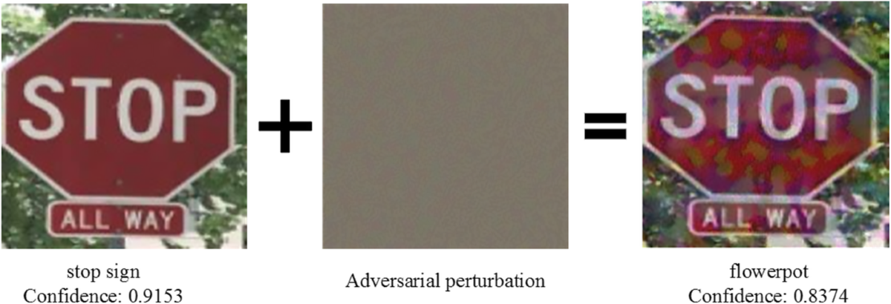
AI For Security: Exploring Adversarial Learning And The Transferability Of Adversarial Attacks
Focus & goals
Understanding and defending against adversarial attacks in AI systems
Adversarial attack:
= When someone intentionally manipulates the input to an AI model in a subtle way that causes the model to make a mistake
Intentional, small changes
Assess vulnerabilities of neural networks
Understand real-world threats
Autonomous vehicles
Improve security

Slide 4
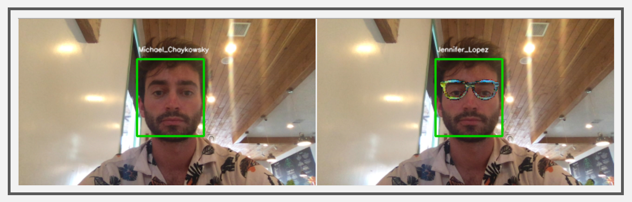
AI For Security: Exploring Adversarial Learning And The Transferability Of Adversarial Attacks
Theoretical foundations
Basics of CNNs
White-box vs. black-box adversarial attacks
White-box = The attacker knows the model’s architecture and parameters → open-source models are more exposed to risk
Black-box = The attacker only sees the model’s outputs and crafts attacks without additional knowledge
Transferability = crafting adversarial examples on surrogate model + test on target
Black-box attacks are more common and realistic
Notes:
Image: adversarial glasses trick facial recognition. This is an example of a black-box attack: usually, attackers train their own model locally, generate adversarial examples that bypass it, then transfer them to the real system. The result is that their face image is falsely recognized as someone else

Slide 5
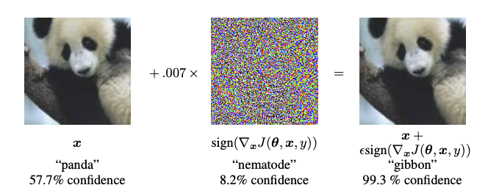
AI For Security: Exploring Adversarial Learning And The Transferability Of Adversarial Attacks
Fast Gradient Sign Method (FGSM)
Simplest way to generate adversarial examples
White-box attack
Idea: use model’s gradients to craft a small but harmful perturbation
FGSM computes the gradient of the loss with respect to the input image → How to change each pixel to increase the loss
Transferable (to fool other models)
Notes:
Image: in the middle, we have the perturbation; Computed using the gradient of the loss from the input image, multiplied by a small constant epsilon

Slide 6
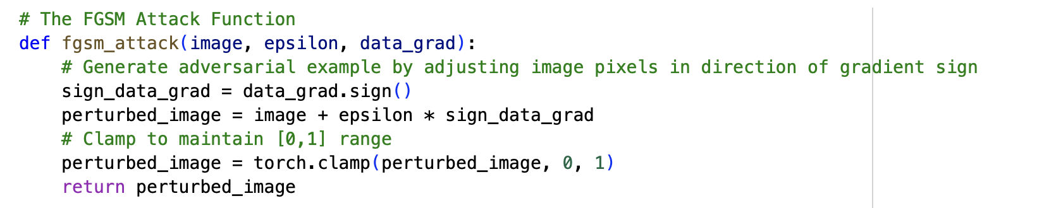
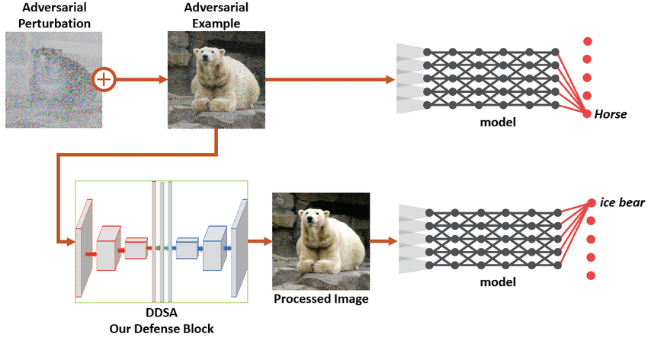
AI For Security: Exploring Adversarial Learning And The Transferability Of Adversarial Attacks
Example
Classification problem
3 class (horse, cat, chicken)
Train CNN for prediction
Attack it using FGSM
Try to improve the model to make it more secure
Best defences against such attacks:
Adversarial training (train also on adversarially perturbed examples)
Input preprocessing (destroy adversarial noise in inputs)
Image compression
Random resizing, cropping, etc.
Use ensemble methods
Harder to transfer
Notes:
Ensembles reduce this effect, since the attacker must craft examples that are adversarial across multiple models simultaneously

Slide 7
Other courses and learning paths
Trustworthy & Explainable AI
AI For Decision Making & Optimization
Machine Learning And Robust AI
AI For Autonomous Systems & Robotics
AI & Reasoning Models

Slide 8
Thank you for your attention!

