Slide 1
Energy expenditure estimation with wearable accelerometers
Mitja Luštrek,
Božidara Cvetković and Simon Kozina
Jožef Stefan Institute
Department of Intelligent Systems
Slovenia

Slide 2
Introduction
Motivation:
Chiron project – monitoring of congestive heart failure patients
The patient’s energy expenditure (= intensity of movement) provides context for heart activity

Slide 3
Introduction
Motivation:
Chiron project – monitoring of congestive heart failure patients
The patient’s energy expenditure (= intensity of movement) provides context for heart activity
Method:
Two wearable accelerometers → acceleration
Acceleration → activity
Acceleration + activity → energy expenditure
Machine
learning

Slide 4
Measuring human energy expenditure
Direct calorimetry
Heat output of the patient
Most reliable, laboratory conditions

Slide 5
Measuring human energy expenditure
Direct calorimetry
Heat output of the patient
Most reliable, laboratory conditions
Indirect calorimetry
Inhaled and exhaled oxygen and CO₂
Quite reliable, field conditions, mask needed

Slide 6
Measuring human energy expenditure
Direct calorimetry
Heat output of the patient
Most reliable, laboratory conditions
Indirect calorimetry
Inhaled and exhaled oxygen and CO₂
Quite reliable, field conditions, mask needed
Diary
Simple, Unreliable, patient-dependant

Slide 7
Measuring human energy expenditure
Direct calorimetry
Heat output of the patient
Most reliable, laboratory conditions
Indirect calorimetry
Inhaled and exhaled oxygen and CO₂
Quite reliable, field conditions, mask needed
Diary
Simple, Unreliable, patient-dependant
Wearable accelerometers

Slide 8
Hardware
Co-located with ECG
One placement
to be selected

Slide 9
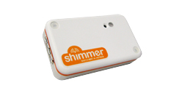
Hardware
Shimmer sensor nodes
3-axial accelerometer @ 50 Hz
Bluetooth and 802.15.4 radio
Microcontroller
Custom firmware
Co-located with ECG
One placement
to be selected

Slide 10
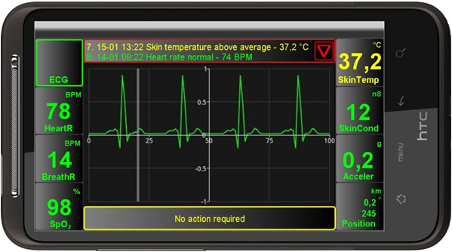
Hardware
Shimmer sensor nodes
3-axial accelerometer @ 50 Hz
Bluetooth and 802.15.4 radio
Microcontroller
Custom firmware
Co-located with ECG
Bluetooth
One placement
to be selected
Android smartphone

Slide 11
Training/test data
Activity
Lying
Sitting
Standing
Walking
Running
Cycling
Scrubbing the floor
Sweeping
...

Slide 12
Training/test data
Activity | Energy expenditure
Lying | 1.0 MET
Sitting | 1.0 MET
Standing | 1.2 MET
Walking | 3.3 MET
Running | 11.0 MET
Cycling | 8.0 MET
Scrubbing the floor | 3.0 MET
Sweeping | 4.0 MET
...
1 MET =
energy
expended
at rest
Recorded
by five
volunteers

Slide 13
Machine learning procedure
a_{t} | a_{t+1} | a_{t+2} | ...
Acceleration data
Sliding window (2 s)

Slide 14
Machine learning procedure
a_{t} | a_{t+1} | a_{t+2} | ...
Acceleration data
Sliding window (2 s)
Training
f₁ | f₂ | f₃ | ... |  | Activity
AR Classifier
Machine learning

Slide 15
Machine learning procedure
a_{t} | a_{t+1} | a_{t+2} | ...
Acceleration data
Sliding window (2 s)
Use/testing
f₁ | f₂ | f₃ | ...
AR Classifier
Activity

Slide 16
Machine learning procedure
a_{t} | a_{t+1} | a_{t+2} | ...
Acceleration data
AR Classifier
Activity

Slide 17
Machine learning procedure
a_{t} | a_{t+1} | a_{t+2} | ...
Acceleration data
Sliding window (10 s)
AR Classifier
Activity

Slide 18
Machine learning procedure
a_{t} | a_{t+1} | a_{t+2} | ...
Acceleration data
Sliding window (10 s)
AR Classifier
Activity
Training
f’₁ | f’₂ | f’₃ | ... |  | Activity | EE
EEE Classifier
Machine learning (regression)

Slide 19
Machine learning procedure
a_{t} | a_{t+1} | a_{t+2} | ...
Acceleration data
Sliding window (10 s)
AR Classifier
Activity
Use/testing
f’₁ | f’₂ | f’₃ | ... |  | Activity
EEE Classifier
EE

Slide 20
Machine learning procedure
a_{t} | a_{t+1} | a_{t+2} | ...
Acceleration data
Energy expenditure
EE

Slide 21
Features for activity recognition
Average acceleration
Variance in acceleration
Minimum and maximum acceleration
Speed of change between min. and max.
Accelerometer orientation
Frequency domain features (FFT)
Correlations between accelerometer axes

Slide 22
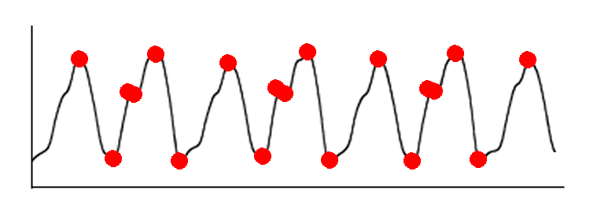
Features for energy expenditure est.
Activity
Average length of the acceleration vector
Number of peaks and bottoms of the signal

Slide 23
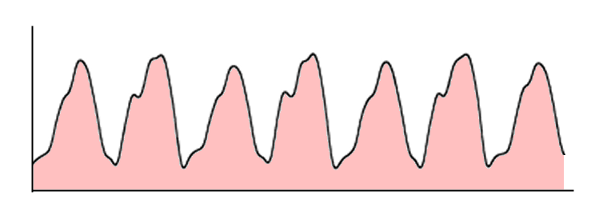
Features for energy expenditure est.
Activity
Average length of the acceleration vector
Number of peaks and bottoms of the signal
Area under acceleration
Area under gravity-subtracted acceleration

Slide 24
Features for energy expenditure est.
Activity
Average length of the acceleration vector
Number of peaks and bottoms of the signal
Area under acceleration
Area under gravity-subtracted acceleration
Change in velocity
Change in kinetic energy

Slide 25
Sensor placement and algorithm
 | Linear regression | Support vector regression | Regression tree | Model tree | Neural network
Chest + ankle | 5.09 | 3.29 | 1.41 | 2.18 | 1.65
Chest + thigh | 6.75 | 3.68 | 1.58 | 2.38 | 1.66
Chest + wrist | 6.75 | 3.94 | 1.30 | 4.95 | 1.39
Mean absolute error in MET

Slide 26
Sensor placement and algorithm
 | Linear regression | Support vector regression | Regression tree | Model tree | Neural network
Chest + ankle | 5.09 | 3.29 | 1.41 | 2.18 | 1.65
Chest + thigh | 6.75 | 3.68 | 1.58 | 2.38 | 1.66
Chest + wrist | 6.75 | 3.94 | 1.30 | 4.95 | 1.39
Mean absolute error in MET

Slide 27
Sensor placement and algorithm
 | Linear regression | Support vector regression | Regression tree | Model tree | Neural network
Chest + ankle | 5.09 | 3.29 | 1.41 | 2.18 | 1.65
Chest + thigh | 6.75 | 3.68 | 1.58 | 2.38 | 1.66
Chest + wrist | 6.75 | 3.94 | 1.30 | 4.95 | 1.39
Mean absolute error in MET

Slide 28
Sensor placement and algorithm
 | Linear regression | Support vector regression | Regression tree | Model tree | Neural network
Chest + ankle | 5.09 | 3.29 | 1.41 | 2.18 | 1.65
Chest + thigh | 6.75 | 3.68 | 1.58 | 2.38 | 1.66
Chest + wrist | 6.75 | 3.94 | 1.30 | 4.95 | 1.39
Mean absolute error in MET

Slide 29
Sensor placement and algorithm
 | Linear regression | Support vector regression | Regression tree | Model tree | Neural network
Chest + ankle | 5.09 | 3.29 | 1.41 | 2.18 | 1.65
Chest + thigh | 6.75 | 3.68 | 1.58 | 2.38 | 1.66
Chest + wrist | 6.75 | 3.94 | 1.30 | 4.95 | 1.39
Mean absolute error in MET

Slide 30
Sensor placement and algorithm
 | Linear regression | Support vector regression | Regression tree | Model tree | Neural network
Chest + ankle | 5.09 | 3.29 | 1.41 | 2.18 | 1.65
Chest + thigh | 6.75 | 3.68 | 1.58 | 2.38 | 1.66
Chest + wrist | 6.75 | 3.94 | 1.30 | 4.95 | 1.39
Mean absolute error in MET

Slide 31
Sensor placement and algorithm
 | Linear regression | Support vector regression | Regression tree | Model tree | Neural network
Chest + ankle | 5.09 | 3.29 | 1.41 | 2.18 | 1.65
Chest + thigh | 6.75 | 3.68 | 1.58 | 2.38 | 1.66
Chest + wrist | 6.75 | 3.94 | 1.30 | 4.95 | 1.39
Lowest error, poor extrapolation, interpolation
Second lowest error, better flexibility
Mean absolute error in MET

Slide 32
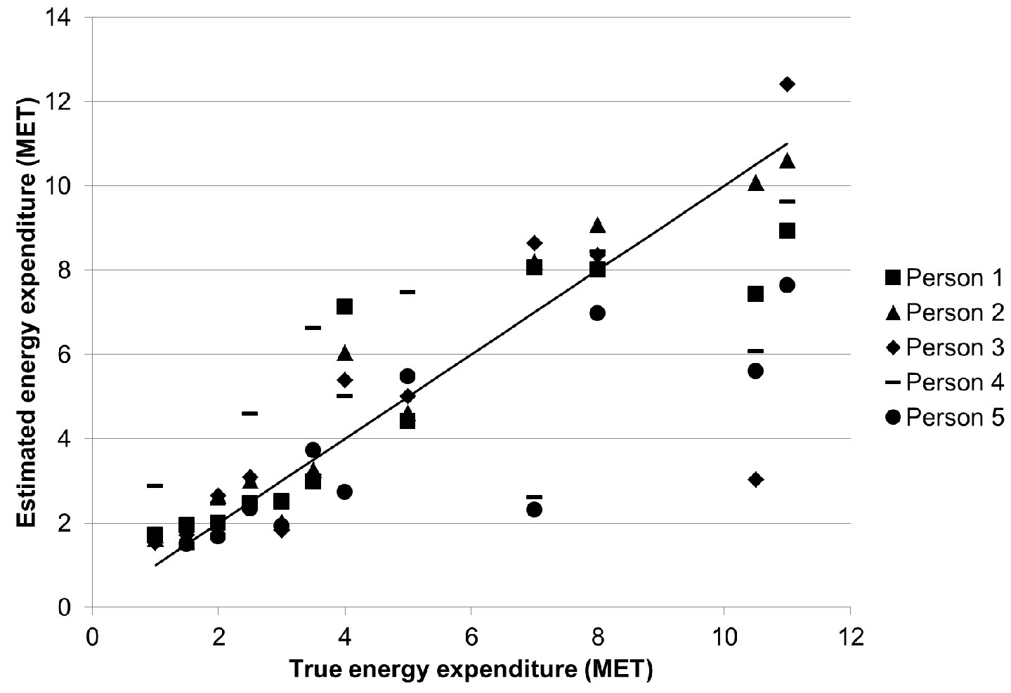
Estimated vs. true energy
Average
error:
1.39 MET

Slide 33
Estimated vs. true energy
Average
error:
1.39 MET
Moderate
intensity
Running, cycling
Low intensity

Slide 34
Estimated vs. true energy
Average
error:
1.39 MET
Moderate
intensity
Running, cycling
Low intensity

Slide 35
Multiple classifiers
AR Classifier
Activity

Slide 36
Multiple classifiers
Activity = running
AR Classifier
Running
EEE Classifier
Activity = cycling
Activity = other
Cycling
EEE Classifier
Activity
EE
General
EEE Classifier

Slide 37
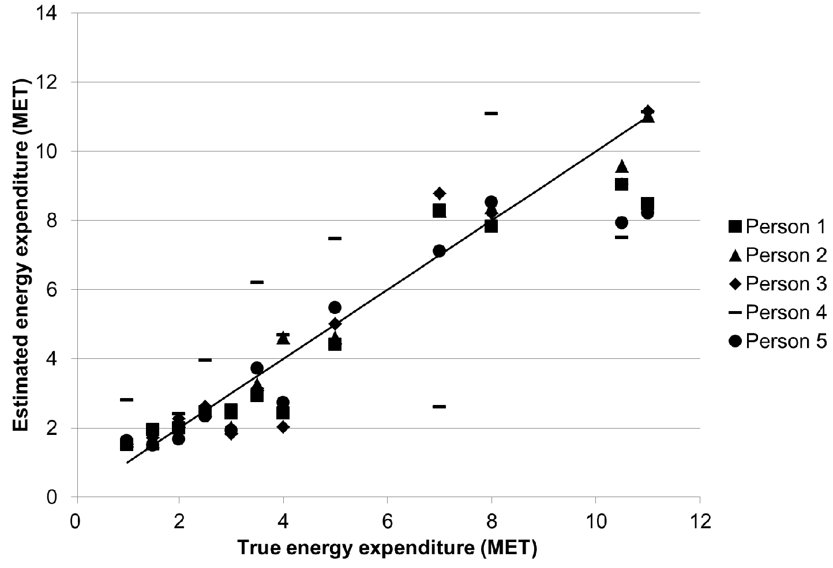
Estimated vs. true energy, multiple cl.
Average
error:
0.91 MET
Moderate
intensity
Running, cycling
Low intensity

Slide 38
Conclusion
Energy expenditure estimation with wearable accelerometers using machine learning
Study of sensor placements and algorithms
Multiple classifiers: error 1.39 → 0.91 MET

Slide 39
Conclusion
Energy expenditure estimation with wearable accelerometers using machine learning
Study of sensor placements and algorithms
Multiple classifiers: error 1.39 → 0.91 MET
Cardiologists judged suitable to monitor congestive heart failure patients
Other medical and sports applications possible

