Slide 1
Behavior analysis based on coordinates of body tags
Mitja Luštrek,
Boštjan Kaluža, Erik Dovgan,
Bogdan Pogorelc, Matjaž Gams
Jožef Stefan Institute,
Department of Intelligent Systems
Špica International, d. o. o.
Slovenia

Slide 2
Introduction
Problem:
Number of elderly increasing
Too few young people to care for them
Notes:
Attention catcher: did you know that over 50 % of adult population will be older than 65 by 2060?

Slide 3
Introduction
Problem:
Number of elderly increasing
Too few young people to care for them
Solution:
Ambient assisted living technology
Confidence project: detect falls, monitor well-being
Notes:
Attention catcher: did you know that over 50 % of adult population will be older than 65 by 2060?

Slide 4
Work presented
Input: coordinates of tags attached to body

Slide 5
Work presented
Input: coordinates of tags attached to body
Task 1: activity recognition (falls)
Task 2: recognition of abnormal walking

Slide 6
Work presented
Input: coordinates of tags attached to body
Task 1: activity recognition (falls)
Task 2: recognition of abnormal walking
Machine
learning

Slide 7
Work presented
Input: coordinates of tags attached to body
Task 1: activity recognition (falls)
Task 2: recognition of abnormal walking
Analyze how recogntion is affected by:
Number of tags
Quality of tag coordinate measurements
Machine
learning

Slide 8
Presentation overview
Sensing hardware
Task 1: activity recognition (falls)
Task 2: recognition of abnormal walking

Slide 9
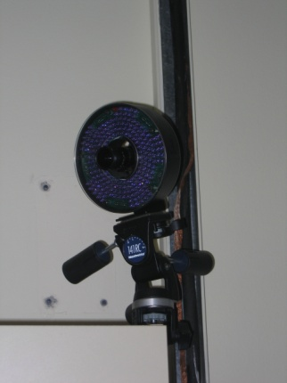
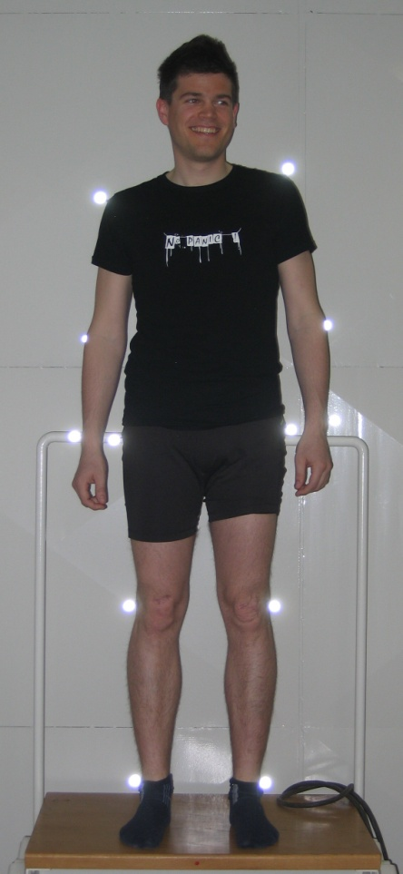
Sensing hardware
Volunteer wearing 12 tags
performing an activity
Infrared
motion
capture

Slide 10
Sensing hardware
Volunteer wearing 12 tags
performing an activity
(x, y, z)
for all tags
at 10 Hz
Infrared
motion
capture

Slide 11
Sensing hardware
Volunteer wearing 12 tags
performing an activity
(x, y, z)
for all tags
at 10 Hz
Infrared
motion
capture
Add noise to
simulate realistic
hardware

Slide 12
Task 1: activity recognition

Slide 13
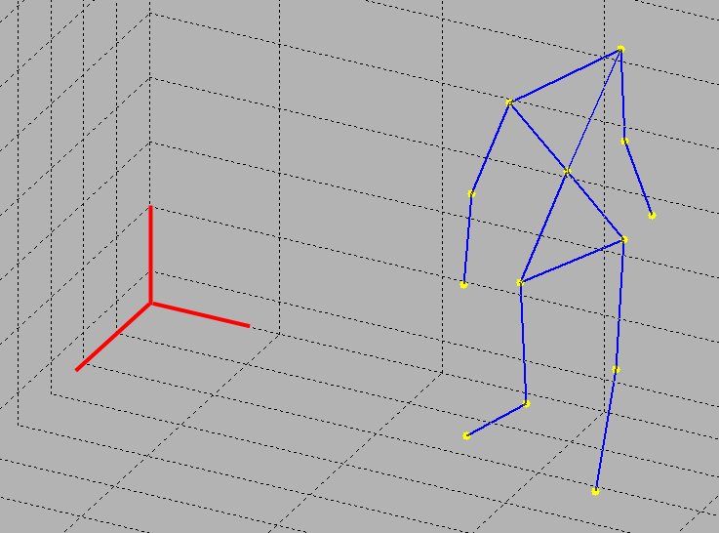
Features
Reference coordinate system
z coordinates
absolute velocities, z velocities
absolute distances between tags, z distances

Slide 14
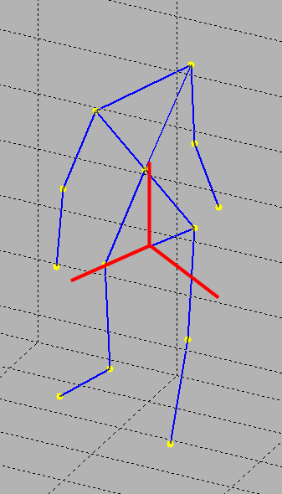
Features
Reference coordinate system
z coordinates
absolute velocities, z velocities
absolute distances between tags, z distances
x, y, z coordinates
absolute velocities, x, y, z velocities
Body coordinate system

Slide 15
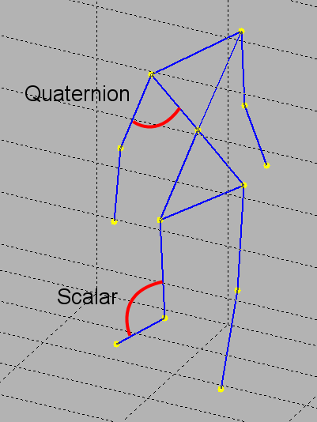
Features
Reference coordinate system
z coordinates
absolute velocities, z velocities
absolute distances between tags, z distances
Angles
x, y, z coordinates
absolute velocities, x, y, z velocities
Body coordinate system

Slide 16
Feature vectors
t
Snapshot
Snapshot

Slide 17
Feature vectors
t-9
...
t-2
t-1
t
Feature vector
Activity

Slide 18
Feature vectors
t-9
...
t-2
t-1
t
t+1
t+2
t+3
...

Slide 19
Feature vectors
t-9
...
t-2
t-1
t
t+1
t+2
t+3
...
Machine learning with SVM

Slide 20
Experimental setup
6 activities:
Walking
Sitting down
Sitting
Lying down
Lying
Falling

Slide 21
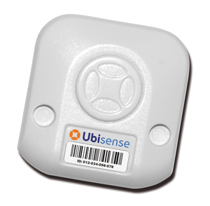
Experimental setup
6 activities:
Walking
Sitting down
Sitting
Lying down
Lying
Falling
Number of tags: 1 to 12
Noise level: none to Ubisense × 2

Slide 22
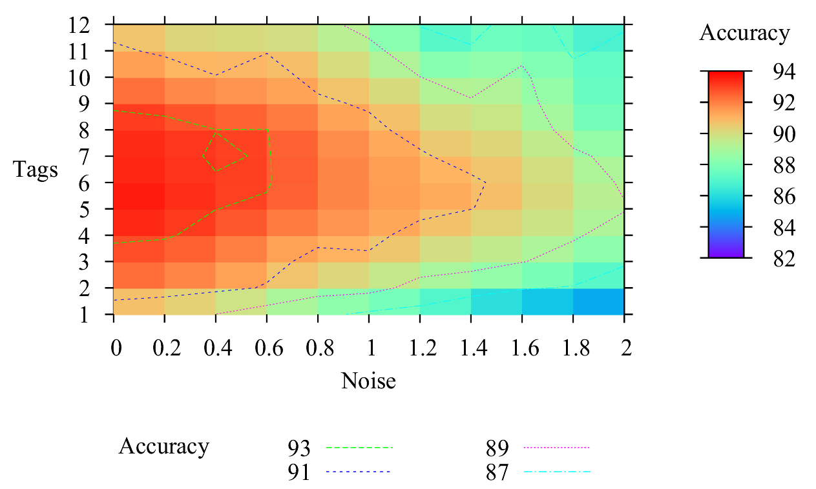
Recognition accuracy

Slide 23
Fall detection
Simple rule: if 3 × recognized falling followed by 1 × recognized lying then fall

Slide 24
Fall detection
Simple rule: if 3 × recognized falling followed by 1 × recognized lying then fall
Fall detection accuracy:
Mostly independent of noise
93–95 %

Slide 25
Summary of activity recognition
SVM to train a classifier for activity recognition
Accuracy: 91 % with Ubisense noise and 4–8 tags

Slide 26
Summary of activity recognition
SVM to train a classifier for activity recognition
Accuracy: 91 % with Ubisense noise and 4–8 tags
Simple rule for fall detection
Accuracy: 93–95 %

Slide 27
Task 2: recognition of abnormal walking

Slide 28
Feature vectors
1 feature vector = 1 left + 1 right step

Slide 29
Feature vectors
1 feature vector = 1 left + 1 right step
Features from medical literature on gait analysis

Slide 30
Features
Double support time

Slide 31
Features
Swing time

Slide 32
Features
Support time

Slide 33
Features
Distance of the foot
from the ground

Slide 34
Features
Hip angle
Knee angle
Ankle angle

Slide 35
Features
And others...
Hip angle
Knee angle
Ankle angle

Slide 36
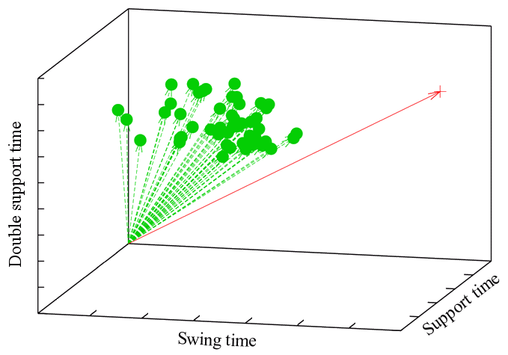
Machine learning = outlier detection
Local outlier factor algorithm

Slide 37
Machine learning = outlier detection
Local outlier factor algorithm
Normal walking
Abormal
walking

Slide 38
Experimental setup
Normal walking
Abnormal walking:
Limping
Parkinson’s disease
Hemiplegia

Slide 39
Experimental setup
Normal walking
Abnormal walking:
Limping
Parkinson’s disease
Hemiplegia
Number of tags: 2, 4, 6, 8
Noise level: none to Ubisense × 2

Slide 40
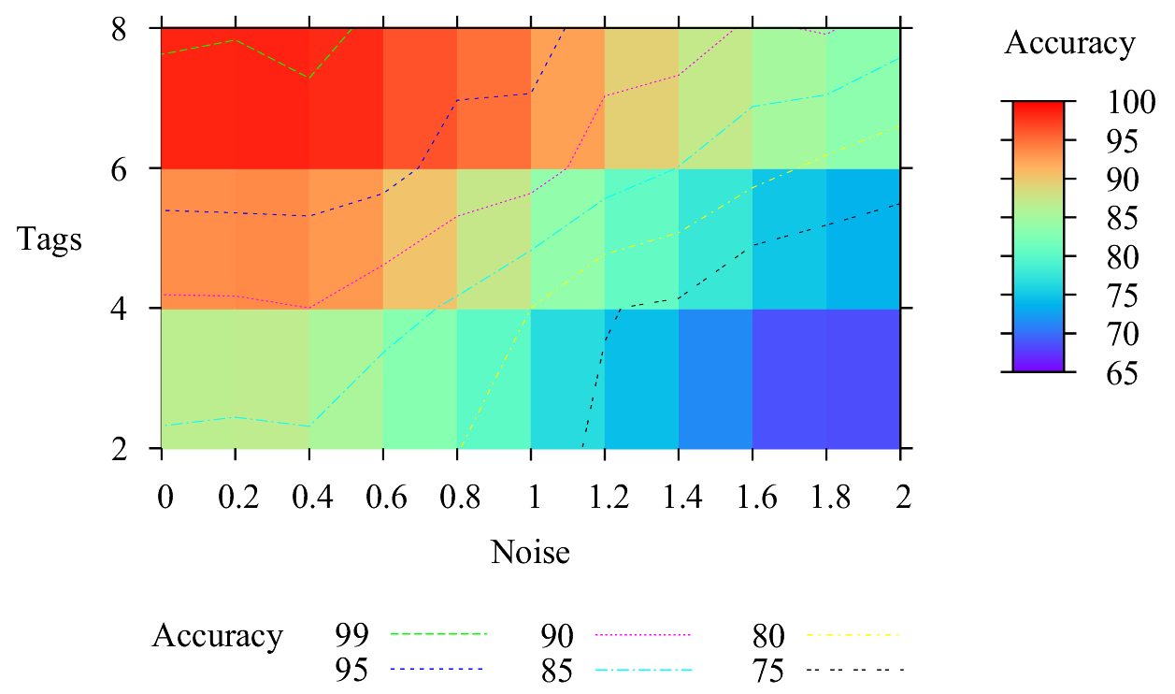
Recognition accuracy

Slide 41
Summary of recognition of abnormal walking
Medically relevant features
Outlier detection to recognize abnormal walking
Accuracy: 92 % with Ubisense noise and 6 tags

Slide 42
Conclusion
Tag localization + machine learning suitable for ambient assised living
Results comparable to competitive approaches (inertial sensors)

Slide 43
Conclusion
Tag localization + machine learning suitable for ambient assised living
Results comparable to competitive approaches (inertial sensors)
Future work:
Test with realistic hardware
Analyze other activities (besides walking)

