Slide 1
Additional tasks related to activity recogntion
Mitja Luštrek
Jožef Stefan Institute
Department of Intelligent Systems
Slovenia
Tutorial at the University of Bremen, November 2012

Slide 2
Outline
Fall detection with accelerometers
Fall detection with location sensors
Fall detection with both sensor types
Human energy expenditure estimation

Slide 3
Outline
Fall detection with accelerometers
Fall detection with location sensors
Fall detection with both sensor types
Human energy expenditure estimation

Slide 4
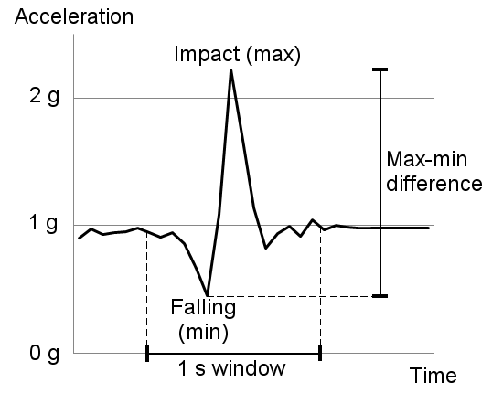
Acceleration threshold
1–1.5 g
IF acceleration > threshold THEN fall

Slide 5
Orientation
IF acceleration > threshold AND AFTERWARDS not upright for 10 seconds THEN fall
Not upright = not –30ᵒ < ϕ < 30ᵒ for 90% of the time
ϕ can be adapted to the person

Slide 6
Activity and movement
IF acceleration > threshold AND AFTERWARDS recognized (lying OR on all fours OR sitting on the ground) for 10 seconds AND user immobile THEN fall
Immobile = s < threshold
Can skip some activities or movement or switch conjunction/disjunction

Slide 7
Outline
Fall detection with accelerometers
Fall detection with location sensors
Fall detection with both sensor types
Human energy expenditure estimation

Slide 8
Fall detection
Sensors
Preprocessing
Activity recogntion
Initialization
User interface
Machine learning
Expert rules
Detection of unusual behavior
Fall detection
False alarm
Merging
Alarm
Warning

Slide 9
Machine learning
Attributes:
Percentages of activities in the last 5, 7.5 and 10 seconds (fall is detected after 10 seconds of lying)
The time of last recognized falling
Is the user in bed

Slide 10
Machine learning
Attributes:
Percentages of activities in the last 5, 7.5 and 10 seconds (fall is detected after 10 seconds of lying)
The time of last recognized falling
Is the user in bed
Two classifiers:
SVM and C4.5 decision trees
Fall if both return fall

Slide 11
Expert rules
IF recognized falling AND AFTERWARDS recognized lying/sitting on the ground outside bed AND user immobile THEN fall

Slide 12
Expert rules
IF recognized falling AND AFTERWARDS recognized lying/sitting on the ground outside bed AND user immobile THEN fall
IF recognized falling AND AFTERWARDS recognized lying/sitting on the ground outside bed for a longer time THEN fall

Slide 13
Expert rules
IF recognized falling AND AFTERWARDS recognized lying/sitting on the ground outside bed AND user immobile THEN fall
IF recognized falling AND AFTERWARDS recognized lying/sitting on the ground outside bed for a longer time THEN fall
IF recognized lying/sitting on the ground outside bed for an even longer time AND user immobile THEN fall

Slide 14
Expert rules
IF recognized falling AND AFTERWARDS recognized lying/sitting on the ground outside bed AND user immobile THEN fall
IF recognized falling AND AFTERWARDS recognized lying/sitting on the ground outside bed for a longer time THEN fall
IF recognized lying/sitting on the ground outside bed for an even longer time AND user immobile THEN fall
IF recognized lying/sitting on the ground outside bed for a very long time THEN fall

Slide 15
Merging
Fall in two cases:
Machine learning and expert rules return fall
One of the modules returns fall continuously for 3 seconds

Slide 16
Outline
Fall detection with accelerometers
Fall detection with location sensors
Fall detection with both sensor types
Human energy expenditure estimation

Slide 17
Accelerometers + location sensors
IF recognized (lying OR on all fours OR sitting on the ground) for 10 seconds AND location = floor AND user immobile THEN fall
Activity recognition (mainly) from accelerometers
Mobility from accelerometers
Location from location sensors
Again variations possible

Slide 18
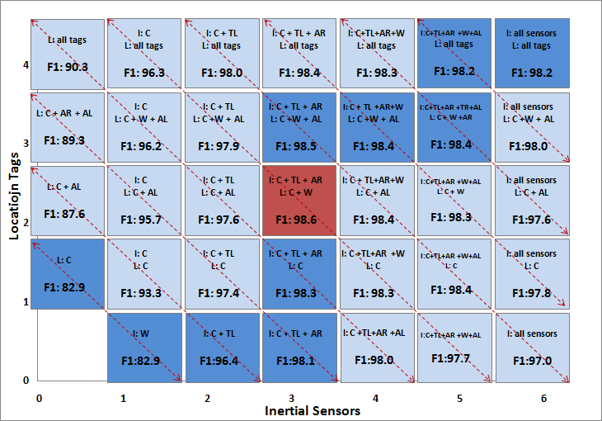
Experimental results – activity recogntion

Slide 19
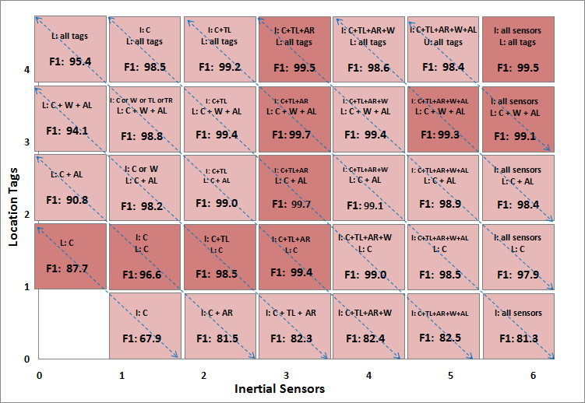
Experimental results – fall detection

Slide 20
Outline
Fall detection with accelerometers
Fall detection with location sensors
Fall detection with both sensor types
Human energy expenditure estimation

Slide 21
Introduction
Motivation:
Chiron project – monitoring of congestive heart failure patients
The patient’s energy expenditure (= intensity of movement) provides context for heart activity

Slide 22
Introduction
Motivation:
Chiron project – monitoring of congestive heart failure patients
The patient’s energy expenditure (= intensity of movement) provides context for heart activity
Method:
Two wearable accelerometers → acceleration
Acceleration → activity
Acceleration + activity → energy expenditure
Machine
learning

Slide 23
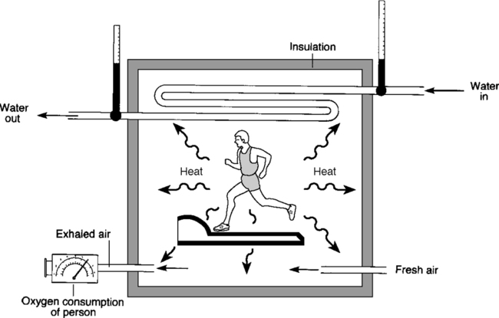
Direct calorimetry
Measures the total heat output of a person
Separate “dry” and “wet” measurements

Slide 24
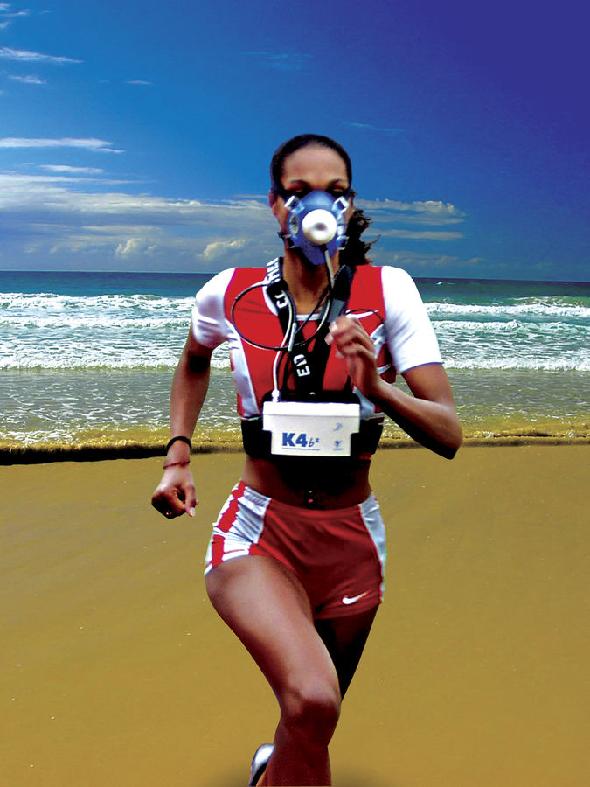
Indirect calorimetry
Measure inhaled, exhaled O₂, CO₂
Compute the amount of O₂ consumed and CO₂ produced by metabolism
Compute energy consumption from these amounts

Slide 25
Doubly labeled water
Water with deuterium and oxygen-18 administered
Oxygen-18 lost through breathing out CO₂
Both elements lost through water in urine, sweat ...
The difference can be used to compute the amount CO₂ produced by metabolism
This amount proportional to the energy consumed

Slide 26
Diary
Write down the activities
Use reference energy consumption value for each activity
Compendium of Physical Activities with values for over 500 common activities

Slide 27
Comparison of the approaches
Direct calorimetry
Most reliable, laboratory conditions

Slide 28
Comparison of the approaches
Direct calorimetry
Most reliable, laboratory conditions
Indirect calorimetry
Quite reliable, field conditions, mask needed

Slide 29
Comparison of the approaches
Direct calorimetry
Most reliable, laboratory conditions
Indirect calorimetry
Quite reliable, field conditions, mask needed
Doubly labeled water
Quite reliable, field conditions, long-term (days)

Slide 30
Comparison of the approaches
Direct calorimetry
Most reliable, laboratory conditions
Indirect calorimetry
Quite reliable, field conditions, mask needed
Doubly labeled water
Quite reliable, field conditions, long-term (days)
Diary
Simple, unreliable

Slide 31
Comparison of the approaches
Direct calorimetry
Most reliable, laboratory conditions
Indirect calorimetry
Quite reliable, field conditions, mask needed
Doubly labeled water
Quite reliable, field conditions, long-term (days)
Diary
Simple, unreliable
Wearable accelerometers

Slide 32
Hardware
Co-located with ECG
One placement
to be selected

Slide 33
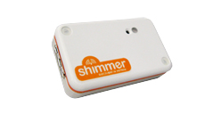
Hardware
Shimmer sensor nodes
3-axial accelerometer @ 50 Hz
Bluetooth and 802.15.4 radio
Microcontroller
Custom firmware
Co-located with ECG
One placement
to be selected

Slide 34
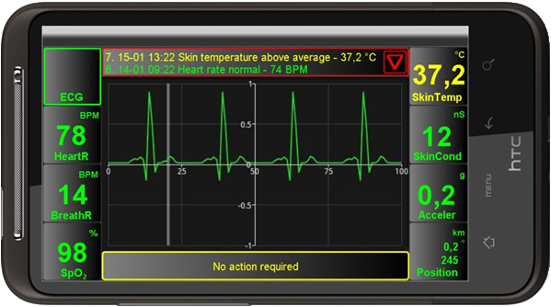
Hardware
Shimmer sensor nodes
3-axial accelerometer @ 50 Hz
Bluetooth and 802.15.4 radio
Microcontroller
Custom firmware
Co-located with ECG
Bluetooth
One placement
to be selected
Android smartphone

Slide 35
Training/test data
Activity
Lying
Sitting
Standing
Walking
Running
Cycling
Scrubbing the floor
Sweeping
...

Slide 36
Training/test data
Activity | Energy expenditure
Lying | 1.0 MET
Sitting | 1.0 MET
Standing | 1.2 MET
Walking | 3.3 MET
Running | 11.0 MET
Cycling | 8.0 MET
Scrubbing the floor | 3.0 MET
Sweeping | 4.0 MET
...
1 MET =
energy
expended
at rest
Recorded
by five
volunteers

Slide 37
Machine learning procedure
a_{t} | a_{t+1} | a_{t+2} | ...
Acceleration data
Sliding window (2 s)

Slide 38
Machine learning procedure
a_{t} | a_{t+1} | a_{t+2} | ...
Acceleration data
Sliding window (2 s)
Training
f₁ | f₂ | f₃ | ... |  | Activity
AR Classifier
Machine learning

Slide 39
Machine learning procedure
a_{t} | a_{t+1} | a_{t+2} | ...
Acceleration data
Sliding window (2 s)
Use/testing
f₁ | f₂ | f₃ | ...
AR Classifier
Activity

Slide 40
Machine learning procedure
a_{t} | a_{t+1} | a_{t+2} | ...
Acceleration data
AR Classifier
Activity

Slide 41
Machine learning procedure
a_{t} | a_{t+1} | a_{t+2} | ...
Acceleration data
Sliding window (10 s)
AR Classifier
Activity

Slide 42
Machine learning procedure
a_{t} | a_{t+1} | a_{t+2} | ...
Acceleration data
Sliding window (10 s)
AR Classifier
Activity
Training
f’₁ | f’₂ | f’₃ | ... |  | Activity | EE
EEE Classifier
Machine learning (regression)

Slide 43
Machine learning procedure
a_{t} | a_{t+1} | a_{t+2} | ...
Acceleration data
Sliding window (10 s)
AR Classifier
Activity
Use/testing
f’₁ | f’₂ | f’₃ | ... |  | Activity
EEE Classifier
EE

Slide 44
Machine learning procedure
a_{t} | a_{t+1} | a_{t+2} | ...
Acceleration data
Energy expenditure
EE

Slide 45
Features for activity recognition
Average acceleration
Variance in acceleration
Maximum and minimum acceleration
Accelerometer orientation
Speed of change between min. and max.
Correlations between accelerometer axes
Frequency domain features (FFT)

Slide 46
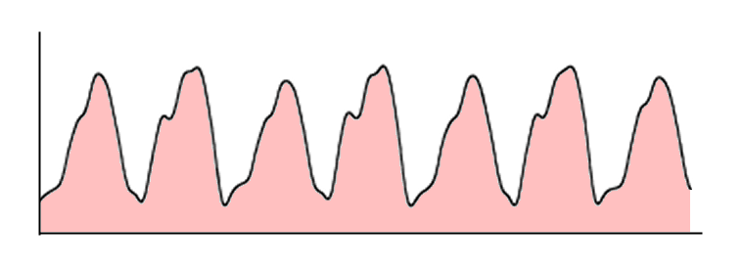
Features for energy expenditure est.
The most prevalent activity
The average length of the acceleration vector
The area under the absolute acceleration along the x, y, and z axes and the area under the length of the acceleration vector

Slide 47
Features for energy expenditure est.
The sum of the areas under the absolute acceleration along the x, y, and z axes
The area under the gravity-subtracted (high-pass filtered) acceleration along the x, y, and z axes
The change in the velocity of the accelerometer along the x, y and z axes

Slide 48
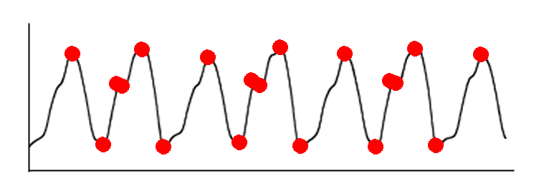
Features for energy expenditure est.
The number of times the movement of the length of the acceleration vector changes direction, i.e., stops increasing and starts decreasing or vice versa, the sum of the values at which the changes occur

Slide 49
Features for energy expenditure est.
The integral of the change in the kinetic energy due to translation along the x, y and z axes over the window

Slide 50
Sensor placement and algorithm
 | Linear regression | Support vector regression | Regression tree | Model tree | Neural network
Chest + ankle | 5.09 | 3.29 | 1.41 | 2.18 | 1.65
Chest + thigh | 6.75 | 3.68 | 1.58 | 2.38 | 1.66
Chest + wrist | 6.75 | 3.94 | 1.30 | 4.95 | 1.39
Mean absolute error in MET

Slide 51
Sensor placement and algorithm
 | Linear regression | Support vector regression | Regression tree | Model tree | Neural network
Chest + ankle | 5.09 | 3.29 | 1.41 | 2.18 | 1.65
Chest + thigh | 6.75 | 3.68 | 1.58 | 2.38 | 1.66
Chest + wrist | 6.75 | 3.94 | 1.30 | 4.95 | 1.39
Lowest error, poor extrapolation, interpolation
Second lowest error, better flexibility
Mean absolute error in MET

Slide 52
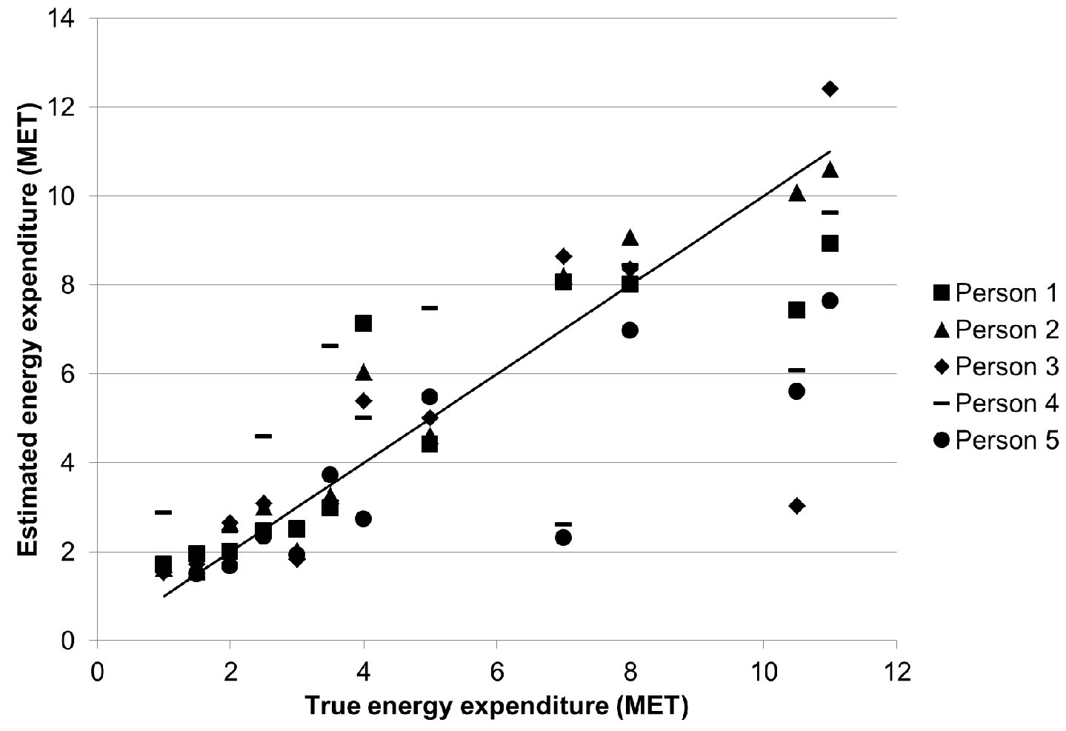
Estimated vs. true energy
Average
error:
1.39 MET

Slide 53
Estimated vs. true energy
Average
error:
1.39 MET
Moderate
intensity
Running, cycling
Low intensity

Slide 54
Estimated vs. true energy
Average
error:
1.39 MET
Moderate
intensity
Running, cycling
Low intensity

Slide 55
Multiple classifiers
AR Classifier
Activity

Slide 56
Multiple classifiers
Activity = running
AR Classifier
Running
EEE Classifier
Activity = cycling
Activity = other
Cycling
EEE Classifier
Activity
EE
General
EEE Classifier

Slide 57
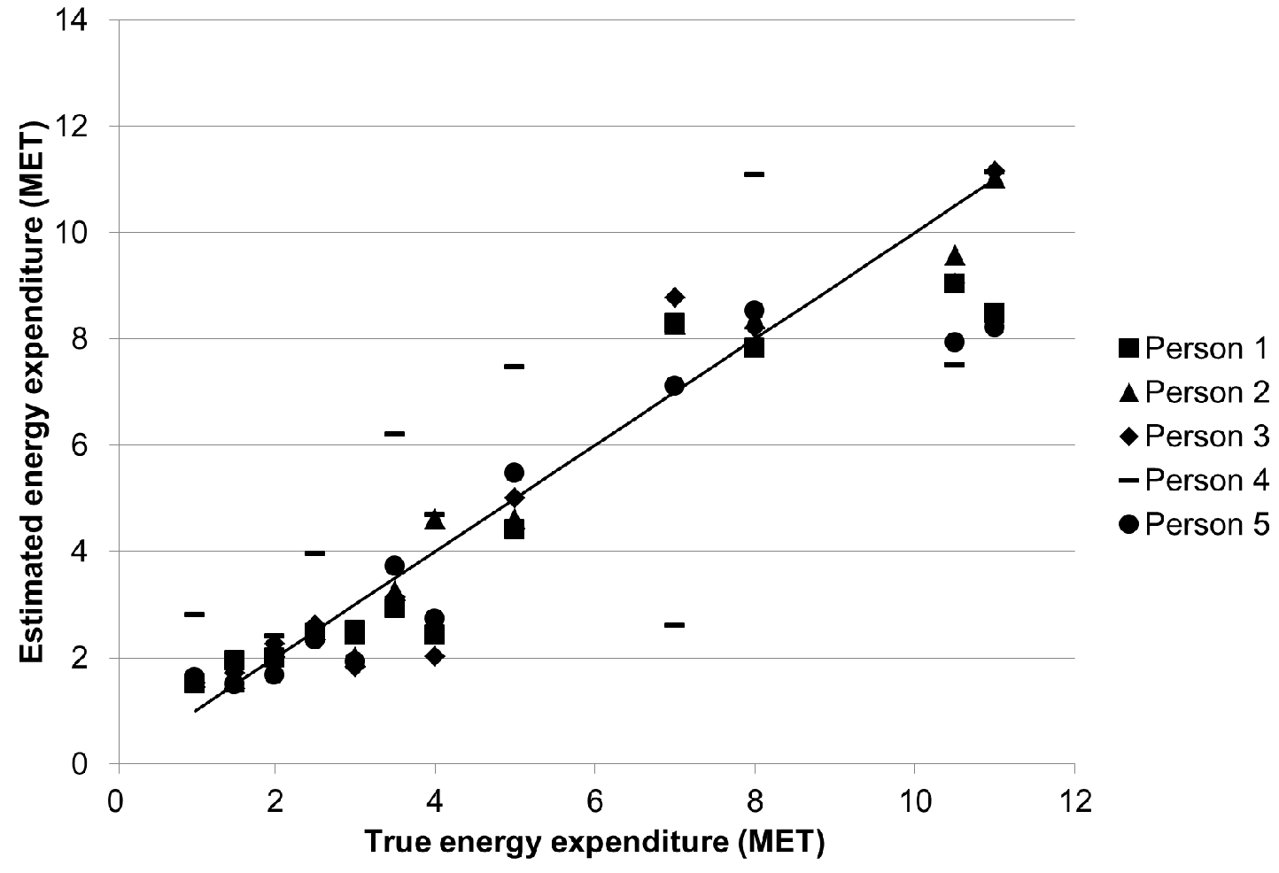
Estimated vs. true energy, multiple cl.
Average
error:
0.91 MET
Moderate
intensity
Running, cycling
Low intensity

Slide 58
Conclusion
Energy expenditure estimation with wearable accelerometers using machine learning
Study of sensor placements and algorithms
Multiple classifiers: error 1.39 → 0.91 MET

Slide 59
Conclusion
Energy expenditure estimation with wearable accelerometers using machine learning
Study of sensor placements and algorithms
Multiple classifiers: error 1.39 → 0.91 MET
Cardiologists judged suitable to monitor congestive heart failure patients
Other medical and sports applications possible

