Slide 1
The state of the Integrated Information Theory, its boundary cases and the question of ‘Phi-conscious’ AI
Tine Kolenik, Matjaž Gams
Department of intelligent systems, Jozef Stefan Institute, Ljubljana, Slovenia

Slide 2
OUTLINE
Introduction
State of the Integrated Information Theory (IIT)
Outline
Tools
Experimental work
Problems
Integrated Information Theory and artificial intelligence
Hypothesis on AI scoring better on IIT consciousness
Analysis
Conclusions & future work

Slide 3
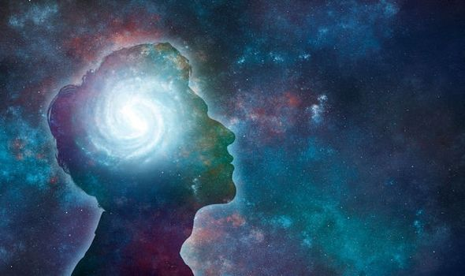
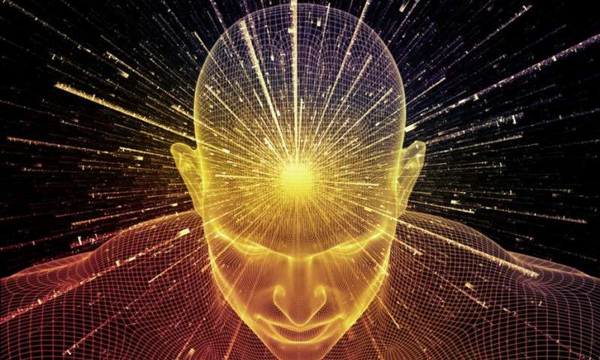
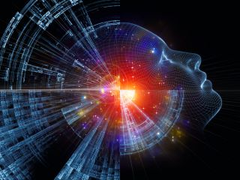
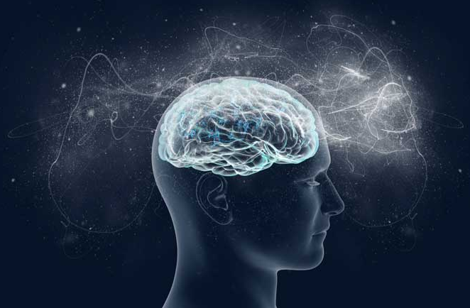
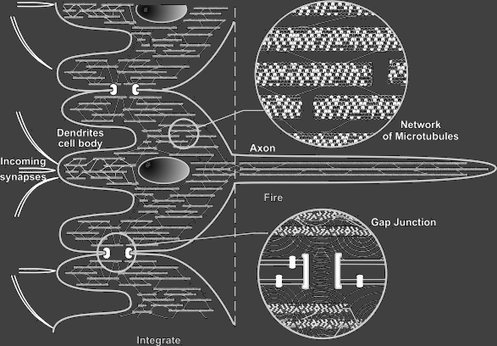
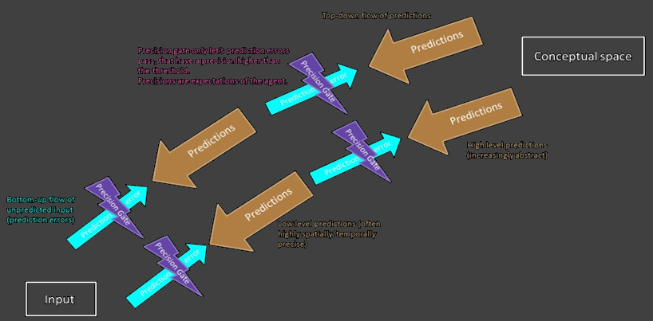
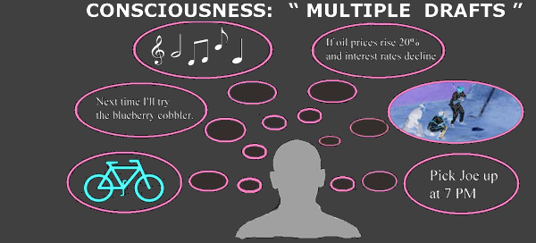
INTRODUCTION
The most well received recent theories:
Global Workspace Theory
the Multiple Drafts Model
predictive coding approaches
quantum theories of consciousness
Integrated Information Theory (Giulio Tononi) described as the most formally sound (useful for AI, scientifically viable)

Slide 4
STATE OF THE IIT
Phi (Φ) – concept of integrated information, closely correlated with consciousness level
Integrated information: information system has about itself and how much this information depends on the interconnectedness of the system‘s parts
Phi can be calculated for any given system, and many times will be positive (panpsychism), e.g. light switch
Tononi bypasses the hard question of consciousness with IIT Axiom 1
IIT tries to answer questions like:
Why does cerebral cortex give rise to consciousness, but not cerebellum (4x more neurons)?
What is important for consciousness in terms of various boundary cases: patients and infants, animals, machines

Slide 5
STATE OF THE IIT
IIT proposes what consciousness is with the following necessary conditions for them to exist (five Axioms and Postulates):
1. Intrinsic experience:
Axiom: Consciousness is real, and it is real from its own perspective. Postulate: System must have cause-effect power upon itself.
2. Composition:
Axiom: Consciousness is composed of phenomenological distinctions, which exist within it. Postulate: System must be composed of elements that have cause-effect power upon the system.
3. Information:
Axiom: Consciousness and each experience is specific, differing from other possible experiences. Postulate: System must possess cause-effect sets that differ from each other in their space of possibilities.
4. Integration:
Axiom: Consciousness is unified and experience is irreducible to a set of its phenomenological distinctions taken apart. Postulate: System must specify its cause-effect structure as to be unified, irreducible to mere sum of its parts (Φ_{system} > Φ_{sum of parts}).
5. Exclusion:
Axiom: Consciousness and experiences are definite and are the way they are, nothing else. Postulate: System must specify its cause-effect structure to be definite, always over a single set of elements and maximally irreducible (Φ_{system} > Φ_{any given sub-system}).

Slide 6
STATE OF THE IIT: TOOLS & PROBLEMS
PyPhi: Python library for calculating Phi
Phi cannot be calculated with our current computational technologies
Algorithm‘s running times = O(n53^{n})
Experiment on 4 × 3.1GHz CPU cores:
# of nodes in system | Running time
3 | ~8 seconds
5 | ~2.5 minutes
7 | ~24 hours

Slide 7
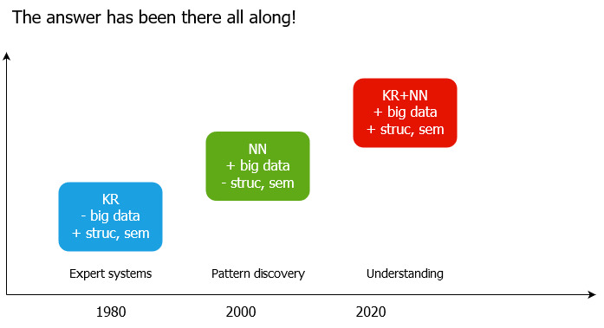
IIT AND AI
HYPOTHESIS:
IF INTELLIGENCE(KR+NN) > INTELLIGENCE(KR)
PHI(KR+NN) > PHI (KR), PHI (NN)?
IF INTELLIGENCE(KR+NN) > INTELLIGENCE(NN)

Slide 8
IIT AND AI
AI type IIT | KNOWLEDGE REPRESENTATION | NEURAL NETWORKS | KR+NN (KR ∨ NN)
Intrinsic experience | TRUE | TRUE | TRUE
Composition | TRUE | FALSE | TRUE
Information | TRUE | FALSE | TRUE
Integration | FALSE | TRUE | TRUE
Exclusion | FALSE | FALSE | FALSE

Slide 9
IIT AND AI
Tononi: IIT should be judged according to how it explains the empirical data about consciousness
AI inherently worse off as there is not empirical data on AI consciousness
Tononi presupposes consciousness and acts accordingly – that neurological data on the brain is in fact empirical data about consciousness, without calculating Φ to find out whether this is true
Can one presuppose it in robots and reverse engineer AI-Phi from there?

Slide 10
CONCLUSIONS AND FUTURE WORK
Contribution of this work: speculation on whether AI is Phi-conscious or not
We speculate about consciousness on various types of AI and hypothesize that combining different types brings us closer to Phi-conscious AI → CONFIRMED
Future work:
Using AI methods as heuristics to shorten the time for calculating Phi
Confirming our hypothesis by calculating Phi
Calculating Phi for various machine and AI setups (e.g. two recurrently connected Turing machines‘ Phi vs two individual Turing machines‘ Phi)

Slide 11
REFERENCES
[1] Hawkins, S. L. 2011. William James, Gustav Fechner, and Early Psychophysics. Front. Physiol. 2, 68 (2011). DOI= 10.3389/fphys.2011.00068.
[2] Chalmers, D. 1996. The Conscious Mind: In Search of a Fundamental Theory. Oxford University Press, Oxford.
[3] Robinson, R. 2009. Exploring the "Global Workspace" of Consciousness. PLoS Biol. 7, 3 (2009), e1000066. DOI= 10.1371/journal.pbio.1000066.
[4] Dennett, D. C. 1991. Consciousness Explained. Little, Brown & Co, Boston, MA.
[5] Clark, A. 2013. Whatever next? Predictive brains, situated agents, and the future of cognitive science. Behav. Brain Sci. 36 (2013), 181-204. DOI= 10.1017/S0140525X12000477.
[6] Atmanspacher, H. 2019. Quantum Approaches to Consciousness. The Stanford Encyclopedia of Philosophy, (2019).
[7] Tononi, G., Boly, M., Massimini, M., and Koch, C. 2016. Integrated information theory: from consciousness to its physical substrate. Nat. Rev. Neurosci. 17, 7 (2016), 450-461. DOI= 10.1038/nrn.2016.44.
[8] Gennaro, R. J. 2018. Consciousness. Springer, Cham.
[9] Tononi, G. 2008. Consciousness as Integrated Information: a Provisional Manifesto. The Biological Bulletin. 215, 3 (2008), 216-242. DOI= 10.2307/25470707.
[10] Alter, T. and Nagasawa, Y. 2015. Consciousness in the Physical World: Perspectives on Russellian Monism. Oxford University Press, Oxford.
[11] Tononi, G. and Koch, C. 2015. Consciousness: here, there and everywhere? Phil. Trans. R. Soc. B. 370 (2015). DOI= 10.1098/rstb.2014.0167.
[12] Gams, M. 2015. Kochove meritve zavesti. In Cognitive science: proceedings of the 18th International Multiconference Information Society – IS 2015 (Ljubljana, Slovenia, October 8-9, 2015). Jožef Stefan Institute, 11-14.
[13] Oizumi, M., Albantakis, L, and Tononi, G. 2014. From the Phenomenology to the Mechanisms of Consciousness: Integrated Information Theory 3.0. PLoS Comput. Biol. 10, 5 (2014), e1003588. DOI= 10.1371/journal.pcbi.1003588.
[14] Dehaene, S. 2015. Consciousness and the Brain. Viking, New York.
[15] Bohannon, J. 2018. A computer program just ranked the most influential brain scientists of the modern era. Retrieved September 11, 2019, from https://www.sciencemag.org/news/2016/11/computer-program-just-ranked-most-influential-brain-scientists-modern-era.
[16] Bayne, T. 2018. On the axiomatic foundations of the integrated information theory of consciousness. Neuroscience of Consciousness, 2018, 1 (2018), niy007. DOI= 10.1093/nc/niy007.
[17] Mayner, W. G. P., Marshall, W., Albantakis, L, Findlay, G., Marchman, R., and Tononi, G. 2018. PyPhi: A toolbox for integrated information theory. PLoS Comput. Biol. 14, 7 (2018), e1006343. DOI= 10.1371/journal.pcbi.1006343.
[18] Robson, D. 2019. Are we close to solving the puzzle of consciousness? Retrieved September 11, 2019, from http://www.bbc.com/future/story/20190326-are-we-close-to-solving-the-puzzle-of-consciousness.
[19] Marr, D. 2010. Vision: A Computational Investigation into the Human Representation and Processing of Visual Information. The MIT Press, Cambridge, MA.
[20] Shoham, Y. Award for Research Excellence presentation. Invited Lecture. 2019 International Joint Conference on Artificial Intelligence.
[21] Gams, M. 2001. Weak intelligence: through the principle and paradox of multiple knowledge. Nova Science, Hauppauge, NY.

