Slide 1
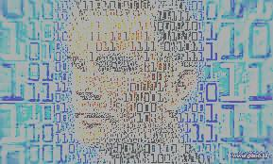
Turing Test and Gullibility
Matjaž Gams,
Institut “Jožef Stefan”

Slide 2
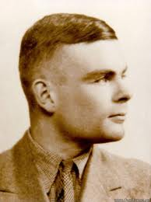
Important years
1912 - birth
1936 – Turing machine
1932-42 - Enigma
1950 – birth of AI, Turing test
1954 - death
2007 - Donald Michie died
2009 – official rehabilitation
2012 - centenary

Slide 3
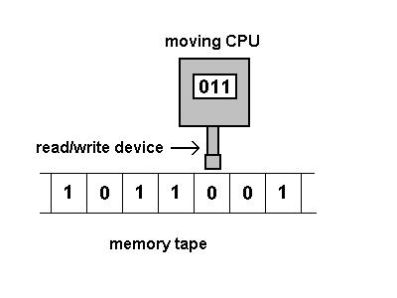
1936 – Turing machine, TM
Abstract computing machine
Can compute anything computable
Formalizes the concept of
algorithm
Universal Turing machine can simulate all other TMs – universal TM, UTM
Church-Turing thesis: “everything algorithmically computable is computable by a Turing machine."
Gödel’s 1st theorem, decidability
Independent of time, HW
Universal concept, like Einstein’s relativity

Slide 4
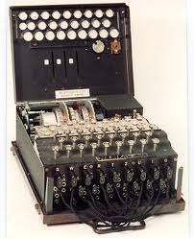
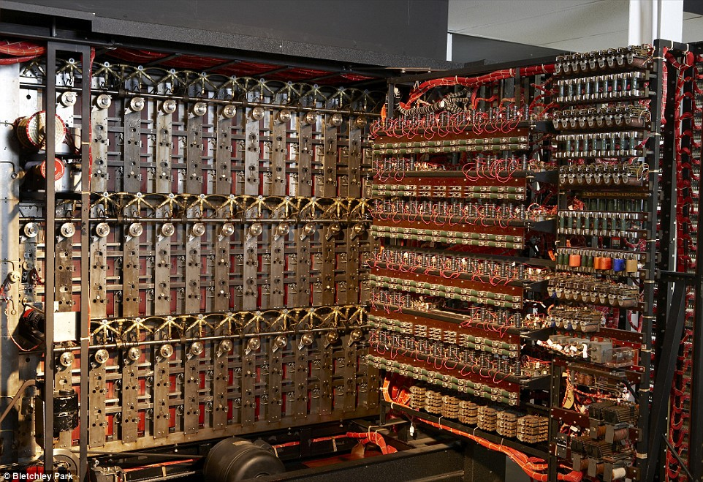
1932-42 - Enigma
German coding machine
Turing led the decoding of Enigma
Designed „bombe“
Donald Michie in the team
Web source:
One of the most important non-military discoveries in WW2
Saved Nx1000 lives
Shortened WW2 by M months

Slide 5
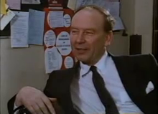
2007 - Donald Michie
With Turing on the Enigma project, first director of any AI department in the world in 1965, was director at the Turing institute where several Slovenian researchers studied for a while, honorary member of JSI, SAZU …
Ivan Bratko, father of Slovenian AI,
Donald was 1 month per year in
Ivan’s room at JSI.
Now at JSI
Turing’s room, Donald Michie’s room
Sobotna priloga Dela: Let this be in memory of Donald Michie as Turing’s contemporary and our dear colleague, and the extreme genius Alan Turing that marked the lives of every human in the world as hardly anybody.

Slide 6
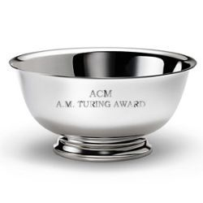
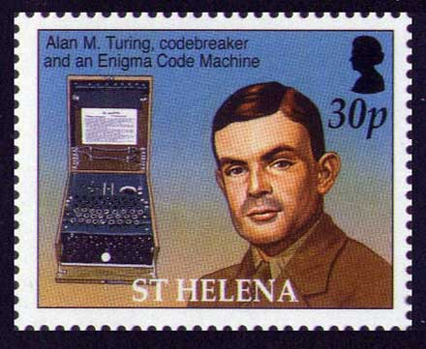
Fame
Lady Gaga 400 millions
Mozart, Einstein 40 millions / 9920
Alan Turing 4 millions / 1677
Most people on streets not familiar
(modest improvement since centenary events)
Invented modern computing and
artificial intelligence.
„Einstein“ of computer science
1966- ACM Turing award
Equivalent to Nobel prize
Street in Manchester (City)

Slide 7
The meaning
In most of the devices around you there are one to tens of TMs.
One of the people that best influenced the progress of human civilization. Like Einstein.

Slide 8
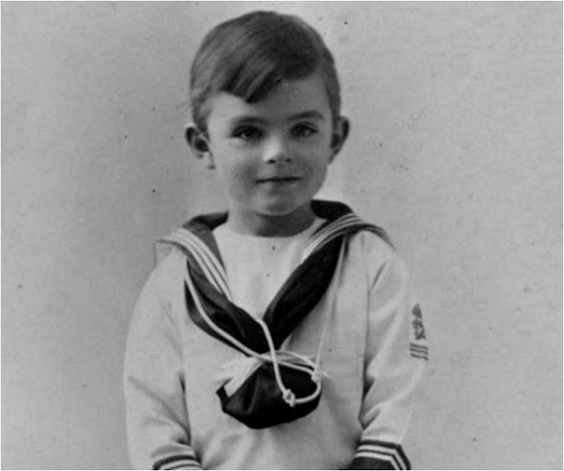
Alan Mathison Turing
Thank you

Slide 9
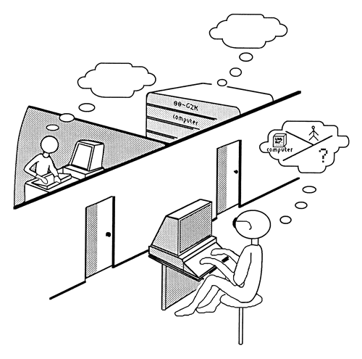
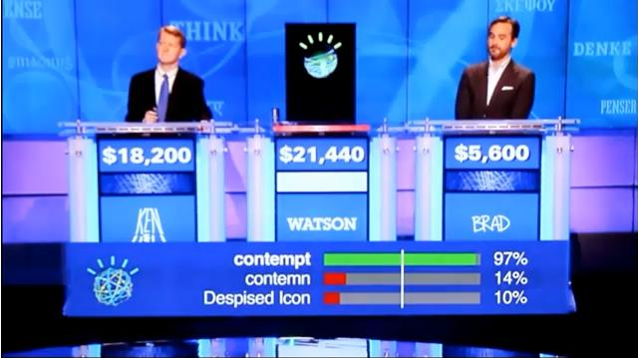
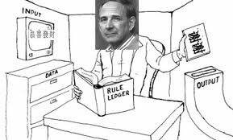
1950 – birth of AI, Turing test
Turing, Alan (October 1950), "Computing Machinery and Intelligence", Mind.
Turing test – TT too hard or too simple?
"Fair" Turing test
Total TT – TTT, visual TT
Total total TT – TTTT
Loebner test 1991-
CAPTCHA, Jeopardy 2011
Searl’s Chinese room

Slide 10
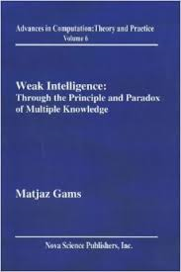
TURING TEST
Humans distinguish computers and humans in the Turing test in about the same time as 30 years ago
According to the fast progress of computer HW and AI this seems unreasonable
According to the Principle of Multiple knowledge computers must apply multiple thinking (not parallel, multiple – enabling semantics)
Analogy: Multiple universes

Slide 11
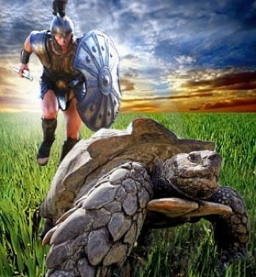
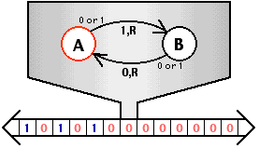
„Stronger than“ Turing machine hypercomputers
TM with oracle
Quantum computers?
Accelerating TM
Multiple TMs (machine, world, ... Not single)

Slide 12
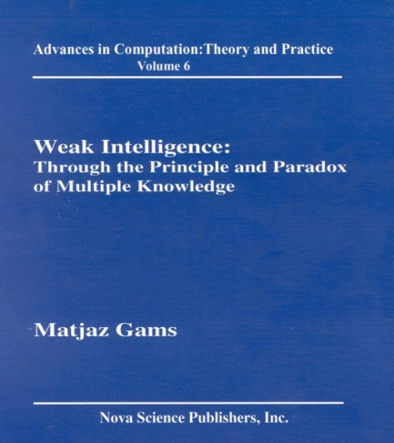
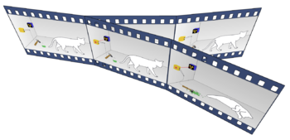
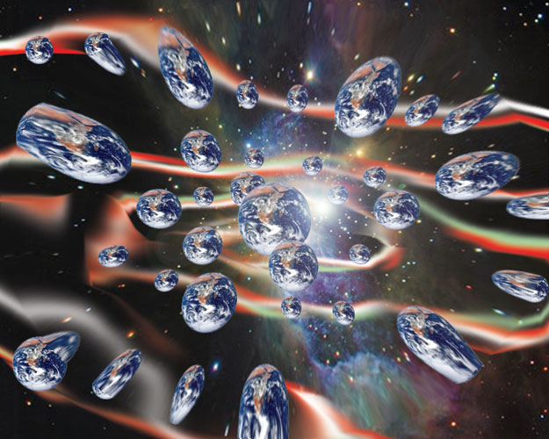
Multiple worlds – quantum or universe based
Schrëding’s equation Heisenberg’s principle, collapse
On the other
hand, the collapse is
considered as redundant in
the Bohm interpretation
the Many-Worlds Interpretation
Multiple universes, TMs, people?
Multiverse
Occam’s razor
Universe is expanding ever faster
100x too little dark matter

Slide 13
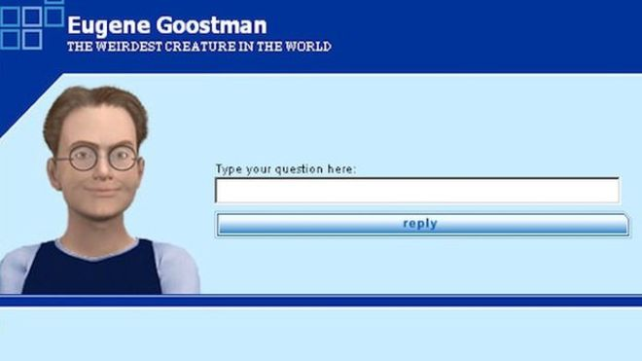
BBC News June 2014 : Computer AI passes Turing test in 'world first'
A computer program called Eugene Goostman, which simulates a 13-year-old Ukrainian boy, is said to have passed the Turing test at an event organised by the University of Reading.
The test investigates whether people can detect if they are talking to machines or humans.
The experiment is based on Alan Turing's question-and-answer game Can Machines Think?
No computer has passed the test before under these conditions, it is reported.

Slide 14
Wikipedia
Scott: Which is bigger, a shoebox or Mount Everest? Eugene: I can’t make a choice right now. I should think it out later. And I forgot to ask you where you are from…
Scott: How many legs does a camel have? Eugene: Something between 2 and 4. Maybe, three? :-))) By the way, I still don’t know your specialty – or, possibly, I’ve missed it?
Conversation between Scott Aaronson and Euge

Slide 15
The Daily Beast October 2014: The AI That Wasn’t: Why ‘Eugene Goostman’ Didn’t Pass the Turing Test
The Internet was ablaze Monday with the news of a computer passing the infamous Turing test—but not so fast. It really didn’t pass at all.
Maybe the real takeaway here is something important about human intelligence: we are deeply gullible, especially when we’re given plausible backstories.
Idea: perform tests at JSI with a mannequin

Slide 16
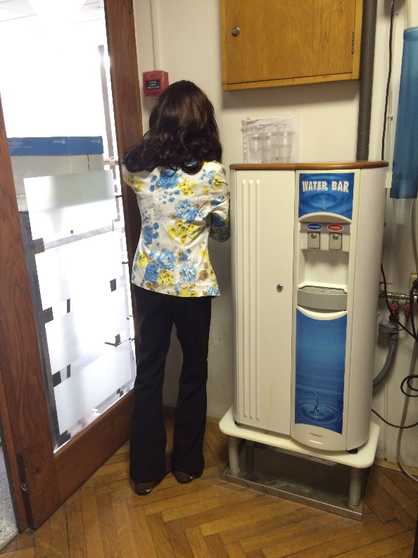
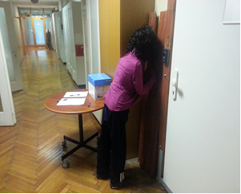
E9 MANNEQUIN
Hypothesis: humans are gullible and a certain share will not recognize an immobile mannequin
Additional test: Study human interactions and reactions
JSI, July and August 2015
125 questionnaires; 68 m, 53 w
¾ know Turing, 79% faculty
highly educated population

Slide 17
E9 MANNEQUIN
33 recognized in a couple of seconds (26%)
36 recognized in less than 10 s (28.8%)
19 explicitly did not recognize the mannequin (15%)
+ higher education and (TT or Turing)
+ men (χ2 (1) = 5,55, p = 0,02)
not higher education
Knowledge about TT or Turing helps?
Men look at women more intensely then women??

Slide 18
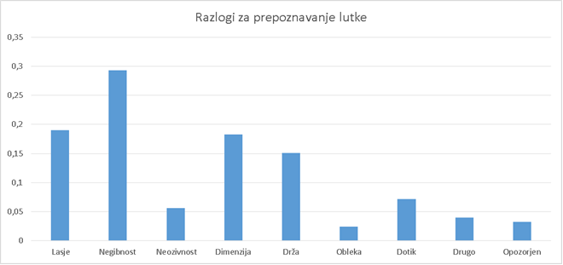
E9 MANNEQUIN
Reasons for recognition:
immobility 2. hair 3. dimensions 4. pose 5. touch

Slide 19
HUMAN INTERACTION
Sufficient number of questionnaires: cooperation with majority OK
The mannequin was often touched (hair, dress, position)
Some colleagues did not recognize the doll for days or weeks, some asked about its wellbeing
Later, most of us first recognized a human posture with peripheral vision and then remembered – it is just Angie
A couple of very negative reactions (non-scientist middle-aged ladies) protesting at the director to remove the mannequin
How is this possible? – other reports also mention protests, but not at the research institutions
How is this possible? - why women and not men – another research needed

Slide 20
SUMMARY
The JSI mannequin confirmed the hypothesis: humans are indeed gullible (easy to trick)
In a consequence – the TT should be performed with prevention of these phenomena
The study revealed several important conclusions:
Knowledge of TT or AT helps
Stiff protests from a couple of JSI ladies – why, how?
More studies are needed to understand the phenomenom of human - mannequin interaction
Future work: talking and touch-aware mannequin; with an AI dog and an AI bird

Slide 21
Thank you and JSI colleagues for help and understanding Contact: matjaz.gams@ijs.si

