Slide 1
COGNITIVE SCIENCE I
KOGNITIVNA ZNANOST I
M. Gams
Institut „Jožef Stefan“

Slide 2
DEFINITIONS
the study of the nature of intelligence
multiple empirical disciplines, including psychology, philosophy, neuroscience, linguistics, anthropology, computer science, AI, sociology, biology, science of intelligence …
differs from cognitive psychology in that algorithms that are intended to simulate human behavior are implemented or implementable on a computer

Slide 3
Wikipedia
Cognitive science is the interdisciplinary scientific study of the mind and its processes.^{[1]} It examines what cognition is, what it does and how it works. It includes research on intelligence and behavior, especially focusing on how information is represented, processed, and transformed (in faculties such as perception, language, memory, reasoning, and emotion) within nervous systems (human or other animal) and machines (e.g. computers).

Slide 4
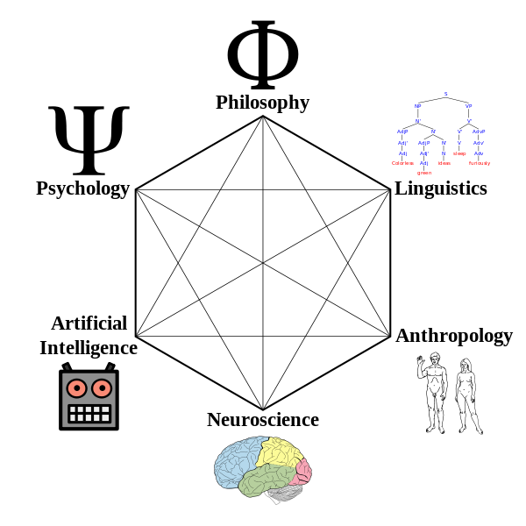
Wikipedia
MAIN TOPICS
Artificial intelligence
Attention
Language processing
Learning and development
Memory
Perception and action
MAIN RESEARCH METHODS
Behavioral experiments
Brain imaging
Computational modeling

Slide 5
CONCEPTUAL MODELLING
Computational models require a mathematically and logically formal representation of a problem. Computer models are used in the simulation and experimental verification of different specific and general properties of intelligence. Computational modelling can help us to understand the functional organization of a particular cognitive phenomenon.
There are two basic approaches to cognitive modeling. The first is focused on abstract mental functions of an intelligent mind and operates using symbols, and the second, which follows the neural and associative properties of the human brain, and is called subsymbolic (connectionism).

Slide 6
True intelligence?
Cognitive science(s)

Slide 7
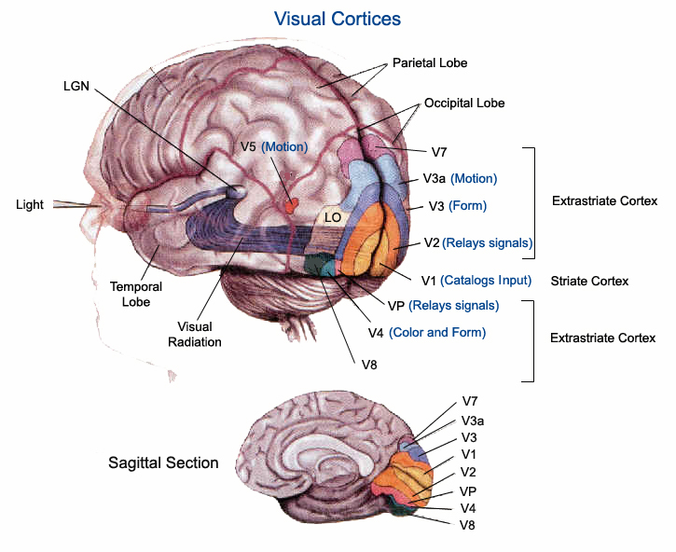
Human brain

Slide 8
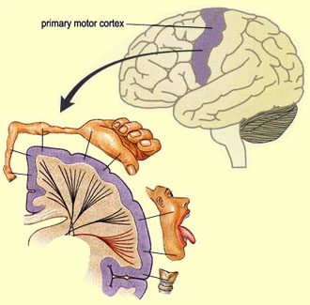
Human brain

Slide 9
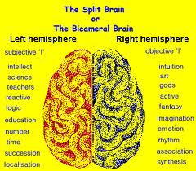
Human brain

Slide 10
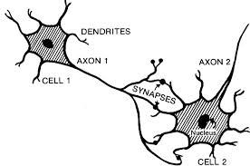
Human brain - neurons

Slide 11
Fruit fly 100.000 10⁷
Honeybee 1.000.000 10⁹
Mouse 75.000.000 10¹¹
Cat 1.000.000.000 10¹²
Human 85.000.000.000 10¹⁴
10¹² stars in Milky Way, planets like Earth?

Slide 12
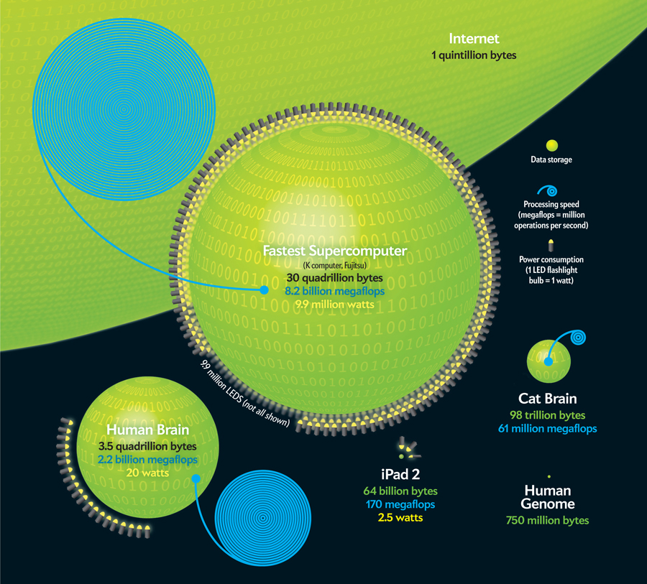
Computer/Human memory

Slide 13
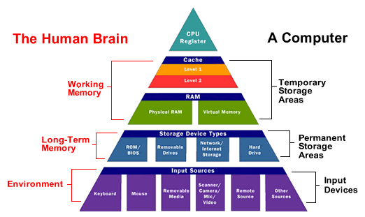
Computer/Human

Slide 14
CT THESIS
Church's thesis: "Every effectively calculable function (effectively decidable predicate) is general recursive" (Kleene 1952:300)
Turing's thesis: "Turing's thesis that every function which would naturally be regarded as computable is computable under his definition, i.e. by one of his machines, is equivalent to Church's thesis by Theorem XXX." (Kleene 1952:376)
Preprosto rečeno: Vse, kar je (simbolno) izračunljivo, je izračunljivo z algoritmom oz. Turingovim strojem. Splošno sprejeto.

Slide 15
CONSEQUENCES OF CTT
The universe is equivalent to a Turing machine; thus, computing non-recursive functions is physically impossible. This has also been termed the strong Church–Turing thesis.
The universe is not equivalent to a Turing machine (i.e., the laws of physics are not Turing-computable). For example, a universe in which physics involves real numbers, as opposed to computable reals, might fall into this category.
The universe is a hypercomputer, and it is possible to build physical devices to harness this property and calculate non-recursive functions. For example, it is an open question whether all quantum mechanical events are Turing-computable, although it is known that rigorous models such as quantum Turing machines are equivalent to deterministic Turing machines. John Lucas and, more famously, Roger Penrose have suggested that the human mind might be the result of some kind of quantum-mechanically enhanced, "non-algorithmic" computation, although there is no scientific evidence for this proposal.

Slide 16
SYMBOL SYSTEM HYPOTHESIS
A physical symbol system (also called a formal system) takes physical patterns (symbols), combining them into structures (expressions) and manipulating them (using processes) to produce new expressions.
The physical symbol system hypothesis (PSSH) is a position in the philosophy of artificial intelligence formulated by Allen Newell and Herbert Simon. They wrote:
"A physical symbol system has the necessary and sufficient means for general intelligent action."
This claim implies both that human thinking is a kind of symbol manipulation (because a symbol system is necessary for intelligence) and that machines can be intelligent (because a symbol system is sufficient for intelligence).

Slide 17
GOFAI
In artificial intelligence research, GOFAI ("Good Old-Fashioned Artificial Intelligence") is an approach to achieving artificial intelligence, based on the assumption that many aspects of intelligence can be achieved by the manipulation of symbols, an assumption defined as the "physical symbol systems hypothesis" by Alan Newell and Herbert Simon in the middle 1960s. The term "GOFAI" was coined by John Haugeland in his 1986 book Artificial Intelligence: The Very Idea, which explored the philosophical implications of artificial intelligence research.
GOFAI was the dominant paradigm of AI research from the middle fifties until the late 1980s. After that time, newer sub-symbolic approaches to AI became popular. Now, both approaches are in common use, often applied to different problems.
Opponents of the symbolic approach include roboticists such as Rodney Brooks, who aims to produce autonomous robots without symbolic representation (or with only minimal representation) and computational intelligence researchers, who apply techniques such as neural networks and optimization to solve problems in machine learning and control engineering.

Slide 18
STRONG AI
Strong AI is artificial intelligence that matches or exceeds human intelligence (singularity)—the intelligence of a machine that can successfully perform any intellectual task that a human being can. It is a primary goal of artificial intelligence research and an important topic for science fiction writers and futurists. Strong AI is also referred to as "artificial general intelligence“ or as the ability to perform "general intelligent action".^{[3]} Science fiction, associates strong AI with such human traits as consciousness, sentience, sapience and self-awareness.
Some references emphasize a distinction between strong AI and "applied AI" (also called "weak AI"): the use of software to study or accomplish specific problem solving or reasoning tasks that do not encompass (or in some cases are completely outside of) the full range of human cognitive abilities.

Slide 19
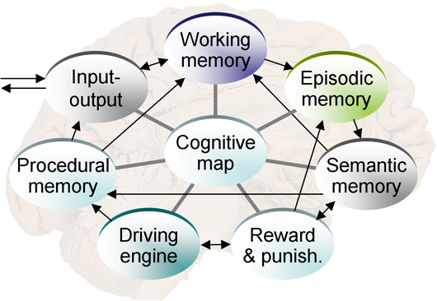
Cognitive architecture
A cognitive architecture proposes (artificial) computational processes that act like certain cognitive systems, most often, like a person, or acts intelligent under some definition. Cognitive architectures form a subset of general agent architectures. The term 'architecture' implies an approach that attempts to model not only behavior, but also structural properties of the modelled system. These need not be physical properties: they can be properties of virtual machines implemented in physical machines (e.g. brains or computers).

Slide 20
Haikonen’s cognitive architecture
Pentti Haikonen (2003) considers classical rule-based computing inadequate: "the brain is definitely not a computer. Thinking is not an execution of programmed strings of commands. The brain is not a numerical calculator either. We do not think by numbers." Rather than trying to achieve mind and consciousness by identifying and implementing their underlying computational rules, Haikonen proposes "a special cognitive architecture to reproduce the processes of perception, inner imagery, inner speech, pain, pleasure, emotions and the cognitive functions behind these. This bottom-up architecture would produce higher-level functions by the power of the elementary processing units, the artificial neurons, without algorithms or programs".
Haikonen believes that, when implemented with sufficient complexity, this architecture will develop consciousness, which he considers to be "a style and way of operation, characterized by distributed signal representation, perception process, cross-modality reporting and availability for retrospection." Haikonen is not alone in this process view of consciousness, or the view that AC will spontaneously emerge in autonomous agents that have a suitable neuro-inspired architecture of complexity; these are shared by many, e.g. Freeman (1999) and Cotterill (2003).

Slide 21
AI UI
Artificial Intelligence (AI) is the intelligence of machines and the branch of computer science which aims to create it. Major AI textbooks define the field as "the study and design of intelligent agents,"where an intelligent agent is a system that perceives its environment and takes actions which maximize its chances of success.^{[2]} John McCarthy, who coined the term in 1956, defines it as "the science and engineering of making intelligent machines."
The field was founded on the claim that a central property of human beings, intelligence—the sapience of Homo sapiens—can be so precisely described that it can be simulated by a machine.This raises philosophical issues about the nature of the mind. Artificial intelligence has been the subject of breathtaking optimism, has suffered stunning setbacks and, today, has become an essential part of the technology industry, providing the heavy lifting for many of the most difficult problems in computer science.
AI research is highly technical and specialized, so much so that some critics decry the "fragmentation" of the field. Subfields of AI are organized around particular problems, the application of particular tools and around longstanding theoretical differences of opinion. The central problems of AI include such traits as reasoning, knowledge, planning, learning, communication, perception and the ability to move and manipulate objects. General intelligence (or "strong AI") is still a long term goal of (some) research.

Slide 22
TURING TEST
The Turing test is a proposal for a test of a machine's ability to demonstrate intelligence. It proceeds as follows: a human judge engages in a natural language conversation with one human and one machine, each of which tries to appear human. All participants are placed in isolated locations. If the judge cannot reliably tell the machine from the human, the machine is said to have passed the test. In order to test the machine's intelligence rather than its ability to render words into audio, the conversation is limited to a text-only channel such as a computer keyboard and screen.[

Slide 23
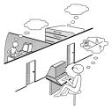
Turing test

Slide 24
TURING TEST
TT (see Moor 2003 and Gams 2001 for references), e.g. the Total Turing test (TTT) in which the subject has to perform tasks in the physical world such as moving blocks. In the TTT version, the subject cannot be observed. A step further is the Totally total Turing test (TTTT), in which one has visual and physical access to the being/machine in question. In other words, you can pinch it and observe the reaction. In yet another version, all tests, including molecular analyses, are allowed. In Truly total TT (TRTT) the interrogator observes not only one subject, but also the historical record of a population.

Slide 25
TURING TEST - Loebner Prize
First in 1991, Hugh Loebner to foster AI; The first winner won, at least in part, because it was able to "imitate human typing errors“ and the unsophisticated interrogators were easily fooled.
Q: Do you want to have sex with me? ELIZA: Please go on.
(Zdenek 2003):
Judge: Do you know Lincoln’s first name?
X: Beats me.
Judge: You are a disgrace to your country. You are American, right?
X: What do you mean?
Judge: I mean, you were born in the United States?
X: What? Maybe I just got too much on my mind. I got real trouble at work. I think I’m going to get fired.
Judge: Maybe you have too little on your mind. You moron.
X: What?
Judge: I just said that you have too little on your mind. You are a moron.
X: I don’t know.

Slide 26
TURINGOV TEST - Loebner Prize
The silver (audio) and gold (audio and visual) prizes have never been won. However, the competition has awarded the bronze medal every year for the computer system that, in the judges' opinions, demonstrates the "most human" conversational behavior among that year's entries. Artificial Linguistic Internet Computer Entity (A.L.I.C.E.) has won the bronze award on three occasions in recent times (2000, 2001, 2004). Learning AI Jabberwacky won in 2005 and 2006.
The Loebner Prize tests conversational intelligence; winners are typically chatterbot programs, or Artificial Conversational Entities (ACE)s. Early Loebner Prizes ruled restricted conversations: each entry and hidden-human conversed on a single topic, thus the interrogators were restricted to one line of questioning per entity interaction. The restricted conversation rule was lifted for the 1995 Loebner Prize. In 2003, each interrogator was allowed five minutes to interact with an entity, machine or hidden-human. Between 2004 and 2007 the interaction time allowed in Loebner Prizes was more than twenty minutes. In 2008 the interrogation duration allowed was five minutes per pair. The 2008 winning entry, Elbot personality is that of a robot yet it deceived three human judges.

Slide 27
TURING TEST - VERSIONS
TT originalno seksualna igrica imitacije
Inverted (reversed) TT is passed when a machine can distinguish humans and computers in a TT.
Immortality (identity) test – if another person is as the same (copied into a computer)
CAPTCHA – zapackane črke, ločevanje med ljudmi in računalniki (implikacija – prave umetne inteligence ni?)
Časovno omejena in z verjetnostjo (Michie)

Slide 28
SEARLOV CHINESE ROOM
John Searle's 1980 paper proposed an argument against the Turing Test known as the "Chinese room" thought experiment. Searle in a room takes Chinese characters as input and, by following the instructions of a book or a program, produces other Chinese characters, which it presents as output. Suppose, says Searle, that this computer performs its task so convincingly that it comfortably passes the Turing test, yet there is no understanding in a room.
Searle argued that software (such as ELIZA) could pass the Turing Test simply by manipulating symbols of which they had no understanding. Without understanding, they could not be described as "thinking" in the same sense people do. Therefore—Searle concludes—the Turing Test cannot prove that a machine can think, contrary to Turing's original proposal. Komentar: Brez razumevanja ne moreš res kvalitetno prevajati.

Slide 29
Searlova Kitajska soba

Slide 30
TURING TEST – ANALYZIS
Imitacija človeka, samo pogovor (tipkanje), ne prepozna druge vrste inteligence
Človek je včasih neinteligenten, računalnik pa “preveč hiter..”
Look-up table (nemogoče teoretično in praktično)
AI mainstream not dealing with TT
Originalni namen Turinga (računalniki bodo slej ko prej kot ljudje) je bil postaviti jasen test, kdaj bo ta meja dosežene
Praksa: Ljudje prepoznamo inteligenco tudi v živalih brez imitacijske igre
Vsak poznavalec razkrinka računalnik v enem ali dveh stavkih (pomena v računalnikih ni)

Slide 31
HISTORY
Plato and Aristotel
Decates – dualizem (10 versions) the brain vs mind with consciousness and self-awareness; hardware vs software / scientific?
differs from cognitive psychology in that algorithms that are intended to simulate human behavior are implemented or implementable on a computer

Slide 32
HISTORY - MINSKY
Marvin Minsky (1927), cofounded AI MIT, one of 6 best known Ai researchers, Turing award, IJCAI, national academy member, … with Papert designer of logo language …, patents, publications … critic of neural ntworks, Loebner prize … avtor The Society of Mind theory (followed by Emotion Machine). The theory attempts to explain how what we call intelligence could be a product of the interaction of non-intelligent parts. The human mind is a vast society of individually simple processes known as agents. These processes are the fundamental thinking entities from which minds are built, and together produce the many abilities we attribute to minds. The great power in viewing a mind as a society of agents, as opposed to as the consequence of some basic principle or some simple formal system, is that different agents can be based on different types of processes with different purposes, ways of representing knowledge, and methods for producing results.
What magical trick makes us intelligent? The trick is that there is no trick. The power of intelligence stems from our vast diversity, not from any single, perfect principle. – Marvin Minsky, The Society of Mind, p. 308

Slide 33
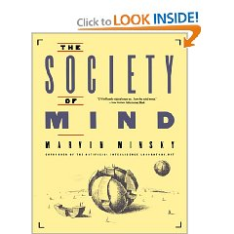
ZGODOVINA - MINSKY

Slide 34
HISTORY – Newell, Simon
Newell (1927) and Simon (prijatelja, vrsto nagrad, Simonu Nobelova) founded AI Carnegie Mellon University and produced a series of important programs and theoretical insights throughout the late fifties and sixties: General Problem Solver, and the physical symbol systems hypothesis, the controversial philosophical assertion that all intelligent behavior could be reduced the kind of symbol manipulation that Newell's programs demonstrated.
Newell's work culminated in the development of a cognitive architecture (the mind is a single sysem using unified principles) known as Soar and his unified theory of cognition, published in 1979.

Slide 35
HISTORY – Noam Chomsky
(1928) Lingvist, kognitivec in politični aktivist, eden najpogosteje citiranih
generative grammar, studies grammar as a body of knowledge, much of this knowledge is innate, implying that children need only learn certain parochial features of their native languages (contraversy – behavioralism – brain evolving – what is learned and what genetically coded)
Chomsky hierarchy
Type-0 Recursively enumerable, Turing machine (no restrictions)
Type-1 Context-sensitive, Linear-bounded non-deterministic Turing m.
Type-2 Context-free, Non-deterministic pushdown automaton
Type-3 Regular, Finite state automaton

Slide 36
HISTORY – Daniel Dennett
(ateist, …), zanj je računalnik najboljše orodje za raziskovanje uma Consciousness Explained, similar to Neural Darwinism. The book puts forward a "multiple drafts" model of consciousness, suggesting that there is no single central place (a "Cartesian Theater") where conscious experience occurs; instead there are "various events of content-fixation occurring in various places at various times in the brain". The brain consists of a "bundle of semi-independent agencies"; when "content-fixation" takes place in one of these, its effects may propagate so that it leads to the utterance of one of the sentences that make up the story in which the central character is one's "self". (he also attacks qualia).

Slide 37
HISTORY – DAVID CHALMERS
Avstralec, “Consciousness explained away”
Chalmers' book, The Conscious Mind (1996), is widely considered (by both advocates and detractors) to be a landmark work on consciousness and its relation to the mind-body problem in philosophy of mind. In the book, Chalmers forcefully and cogently argues that all forms of physicalism (whether reductive or non-reductive) that have dominated philosophy and the sciences in modern times fail to account for the most essential aspects of consciousness. He proposes an alternative dualistic view that has come to be called property dualism but which Chalmers deemed "naturalistic dualism.”
Easy - Hard question He makes the distinction between easy problems of consciousness (which are, amongst others, things like finding neural correlates of sensation) and the hard problem, which could be stated "why does the feeling which accompanies awareness of sensory information exist at all?" A main focus of his study is the distinction between brain biology and behavior as distinct from mental experience taken as independent of behavior (known as qualia). He argues that there is an explanatory gap between these two systems, and criticizes physical explanations of mental experience, making him a dualist in an era that some have seen as being dominated by monist views.

Slide 38
HISTORY – DAVID CHALMERS
Chalmers main argument against physicalism, and his primary contribution to the ancient debate on the mind-body problem, is based on a thought-experiment in which there are hypothetical philosophical zombies. These zombies are not like the zombies of film and television series, but are exactly the same as ordinary human beings, except that they lack qualia. He argues that since such zombies are conceivable to us, they must therefore be logically possible. Since they are logically possible, then qualia and sentience are not fully explained by physical properties alone.
Instead, Chalmers argues that consciousness is a set of emergent, higher-level properties that arise from, but are ontologically autonomous of, the physical properties of the brains of organisms. This is the essence of his famous thesis of property dualism.

