Slide 1
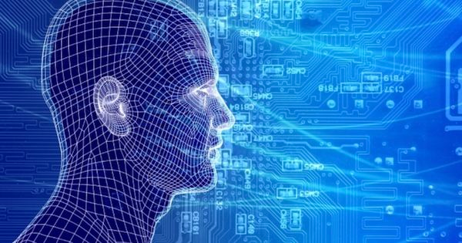
Superintelligence, human progress, AI, agents, BI, AmI, cognitive science
D o b r o d o š l i.
Matjaž Gams
Institut „Jožef Stefan“

Slide 2
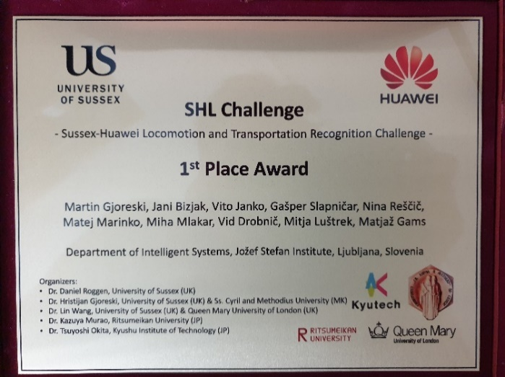
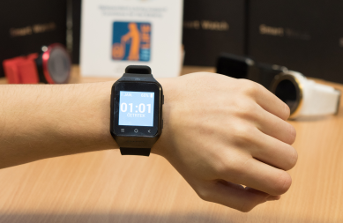
INTRODUCTION
Head of dept of intelligent systems, Jozef Stefan Institute Head of research class, Engineering academy of Slovenia Member of Executive Boards of Slovenian Engineering Academy, Artificial Intelligence Society, Cognitive Science Society, ACM Computing National Councillor for science, Slovenia
Heartman – heart Smart watch – elderly Huawei competition

Slide 3
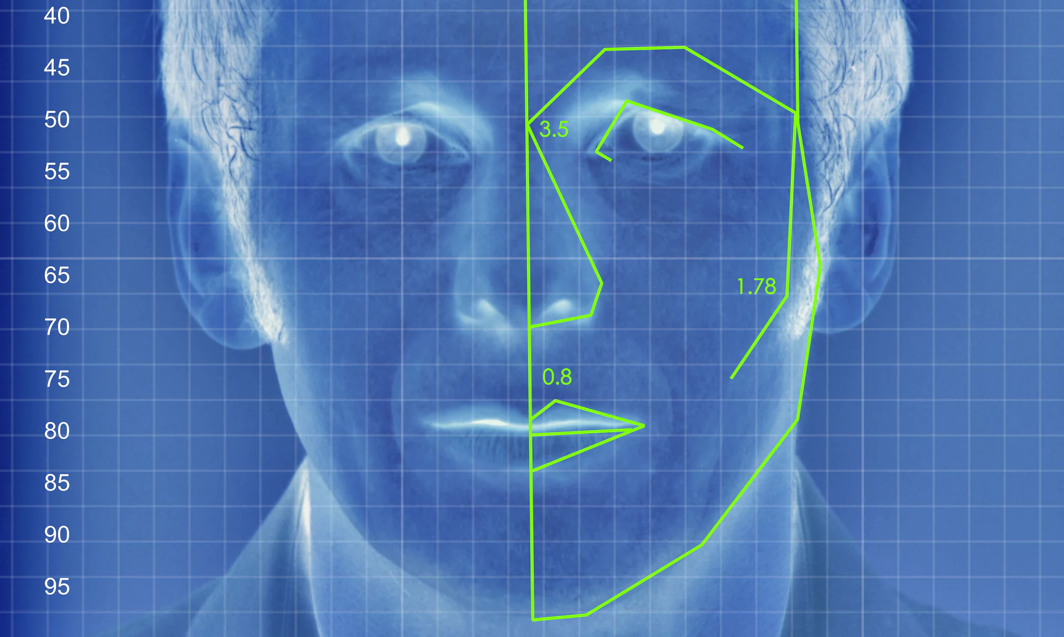
THE INFLUENCE OF AI
M. Kosinski, Y. Wang, Stanford university
2017 Journal of Personality and Social Psychology,
91% man homo or hetero, 83% women homo or hetero
20% better than humans
Q: Explanation, how? (DNN, 30.000)

Slide 4
THE INFLUENCE OF AI
M. Kosinski, Y. Wang, Stanford university
2017 Journal of Personality and Social Psychology,
91% man homo or hetero, 83% women homo or hetero
20% better than humans
Q: Explanation, how?
Is orientation genetically determined? (YES)

Slide 5
THE INFLUENCE OF AI
M. Kosinski, Y. Wang, Stanford university
2017 Journal of Personality and Social Psychology,
91% man homo or hetero, 83% women homo or hetero
20% better than humans
Q: Explanation, how?
Is orientation genetically determined?
AI teaches humans? (YES)

Slide 6
THE INFLUENCE OF AI
M. Kosinski, Y. Wang, Stanford university
2017 Journal of Personality and Social Psychology,
91% man homo or hetero, 83% women homo or hetero
20% better than humans
Q: Explanation, how?
Is orientation genetically determined?
AI teaches humans?
Is it going to be misused?

Slide 7
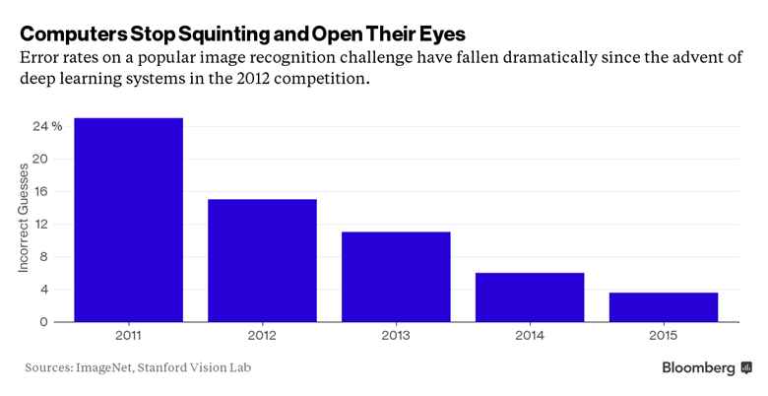
THE INFLUENCE OF AI
M. Kosinski, Y. Wang, Stanford university
2017 Journal of Personality and Social Psychology,
91% man homo or hetero, 83% women homo or hetero
20% better than humans
Q: Explanation, how?
Is orientation genetically determined?
AI teaches humans?
Is it going to be misused?
How is it possible?
100 trillion decisions daily

Slide 8
HOW TO PREDICT – using laws
Moore’s law (exponential growth of chip capabilities)
Makimoto’s law (10-year cycle of semiconductors)
Metcalf’s law: value(network) = square(no. of nodes) or n*logn /Odlyzko (size of network is very important)
Keck’s, Sidgemor’s law (exponential growth of net traffic, capabilities)
Groschs’law (cost equals sq. root (speed))
Amdahl’s law (T=S/R + P/(M*R))
Andreesen Lewis Fleming... net capitalism
Computer Laws revisited, Computer, December 2013, vol. 46, no. 12

Slide 9
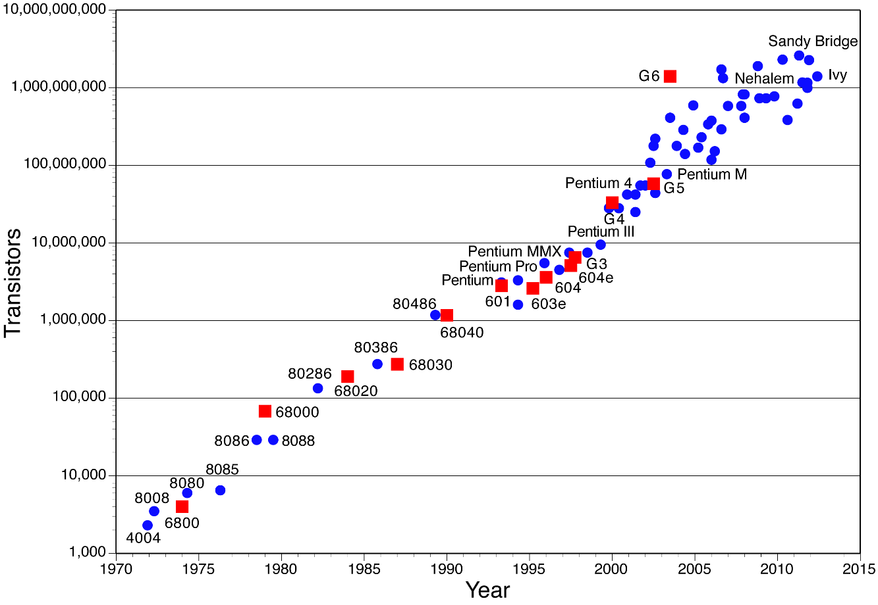
Moore’s law
Exponential growth; 1 transistor per 1 m radius of our galaxy
Pushing human progress forward: yearly +50% (corn 2%)
HW stalling, lots of room

Slide 10
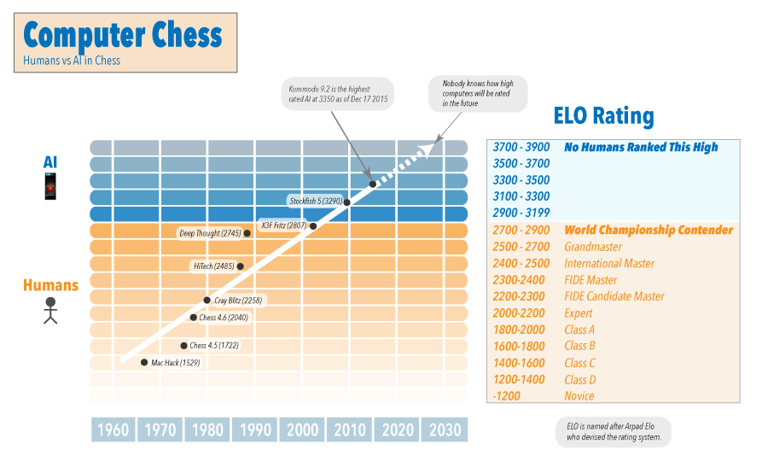
Computer chess

Slide 11
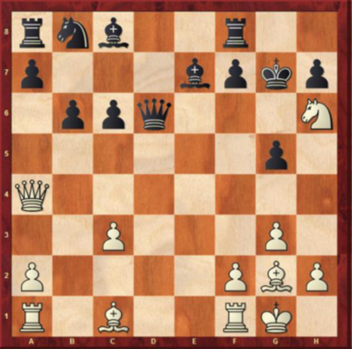
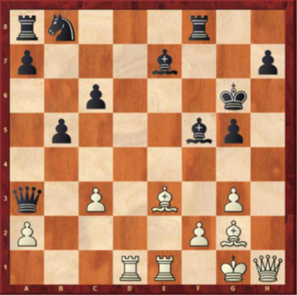
AlphaZero 4h learning
19. Rf1-e1 26. (+8) Qh4-h1
+ 20 moves - winning 1500 years?

Slide 12
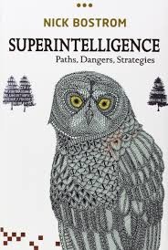
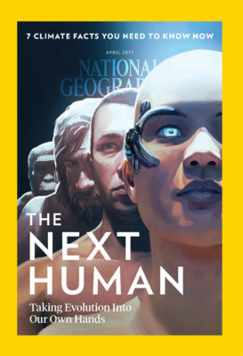
Razvoj človeštva

Slide 13
Humans versus computers
Kurtzweil
humans + computers
processing power
Fermi paradox
computers
humans
Moore’s law
time
Notes:
Nora rast znanosti bo pripeljala v teorijo singularnosti, v nove fantastične čase. Flaynnov učinek – ljudje so čedalje pametnejši. So pa morebitni problemi, npr. Fermijev paradoks.

Slide 14
Humans versus computers
Kurtzweil
humans + computers
processing power
Fermi paradox
computers
humans
Moore’s law
General AI
time
Notes:
Nora rast znanosti bo pripeljala v teorijo singularnosti, v nove fantastične čase. Flaynnov učinek – ljudje so čedalje pametnejši. So pa morebitni problemi, npr. Fermijev paradoks.

Slide 15
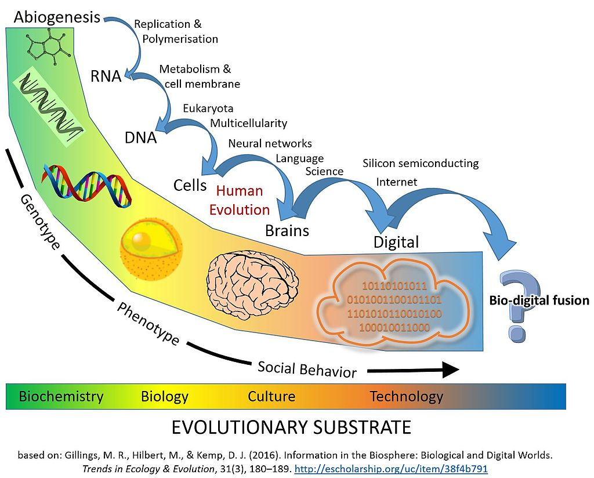
Information society
2 merges:
individual
society

Slide 16
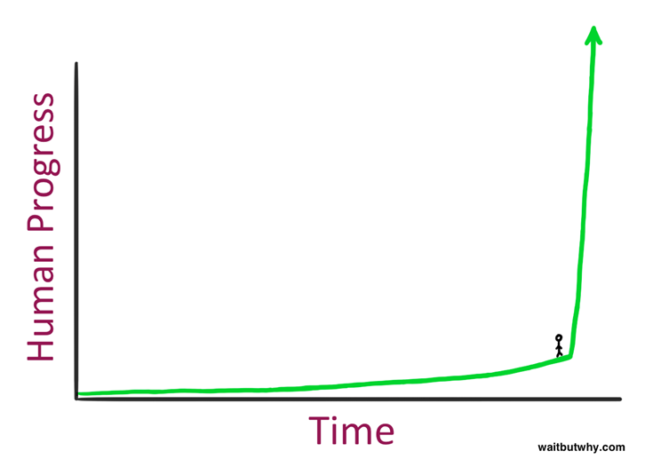
Singularity / superintelligence
John von Neumann 1959 first use
2005 book, The Singularity is Near, Ray Kurzweil, Google director for engineering, patents, 15. 3. 2017: The singularity: AI will make humans sexier and funnier, says Google expert
25.6.2017: How AI is going to cure our sick health care system. The doctor will see you now. Newsweek
14. 4. 2017: AI will have 10 times the impact of any technology in history in one-fifth the time. Newsweek
Jump-up will be very fast / singular (like flying)

Slide 17
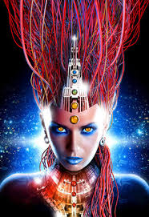
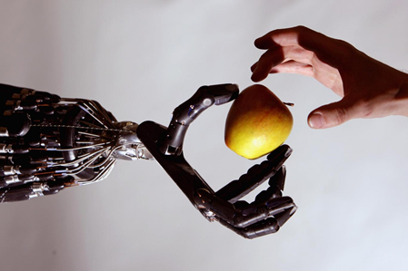
Superintelligence
We can predict approximately, but we don’t have the knowledge and capabilities to fully understand. Why? How?
Human + computer (robot) merging
Programming ourselves at molecular level
Elon Musk Launches Neuralink Startup To Connect Your Brain to the Internet, Newsweek 28.3.2017; currently: human+internet, human-diseases
When? Kurzweil: 2029; 86%, 2000 Web world phenomenon
Predictions: 10-100 years, probably several decades
MG: End of PCs 20 years ago, now?!

Slide 18
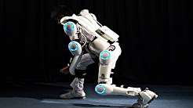
Superintelligence – new concepts
Human + exoscelet, joints, implants
3D printing of tissue, organs, stem cells
Can we live forever?
Imagine -250, -500 years?
London -150 years l.e. 20 years

Slide 19
Superintelligence – new concepts
Human + exoscelet, joints, implants
3D printing of tissue, organs, stem cells
Can we live forever?
Imagine -250, -500 years?
London -150 years l.e. 20 years
New civilization era, new powers!
Fantastic possibilities!!

Slide 20
Humans versus computers
Kurtzweil
humans + computers
processing power
Fermi paradox
computers
humans
Moore’s law
time
Notes:
Nora rast znanosti bo pripeljala v teorijo singularnosti, v nove fantastične čase. Flaynnov učinek – ljudje so čedalje pametnejši. So pa morebitni problemi, npr. Fermijev paradoks.

Slide 21
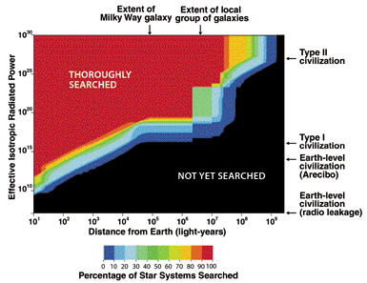
Fermi paradox
Drake equation : civilizations should be abundant – Fermi : where??
Short span??

Slide 22
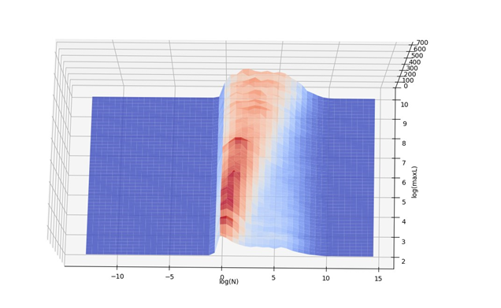
HUMAN PROGRESS
Drake, Fermi – longevity (UN)
Oxford (Wikipedia): 19% till 2100
molecular, nano 5%
superintelligence 5%
wars 5%
desease 2%
Avoid danger - stop killer robots - not plant / human / animal /aliens, but special category to robots - demography - climate

Slide 23
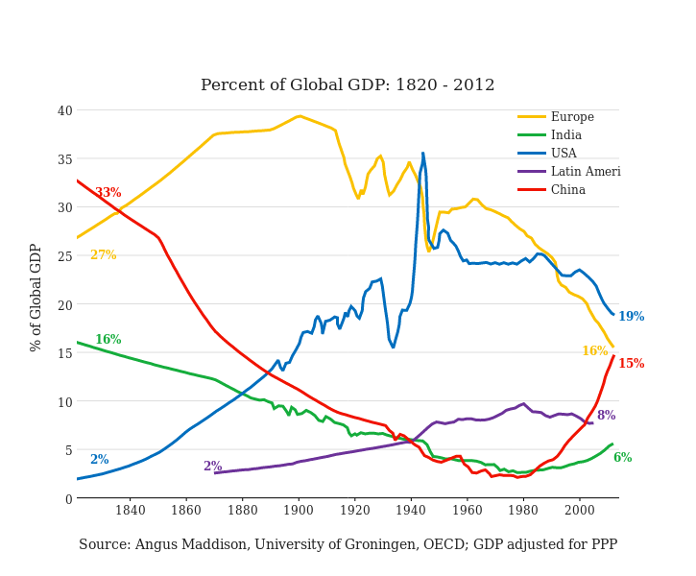
A COUPLE OF PREDICTIONS WORLD SHARE

Slide 24
Middle-class consumption

Slide 25
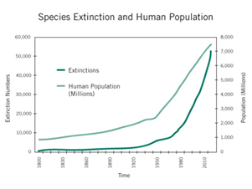
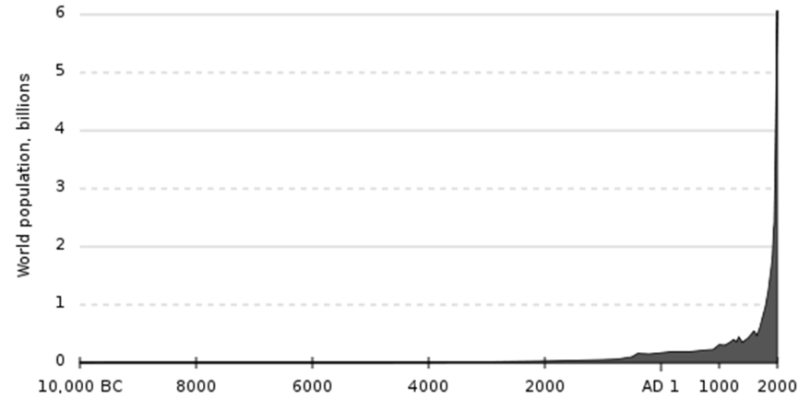
Demography: Fast human growth will destroy human civilisation
Fertility 5: 13 gen. 1 per m2
Animal extinction 100x faster
In 40 years 50% animals less
In 27 years in Germany 75% less flying insects
40 gen. 1 per 1 kg planet

Slide 26
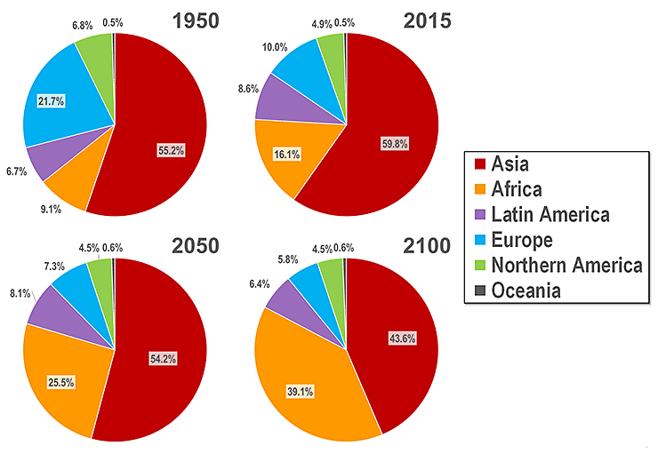
World population - demography

Slide 27
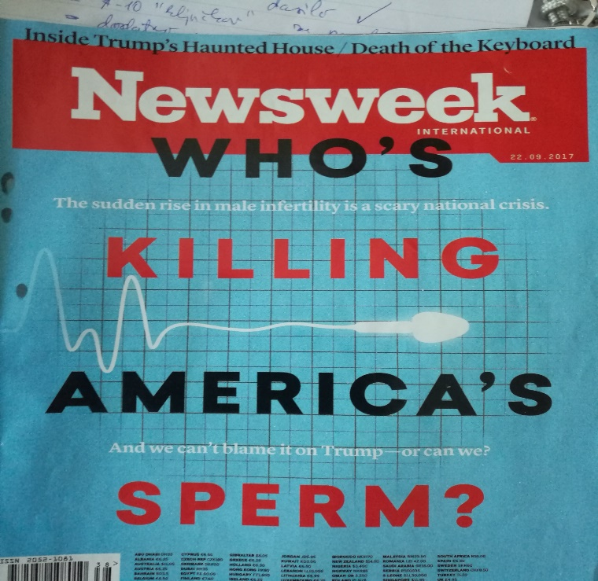
Slovenians, Europeans extinction
Human, European, Slovenian civilisation
- 17% Slovenians without children
- 50% less sperm
- 8000 emigration, 1000 best educated not enough fresh blood fresh brain courage

Slide 28
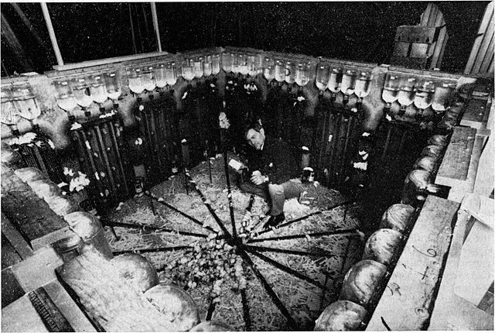
Mouse utopia - implosion
Japan, Sweden, emergent??
Sperm count 60% lower than 40 years ago
Why? Why are bees dying? Hyperglobalisation!

Slide 29
Future ?

Slide 30
Unbelivable progress!

Slide 31
Unbelivable progress! Dangers ahead – mysterious (hyperglobalisation)

Slide 32
Unbelivable progress! Dangers ahead – mysterious (hyperglobalisation) Superintelligence is our savior!

Slide 33
Thank you
Matjaž Gams

Slide 34
Before I came here I was confused about this subject. After listening to your lecture I am still confused but at a higher level. Enrico Fermi

