Slide 1
INTELLIGENT SYSTEMS AND AGENTS + INTELLIGENCE
Prof. dr. Matjaž Gams
MPŠ

Slide 2
INTELLIGENT SYSTEMS AND ROBOTICS INTELIGENTNI SISTEMI IN ROBOTIKA
Intelligent Systems and Robotics (ISR) are dealing with advanced information sciences and technologies including intelligent systems, ambient intelligence, business intelligence, evolutionary computation, cognitive sciences, humanoid robotics, computer vision, controlling robots and systems. These are key information society technologies enabling knowledge-based society. Evolutionary algorithms Humanoid and service robotics
Intelligent systems and agents
Intelligent robot control
Cognitive sciences
Business intelligence
Ambient intelligence
Robot vision basic book: AI – A modern approach each section Modern control systems seminar work + oral exam

Slide 3
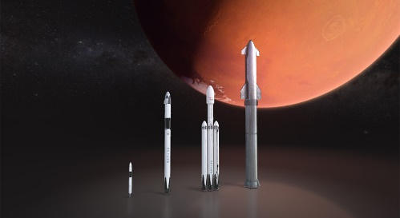
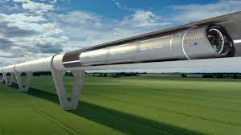
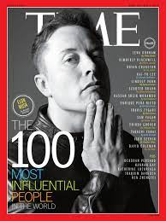
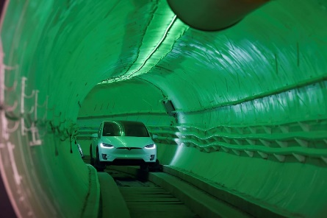
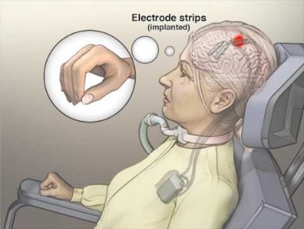
ELON MUSK
PayPal – online payment systems
SolarCity, Tesla Energy – clean energy (solar)
SpaceX – reusable, to Mars, more risky
Tesla – el. car, m. production, m. phone
Boring Company, Hyperloop - mobility
Neuralink – implantable brain-machine
StarLink - satellites
Open AI – GPT3, DALL-E (-Google)
Twitter (?PayPal)
Existential threats
AI (superintelligence), autonomous weapons, climate change, multiplanetary, population decline

Slide 4
ELON MUSK
Why Musk?
The richest person: how to succeed
The smartest – key issues of humanity
Engineering approach – make better systems
To support his vision
To escape „classical“ learning
Saving the humanity
How to make intelligent systems

Slide 5
ARTIFICIAL INTELLIGENCE
Russell and Norvig ARTIFICIAL INTELLIGENCE: A Modern Approach

Slide 6
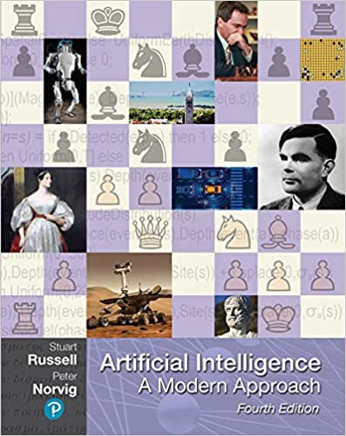
Fourth edition, 2020 older also OK
The leading textbook in Artificial Intelligence, used in 1500 schools in 135 countries and regions
Basic theory, understanding

Slide 7
Youtube: AI a modern approach
Dan Klein, Peter Abbeel Berkeley
Video:
http://aima.cs.berkeley.edu/
https://www.youtube.com/watch?v=tONNlv6osG4&list=PL5cz44VCrscVrzSJ9ptlybpWyKdIypvPj

Slide 8
Berkeley Course
http://aima.cs.berkeley.edu/
https://aimacode.github.io/aima-exercises/
Exercises
Exercise 1.1 // exam Q
Define in your own words:
(a) intelligence, (b) artificial intelligence, (c) agent, (d) rationality, (e) logical reasoning.

Slide 9
Contents
Part I Artificial Intelligence 1 Introduction 2 Intelligent Agents
Part II Problem Solving 3 Solving Problems by Searching 4 Informed Search and Exploration 5 Constraint Satisfaction Problems 6 Adversarial Search Part III Knowledge and Reasoning 7 Logical Agents 8 First-Order Logic 9 Inference in First-Order Logic 10 Knowledge Representation

Slide 10
Contents
Part IV Planning 11 Planning 12 Planning and Acting in the Real World
Part V Uncertain Knowledge and Reasoning 13 Uncertainty 14 Probabilistic Reasoning 15 Probabilistic Reasoning Over Time 16 Making Simple Decisions 17 Making Complex Decisions Part VI Learning 18 Learning from Observations 19 Knowledge in Learning 20 Statistical Learning Methods 21 Reinforcement Learning

Slide 11
Contents
Part VII Communicating, Perceiving, and Acting 22 Communication 23 Probabilistic Language Processing 24 Perception 25 Robotics Part VIII Conclusions 26 Philosophical Foundations 27 AI: Present and Future
Data mining …

Slide 12
Contents
Part I Artificial Intelligence 1 Introduction Check exercises for all sections 2 Intelligent Agents
Types of agents – see Wikipedia, Roomba
https://en.wikipedia.org/wiki/Intelligent_agent Part II Problem Solving 3 Solving Problems by Searching
search problem, (Pac-man)
solution, state space, graph/tree depth-first, breadth-first
uniform-cost search

Slide 13
Contents
4 Informed Search and Exploration heuristics (estimate to goal)
greedy search (most promising)
A*, f(n) = g(n) + h(n)
h less than true, optimal bidirectional (if), common 5 Constraint Satisfaction Problems 6 Adversarial Search Part III Knowledge and Reasoning ….

Slide 14
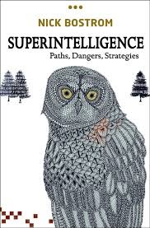
SUPERINTELLIGENCE
Bostrom, N. 2014. Superintelligence – Paths, Dangers, Strategies. Oxford University Press, Oxford, UK. (100 Global Thinkers)
Future of Life Institute: „Because of the great potential of AI, it is important to research how to reap its benefits while avoiding potential pitfalls“
Relations when computers surpass humans 3 forms of superintelligence: speed, collective, quality Intelligence can not be controlled Depending on the form, AI will be more or less dangerous Most dangerous: 1 global, conflict with humans

Slide 15
AI PROGRESS Generative Pre-trained Transformer 3 (GPT-3)
Wikipedia: An autoregressive language model that uses deep learning to produce human-like text, created by OpenAI. GPT-3's full version has a capacity of 175 billion machine learning parameters. GPT-3, which was introduced in May 2020, and is in beta testing as of July 2020.
The quality of the text generated by GPT-3 is so high that it is difficult to distinguish from that written by a human, which has both benefits and risks.
Is AI finally closing in on human intelligence? https://www.ft.com/content/512cef1d-233b-4dd8-96a4-0af07bb9ff60

Slide 16
DEFINITIONS OF INTELLIGENCE
Intelligence has been defined in different ways, including the abilities for abstract thought, understanding, communication, reasoning, learning, planning, emotional intelligence and problem solving.
Intelligence is most widely studied in humans, but has also been observed in animals and plants.
Artificial intelligence is the intelligence of machines or the simulation of intelligence in machines.
Numerous definitions of and hypotheses about intelligence have been proposed since before the twentieth century, with no consensus reached by scholars.

Slide 17
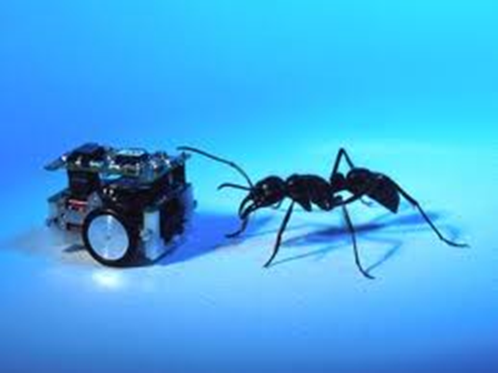
DEFINITIONS OF ARTIFICIAL INTELLIGENCE
Wikipedia: Artificial intelligence (AI) is the intelligence of machines and the branch of computer science that aims to create it.
AI textbooks define the field as "the study and design of intelligent agents"[2] where an intelligent agent is a system that perceives its environment and takes actions that maximize its chances of success.
[3] John McCarthy, who coined the term in 1956,[4] defines it as "the science and engineering of making intelligent machines."[5]
Types: Natural intelligence (humans, animals, plants), Artificial intelligence, Engineering intelligence.
Artificial intelligence has been the subject of breathtaking optimism, has suffered stunning setbacks and is today an essential part of the technology industry, computer science and IS.

Slide 18
DEFINITION OF INTELLIGENT SYSTEMS
Intelligent system is a system that learns during its existence. AI systems are intelligent systems.
It senses its environment and learns, for each situation, which action permits it to reach its objectives.
It continually acts, mentally and externally, and by acting reaches its objectives.
To reach its objective it has to select its response. A simple way to select a response is to select one that was favorable in a similar previous situation.

Slide 19
PROPERTIES OF INTELLIGENT SYSTEMS
Learning
Flexibility
Adaptation
Explanation
Discovery

Slide 20
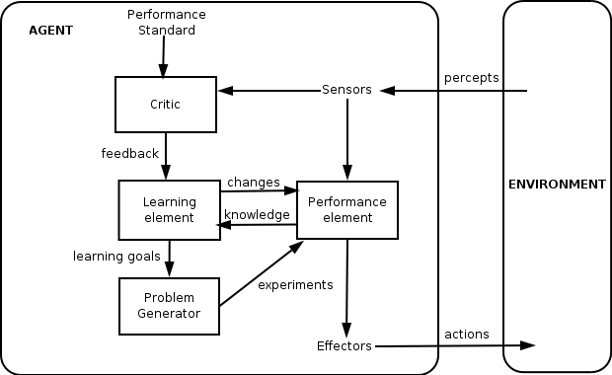
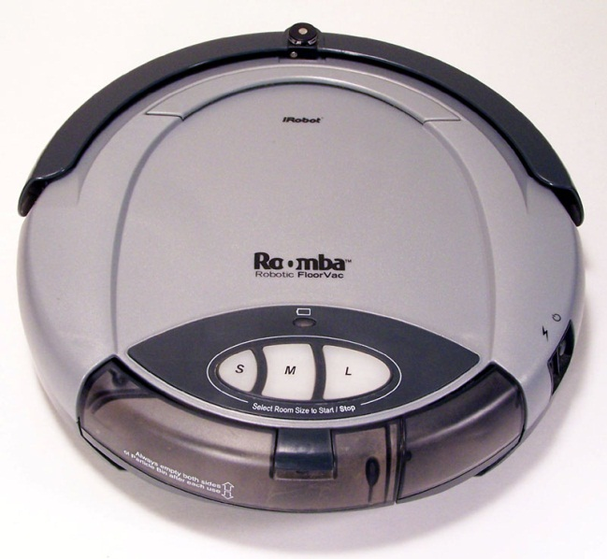
DEFINITION OF INTELLIGENCE
Definition: An intelligent entity is capable of learning. What learns is intelligent.
An intelligent entity is an intelligent system.
Engineering definition: More advanced than current classical solutions (may not learn).
According to Wikipedia: A thermostat is an intelligent agent.
Our definition: an intelligent agent learns.
An intelligent agent without learning is just an agent.

Slide 21
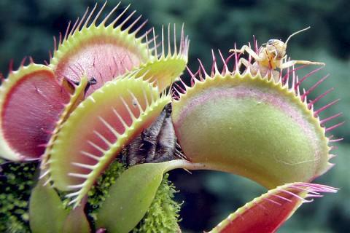
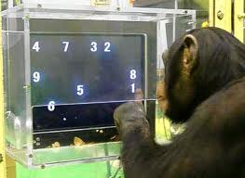
NATURAL INTELLIGENCE
Humans, animals, plants?
Are viruses intelligent?
All beings are!
Different levels of intelligence.
Sort dogs by intelligence.
Do animals really think?
Tools (birds, apes)
Joy, empathy, greed (apes, orkas, elephants, pigs)
Are animals getting smarter?
(humans + aliens?) (interactions with humans, wash food, crash walnuts)
Notes:
muholovka

Slide 22
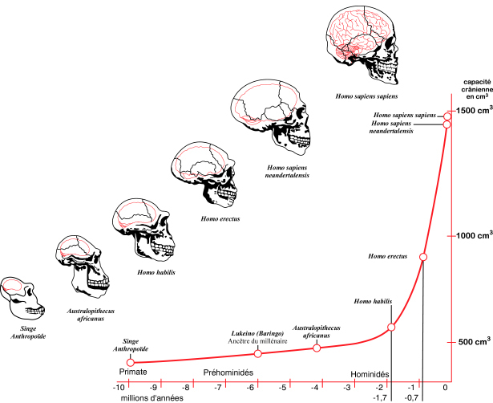
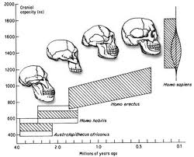
HUMAN INTELLIGENCE
Intelligence = better predictions, better reaction. More energy consumption – 25%.
Sexual attraction? Anthropological principle.
Tool evolution? INTELLIGENCE WINS! Complex issue

Slide 23
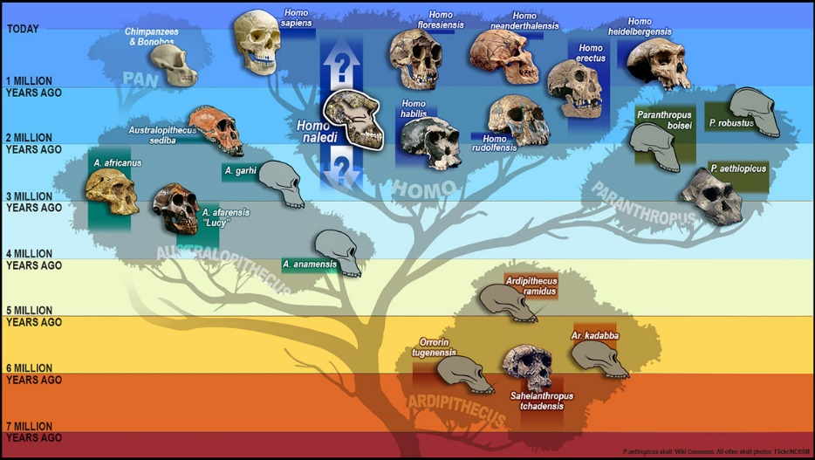
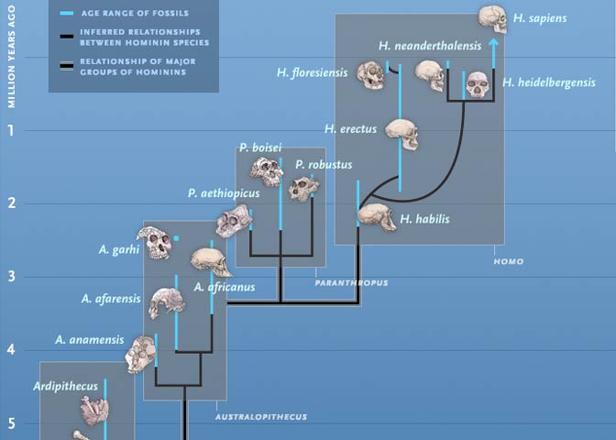
HUMAN INTELLIGENCE

Slide 24
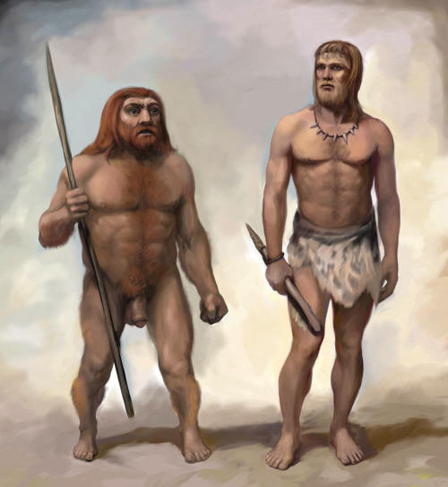
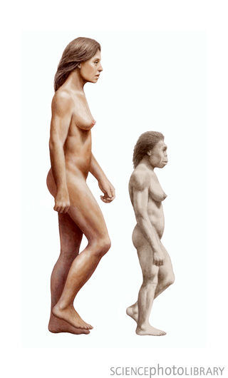
HUMAN (sub)SPECIES extinct
European Neanderthals (Denisovans)
Very similar to us, big brained
Europe 230.000-25.000 years
Reason: climate, our species
Genetic cross-breading with Europeans-us
Homo Floresiensis
Indonesian island 95,000 – 17,000 / 10.000 / 5.000 (folk saying)
1m, brain size of an orange
Folk saying: we burned them out
USA Indians 55-2, AU aborigins …
Sounds similar to animal extinctions?

Slide 25
Dwarf humans
Scientists have discovered a tiny species of ancient human that lived 18,000 years ago on an isolated island east of the Java Sea -- a prehistoric hunter in a "lost world" of giant lizards and miniature elephants.
These "little people" stood about three feet tall (1 m) and had heads the size of grapefruit. They coexisted with modern humans for thousands of years yet appear to be more closely akin to a long-extinct human ancestor.
Prebivalci okoliških vasi pripovedujejo zgodbe o teh „malih ljudeh“, ki so živeli v pečinah. Ženske so metale prsi čez rame. Ker so jim kradli otroke, so se njihovi predniki enkrat razjezili in jih požgali.

Slide 26
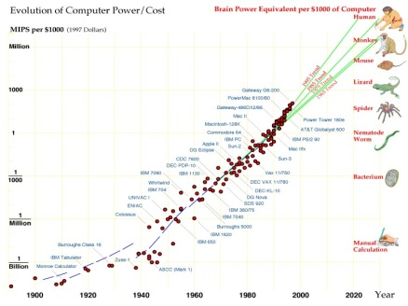
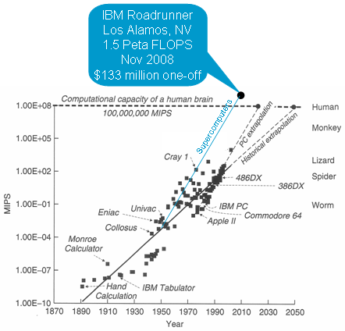
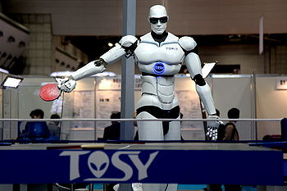
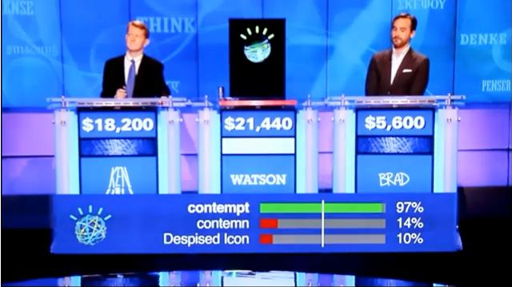
COMPUTERS
Chess, JEOPARDY …

Slide 27
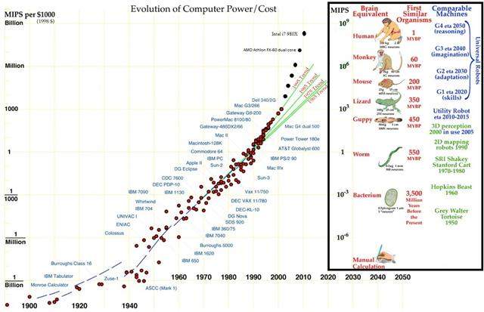
HUMAN INTELLIGENCE VS. COMPUTERS

Slide 28
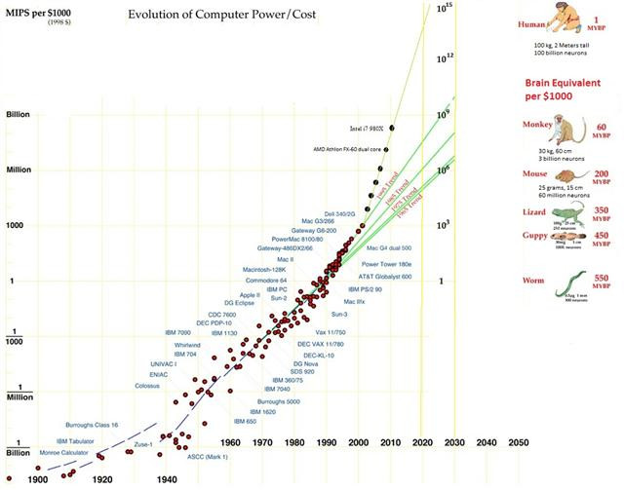
HUMAN INTELLIGENCE VS. COMPUTERS
Predictions failed

Slide 29
HUMAN/COMPUTER INTELLIGENCE
Kurtzweil
Kurtzweil
People + Computers = Information society
Flynn +30
Processing power
Drake’s equation
Computers
Human
Time
Computers are tools for enhancing our mental capabilities
Million times
Computers and robots are far less dangerous than real life
All doomsday talks failed to this day, but catastrophies do happen

Slide 30
Human-level intelligence ≠ AI
Unknown barrier

Slide 31
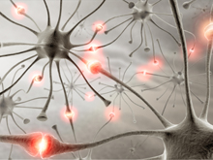
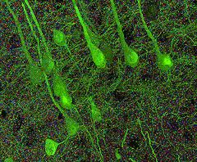
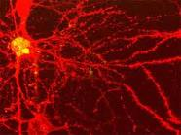
Humans are smart! NEURON different than of animals
Connected to 10.000 each, a switch? Stanford 2010: … the brain’s overall complexity is almost beyond belief, said Smith. “One synapse, by itself, is more like a microprocessor —with both memory-storage and information-processing elements — than a mere on/off switch. In fact, one synapse may contain on the order of 1,000 molecular-scale switches. A single human brain has more switches than all the computers and routers and Internet connections on Earth,” he said.
…neuroscientists uncovered strong evidence that neurons also communicate with each other through weak electric fields. The study, published in the journal Nature Neuroscience, by Dr Costas Anastassiou (Caltech), explains how every time an electrical impulse races down the branch of a neuron, a tiny electric field surrounds that cell ..

Slide 32
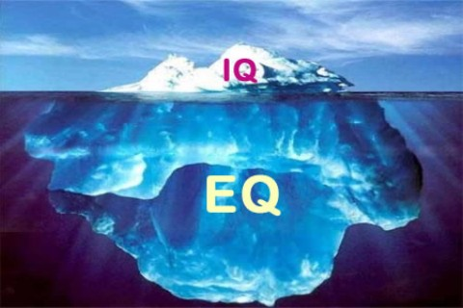
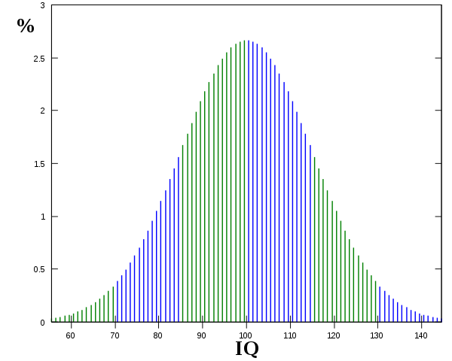
HUMAN INTELLIGENCE
10-30 types of intelligence: general, symbolic, emotional, abstract, motion, visual, speech, read-write, music …
Emotional intelligence (EI) is a skill or ability in the case of the trait EI model, a self-perceived ability to identify, assess, and control the emotions of oneself, of others, and of groups. Various models and definitions have been proposed of which the ability and trait EI models are the most widely accepted in the scientific literature. Criticisms have centered on whether the construct is a real intelligence and whether it has incremental validity over IQ and the Big Five personality dimensions.
Flynnov effect / smarter people have less children
IQ tests of different kinds: specific, integral … Advanced

Slide 33
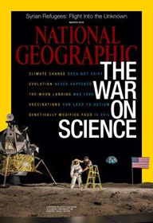
HUMAN INTELLIGENCE
IQ is the best single predictor of success at job. People with higher IQ have higher title, status, income, live longer and healthier. And vice versa.
(W: individuals with low IQs are more likely to be divorced, have a child out of marriage, be incarcerated, and need long-term welfare support).
What is this – a political lecture?? This is too sensible?
The world is not as it seems! (commercial, political, popular, semi-popular, scientific)
Science, facts, empirical verification, platonism Engineers: Science should deal with relevant issues. What is your opinion?

Slide 34
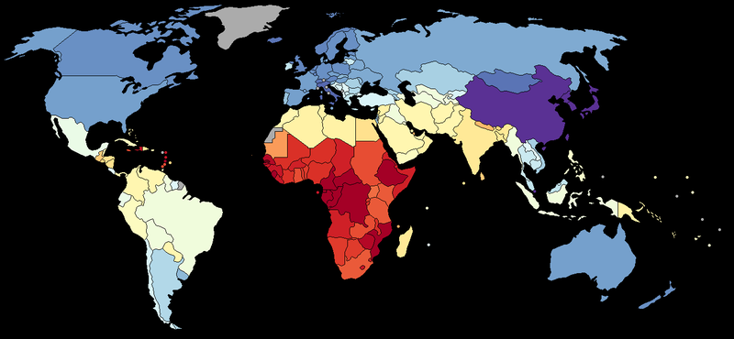
DISTRIBUTION OF HUMAN INTELLIGENCE
DISTRIBUTIONS: big/small, man/woman, religious, use of browser … no major difference! Is study of regional intelligence allowed (ideology?; Take care!)

Slide 35
DISCUSSION
What is intelligence?
What is science/ scientific and what not?
A superior level of understanding
and predictions
Knowledge and intelligence enable better predictions and performance

Slide 36
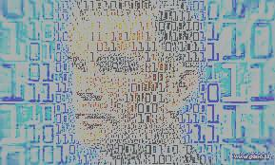
The Intelligent Future is Near
Matjaž Gams
Institut “Jožef Stefan”

