Slide 1
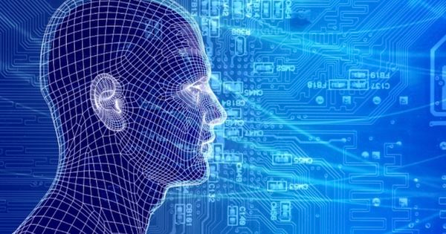

Information society, AI, superintelligence, agents, BI, AmI, cognitive science
Overview
Matjaž Gams
Institut „Jožef Stefan“

Slide 2

COURSE
INTELLIGENT SYSTEMS
ARTIFICIAL INTELLIGENCE AI, a modern approach
framework first
Information society, science, …
Intelligence

Slide 3
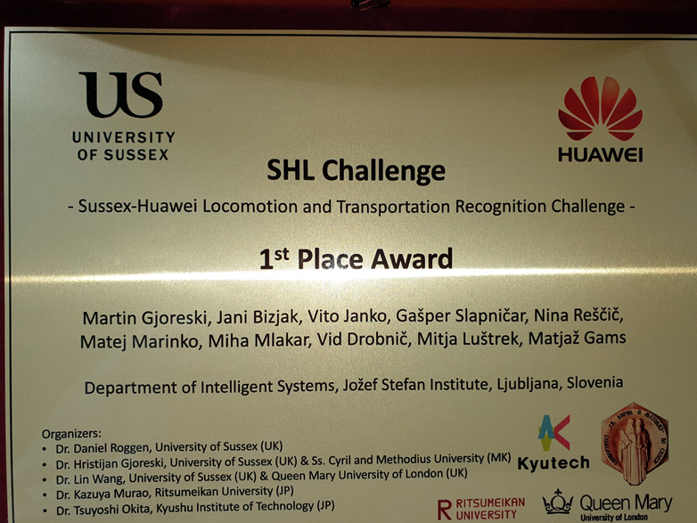
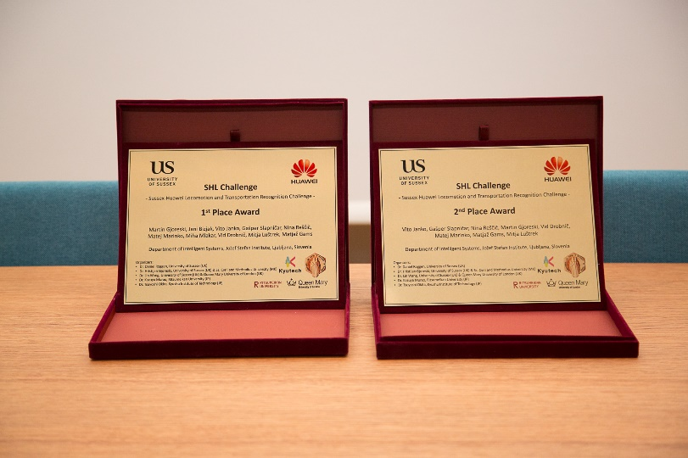
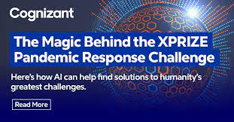
World-wide competitions Sussex-Huawei, XPRIZE 250.000 $
6 out of 10
JSI XPRIZE VIDEO: https://video.arnes.si/watch/r14bzpjl19z2

Slide 4
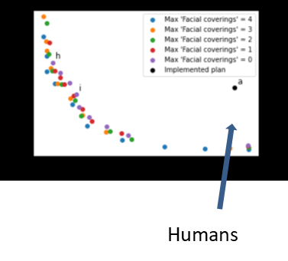
Show COVID-19 progress months in advance and find best measures – program sent to all EU ministries
20% better than humans! Which methods? Multiple knowledge use of AI

Slide 5
DEFINITIONS
Science
Intelligence – learning sufficient, more specific
Information society – 30 laws
Artificial intelligence – intelligence on artificial sy., learn
Superintelligence – superior to humans
Intelligent systems – most of 5 properties, softer than AI
Ambient intelligence – AI in environment
Business intelligence – AI in business, competitive intell.
(Intelligent) agents – 5 types, properties
Cognitive science – 5 axioms, IIT, Tononi

Slide 6


Basic relations:
Humans versus computers
Kurtzweil
humans
+
computers
processing power
Fermi paradox
computers
humans
Moore’s law
time
Notes:
Nora rast znanosti bo pripeljala v teorijo singularnosti, v nove fantastične čase. Flaynnov učinek – ljudje so čedalje pametnejši. So pa morebitni problemi, npr. Fermijev paradoks.

Slide 7
Humans versus computers
Superintelligence
Kurtzweil
humans
+
computers
processing power
Fermi paradox
computers
humans
Moore’s law
General AI
time
Notes:
Nora rast znanosti bo pripeljala v teorijo singularnosti, v nove fantastične čase. Flaynnov učinek – ljudje so čedalje pametnejši. So pa morebitni problemi, npr. Fermijev paradoks.

Slide 8
Generative, general AI
Kurtzweil
humans
+
computers
processing power
Fermi paradox
computers
humans
Moore’s law
General AI
time
Notes:
Nora rast znanosti bo pripeljala v teorijo singularnosti, v nove fantastične čase. Flaynnov učinek – ljudje so čedalje pametnejši. So pa morebitni problemi, npr. Fermijev paradoks.

Slide 9

Humans versus computers
Kurtzweil
humans
+
computers
processing power
Fermi paradox
computers
humans
Moore’s law
time
Notes:
Nora rast znanosti bo pripeljala v teorijo singularnosti, v nove fantastične čase. Flaynnov učinek – ljudje so čedalje pametnejši. So pa morebitni problemi, npr. Fermijev paradoks.

Slide 10
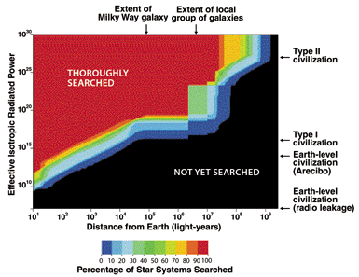

Human longevity - Fermi paradox
Drake equation : civilizations should be abundant – Fermi : where??
Short span??

Slide 11
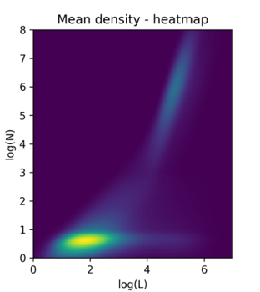
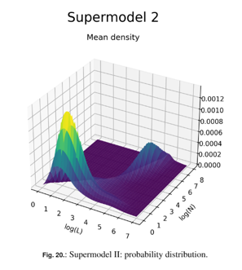
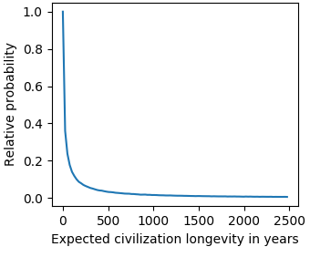
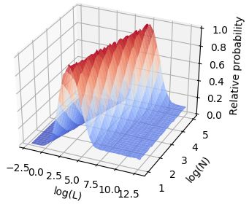
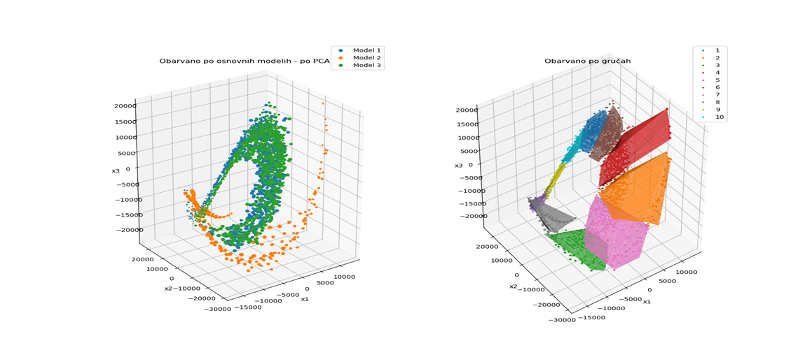
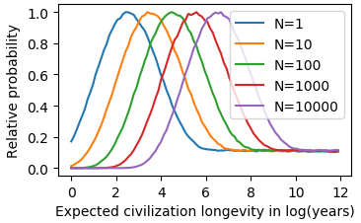
Human longevity – 1.000 to 10.000 years
go to other planets or perish
11

Slide 12
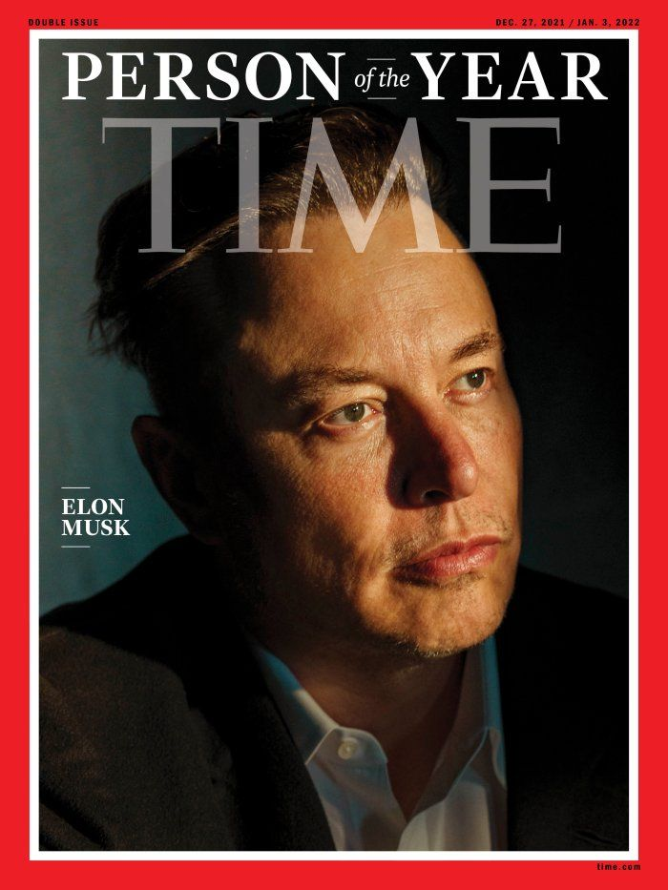
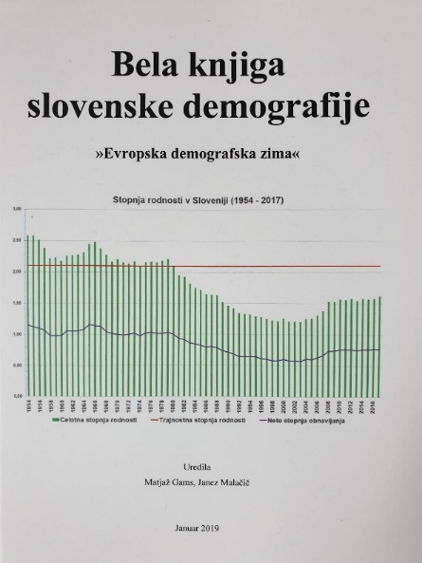
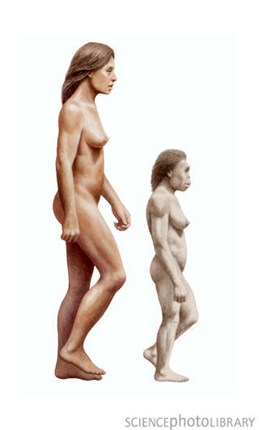
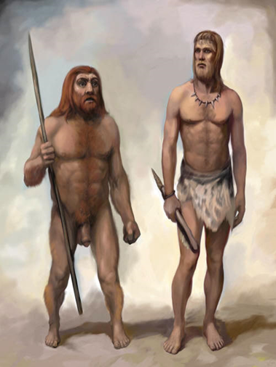

The world we live in?
Potencial civilization problems
1. Superinteligence
2. Nuclear war
3. Environment destruction
4. Eu demographic winter
5. Biological agents
6. Human activity
Vesoljci H
Planetarno-vesoljski

Slide 13
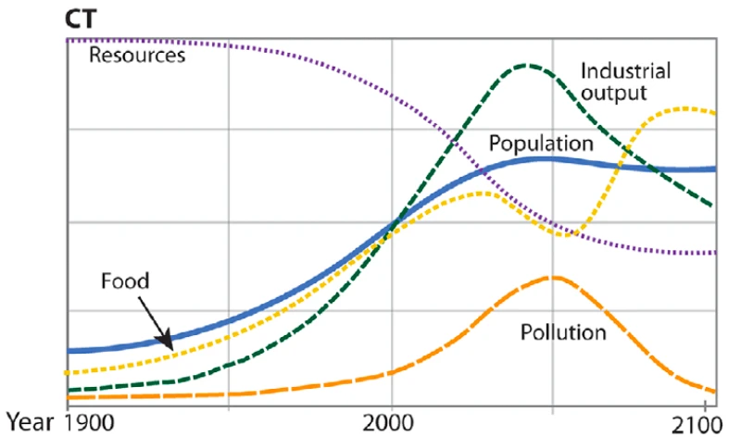
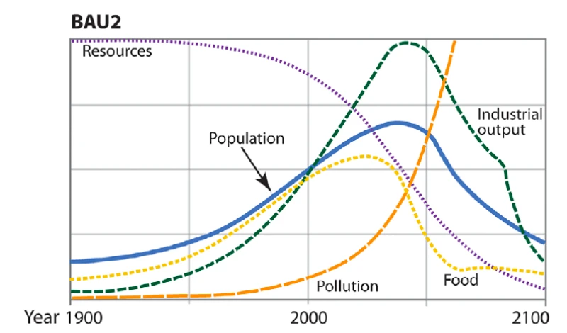
MIT: Realistic? / pessimistic
1. Superinteligence
2. Nuclear war
3. Environment destruction
4. Eu demographic winter
5. Biological agents
6. Human activity
Vesoljci H
Planetarno-vesoljski

Slide 14
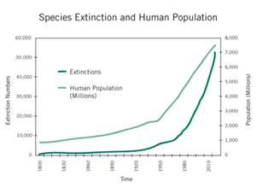
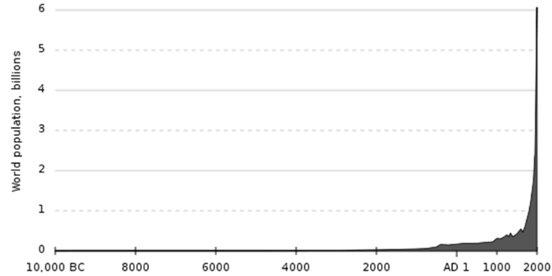


Demography / environment: Fast human growth will destroy human civilisation – exponential
Fertility 5: 13 gen. 1 per m2
Animal extinction 100x faster
In 40 years 50% animals less
2% wild mammals
In 27 years in Germany 75% less
flying insects
Our book: speed limit, no HW commercials,
invasive species hunt, no sun plants on fertile land, rewild your garden …
No costs, just awareness // nuclear - costs
40 gen. 1 per 1 kg planet

Slide 15
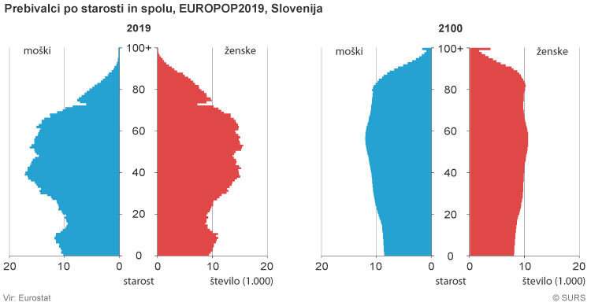
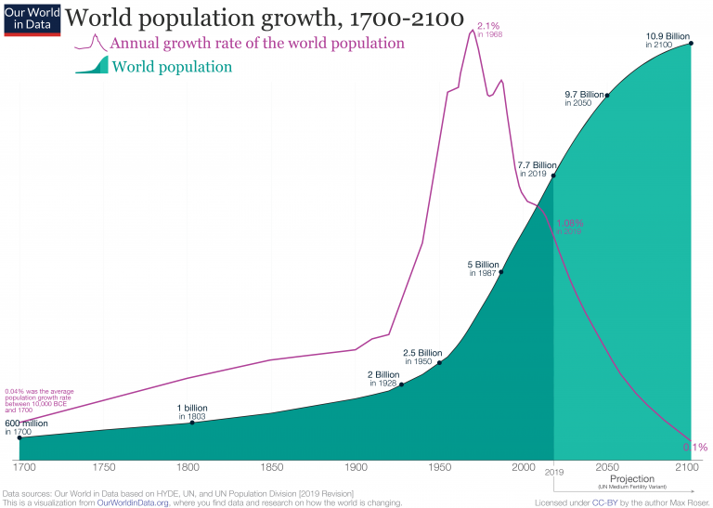
Potencial civilization problems
1. Superinteligence
2. Nuclear war
3. Environment destruction
4. Eu demographic winter / extinction of smaller EU nations in several 100 years
5. Biological agents
6. Human activity
Vesoljci H
Planetarno-vesoljski

Slide 16
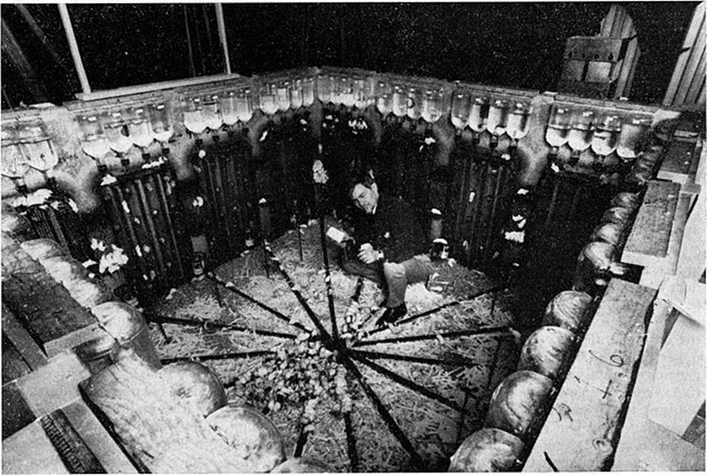
Potencial civilization problems /extinctions
Humans will destroy themselves / mouse utopia
1. Superinteligence
2. Nuclear war
3. Environment destruction
4. Human civilization decline
5. Biological agents
6. Social decline
Vesoljci H
Planetarno-vesoljski

Slide 17
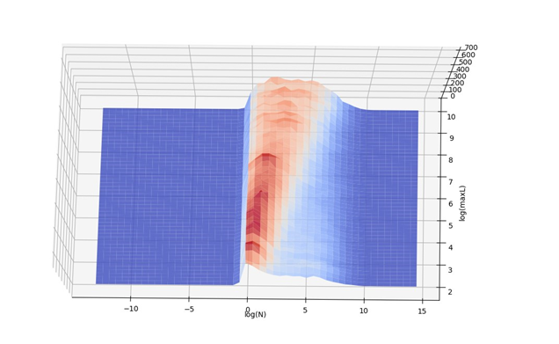
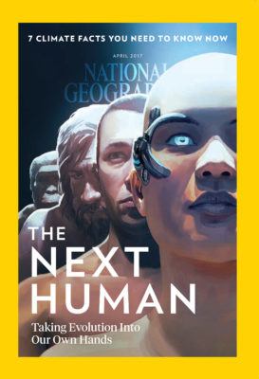
HUMAN PROGRESS
Drake, Fermi – longevity (UN)
Oxford (Wikipedia): 19% till 2100
molecular, nano 5%
superintelligence 5%
wars 5%
desease 2%
societal decline ?
Avoid danger – act!
- stop killer robots
- not plant / human / animal /aliens,
but special category to robots
- demography
- climate, environment: rewild your garden
- go to other planets

Slide 18
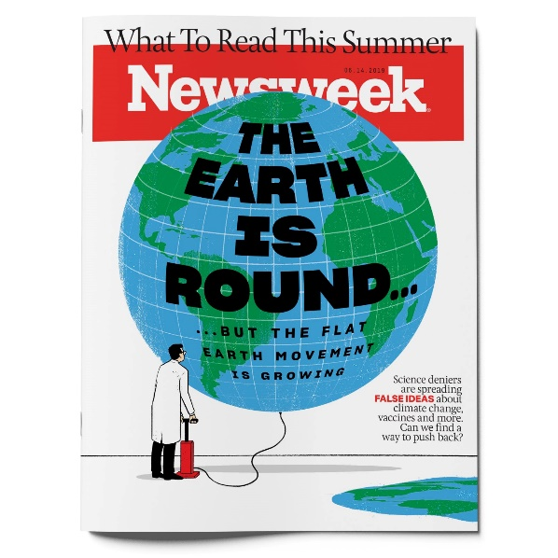
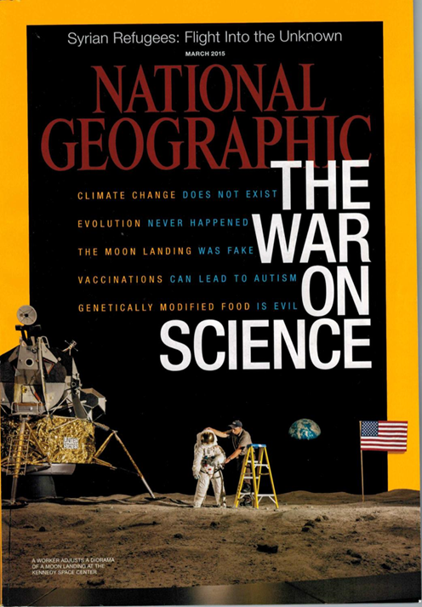
Basics about science
Platonisms – facts exist regardless of source
A lot is unknown (universe …)
Truth – science – semi-popular – popular –
politics, pub ; Media ?? Fake news, science
Myths:
No global warming
Vaccionating dangerous
The Earth is flat
Trump IQ ?
Women earn less than men
take care: dangerous
IQ of race // censorship
Wikipedia - partially, sc. papers, experts,
Google if used properly??

Slide 19
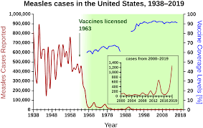
Vaccine hesitancy
Contents
1 Effectiveness
1.1 Population health
1.2 Cost-effectiveness
1.3 Necessity
2 Common themes
2.1 Autism
2.2 Vaccine overload
2.3 Prenatal infection
2.4 Ingredient concerns
2.5 Sudden infant death syndrome
2.6 Anthrax vaccines
2.7 Swine flu vaccine
2.8 Other safety concerns
2.9 Muslims
2.10 Other vaccine myths
3 Events following reductions in vaccination
3.1 Stockholm, smallpox (1873–74)
3.2 Vietnam
3.3 UK, pertussis (1970s–80s)
3.4 Sweden, pertussis (1979–96)
3.5 Netherlands, measles (1999–2000)
3.6 UK and Ireland, measles (2000)
3.7 Nigeria, polio, measles, diphtheria (2001–)
3.8 United States, measles (2005–)
3.9 Wales, measles (2013–)
3.10 United States, tetanus
3.11 Romania (2016–present)
3.12 Samoa, measles (2019)
4 Approach
5 History
5.1 Variolation
6 Smallpox vaccination
6.1 England
6.2 United States
6.3 Brazil
7 Later vaccines and antitoxins
8 Epidemiology
9 Policy implications
9.1 Individual liberty
9.2 Children's rights
10 Religion
11 Alternative medicine
11.1 Chiropractic
11.2 Homeopathy
12 Financial motives
13 War
13.1 Spanish–American War
14 Information warfare
15 See also
16 References
17 Further reading
18 External links
Measles 140.000 v 2018
Vaccine hesitancy, also known as anti-vaccination or anti-vax ... It is identified by the World Health Organization as one of the top ten global health threats of 2019.[1][2] … Vaccine hesitancy often results in disease outbreaks and deaths from vaccine-preventable diseases.[10][11][12][13][14][15] … Discussion: … As a result, in 1999, the Centers for Disease Control (CDC) and the American Academy of Pediatrics (AAP) asked vaccine makers to remove thiomersal from vaccines …. Thiomersal is now absent from all common US and European vaccines …
3-5 million
19
Notes:
*
07/16/96
*
##

Slide 20
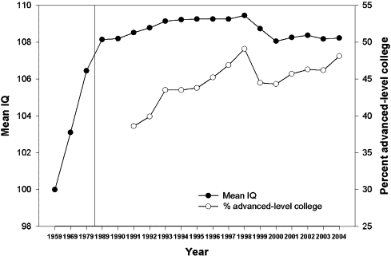
Is ideology hurting science and civilization
Flynn effect, fake science (1+1 subjective?)
Media, Web … stronger influence than communistic party in ex-Yu
THE SOCIAL DILEMMA (Google), AI + marketing + supercomputers
40 years science against smoking companies (5 million deaths)
20
Notes:
*
07/16/96
*
##

Slide 21


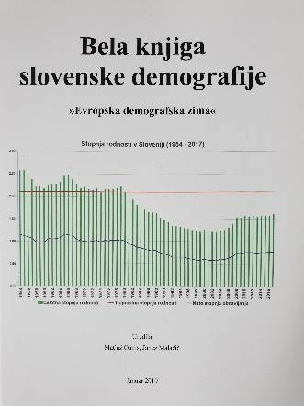
Where is the truth?
known, true known, untrue
unknown
BOJADŽIEV, D., GAMS, M. Addendum to "Sloman's view of Gödel's sentence". Artif. intell., 1998, vol. 98
21
Notes:
*
07/16/96
*
##

Slide 22
Where is the truth?
known, true known, untrue
nobody knows
BOJADŽIEV, D., GAMS, M. Addendum to "Sloman's view of Gödel's sentence". Artif. intell., 1998, vol. 98
WIKIPEDIA (non-political!)
complicated
22
Notes:
*
07/16/96
*
##

Slide 23
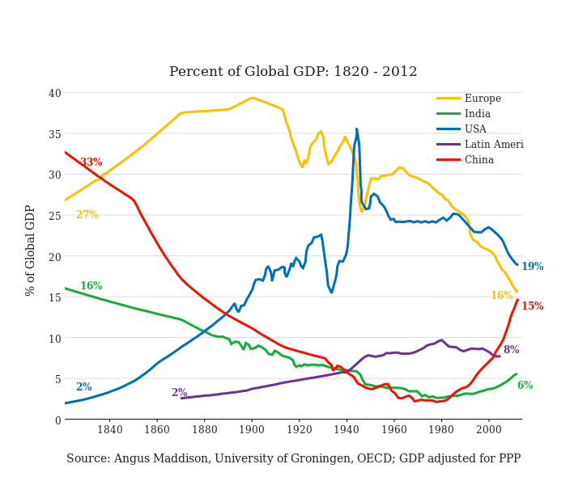
A COUPLE OF PREDICTIONS
WORLD SHARE
50% of Chinese

Slide 24
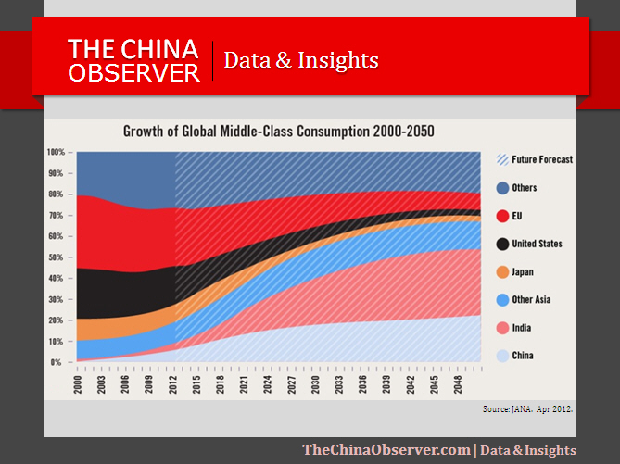
Middle-class consumption

Slide 25

Three worlds with different properties
Intelligent systems - integration of the three
ELECTRONIC WORLD
Collapse of time, space.

Slide 26
Information society
Moore’s law (exponential growth of chip capabilities)
Makimoto’s law (10-year cycle of semiconductors)
Metcalf’s law: value(network) = square(no. of nodes) or n*logn /Odlyzko (size of network is very important)
Keck’s, Sidgemor’s law (exponential growth of net traffic, capabilities)
Groschs’law (cost equals sq. root (speed))
Amdahl’s law (T=S/R + P/(M*R))
Andreesen Lewis Fleming... net capitalism
Computer Laws revisited, Computer, December 2013, vol. 46, no. 12

Slide 27
IS laws I
2. Joy's Law: The maximum speed of a computer doubles every year (Wikipedia).
3. Pollack's law: the capacity of microprocessors increases…
4. Bell's law: about every decade, a new, cheaper class of computers appears…
5. Kryder's law: disk capacity increases exponentially (Wikipedia).
6. Makimoto's Law: There is a 10-year cycle between research and market penetration
7. Metcalf's law: value (network) = square (no. Of nodes) or n * log (n) according to Odlyzko
8. Keck's law: communication skills (actual traffic) grow exponentially
9. Gilder's law or the law of telecommunications: the total capacity of the telecommunications system (b / s) is tripled every three years
10. Koomey’s law: the number of calculations on the energy discharged doubles about every 1.5 years
11. Linus' law: given a sufficiently large base of testers and developers, almost every problem will be quickly identified and the weaknesses eliminated
27

Slide 28
IS laws II
12. Amdahl's law: there is always a part of the problem that cannot be distributed in parallel
13. Gustafson's law addresses the shortcomings of Amdahl's law
14. Grosch or Cray's law: added value is proportional to the square root of the increase in velocity
15. Rock or Moore's Law: the cost of a semiconductor chip plant doubles every four years
16. Wirth or Pagev or Gates or May law: software gets slower faster than hardware gets faster
17. Legislation of Andreessen or Lewis or Fleming or network capitalism: the post-industrial economy is transformed into a friction-free economy
18. The cyber world doubles wealth real or fictional
19. A side effect of the information society is the overloading of people with information
20. The Internet is the most democratic and free medium in the world
21. The information society belongs to all of us, or at least should
28

Slide 29
Exponential laws
1 mm, each step x10
ICT enables progress of human civilisation!
Pushing forward with fantastic speed
29

Slide 30
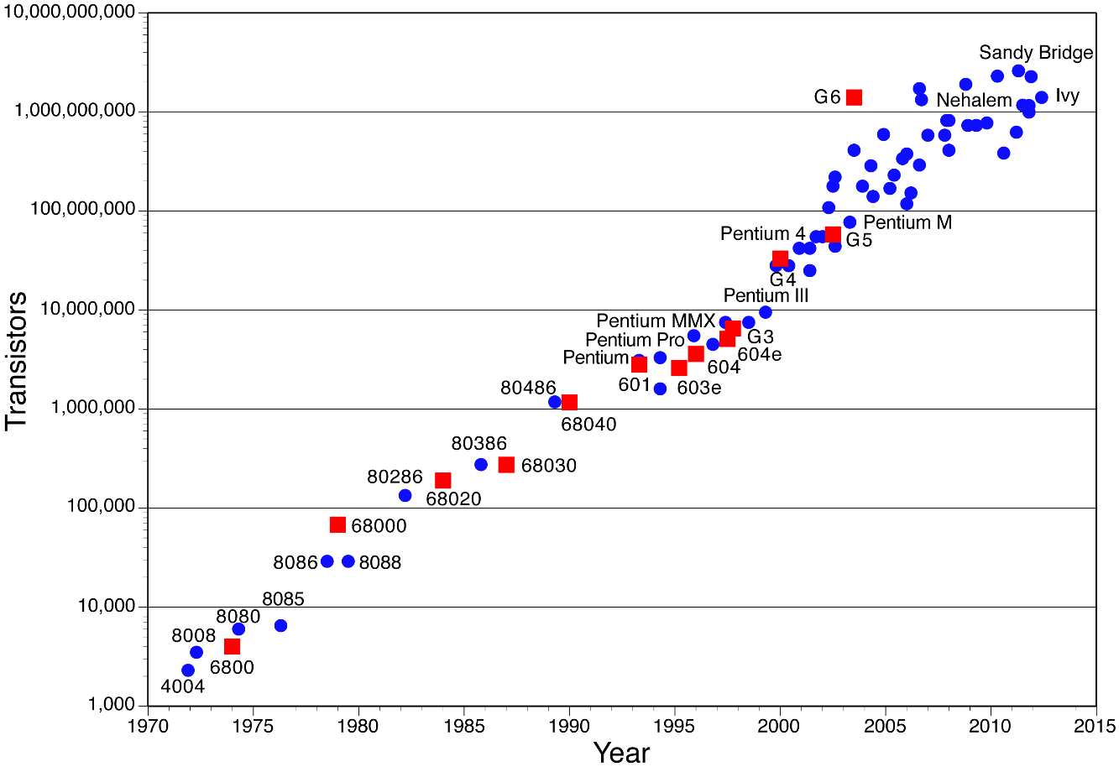
Moore’s law
Exponential growth; Moore’s law : 51 let, „power of chips“ + 50% yearly (corn 2%), Transistors: 1 per 1 m of diameter of Milky way (our galaxy)
Steps: 1mm, 1 dm … universe
Pushing human progress forward: yearly +50% (corn 2%)
HW stalling, lots of room; amazing progress!!

Slide 31
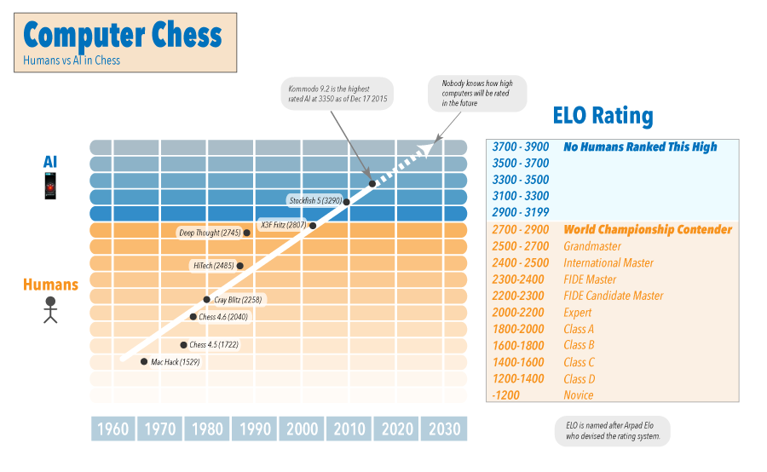
Computer chess

Slide 32
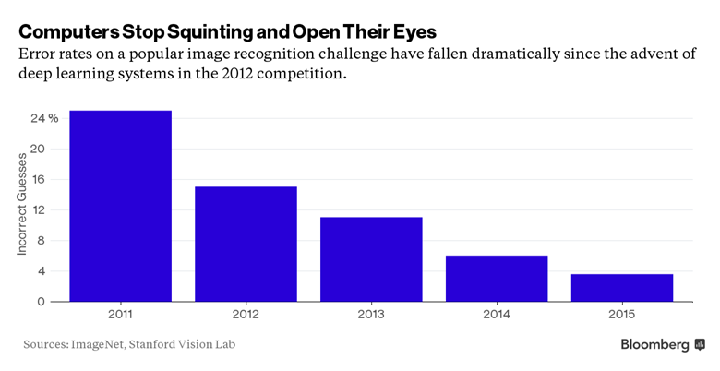
THE INFLUENCE OF AI
M. Kosinski, Y. Wang, Stanford university
2017 Journal of Personality and Social Psychology,
91% man homo or hetero, 83% women homo or hetero
20% better than humans, AI teaches humans like in chess?
AI helps solve mathematical problems
Predict Covid from cough (MIT)
Autonomous cars
Robots
Google
…..
100 trillion decisions daily

Slide 33
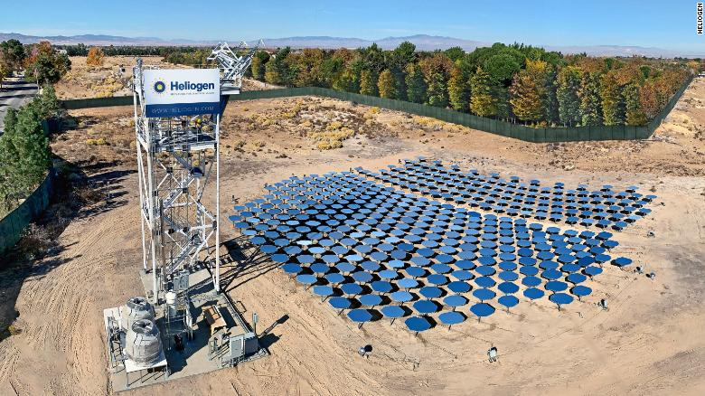
THE INFLUENCE OF AI
- Bill Gates-Backed Startup Uses AI to
Create Solar Rays Hot Enough to Melt Steel
- Artificial intelligence can predict a person’s chances of dying within a year by looking at heart test results – even when they look normal to doctors. How it does so is a mystery. AI with examining 1.77 million electrocardiogram (ECG) results from nearly 400,000 people to predict who was at a higher risk of dying within the next year.
- Between 2018 and 2019, organizations that have deployed artificial intelligence (AI) grew from 4% to 14%, according to Gartner’s 2019 CIO Agenda survey. Conversational AI remains at the top of corporate agendas spurred by the worldwide success of Amazon Alexa, Google Assistant and others. Meanwhile, new technologies continue to emerge such as augmented intelligence, edge AI, data labeling and explainable AI.

Slide 34
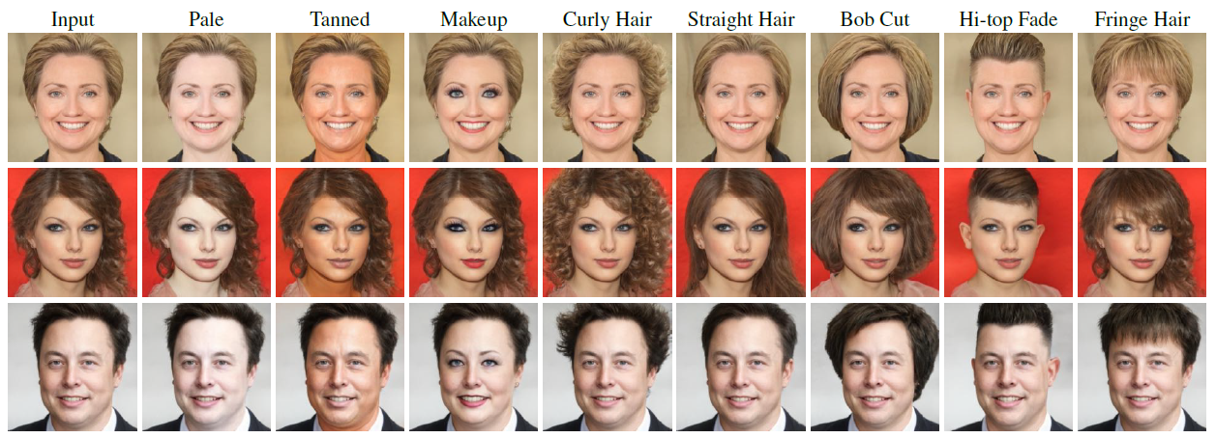
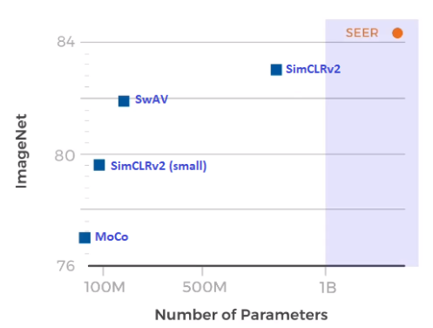
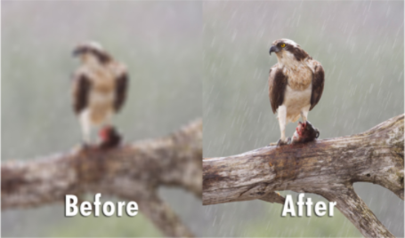
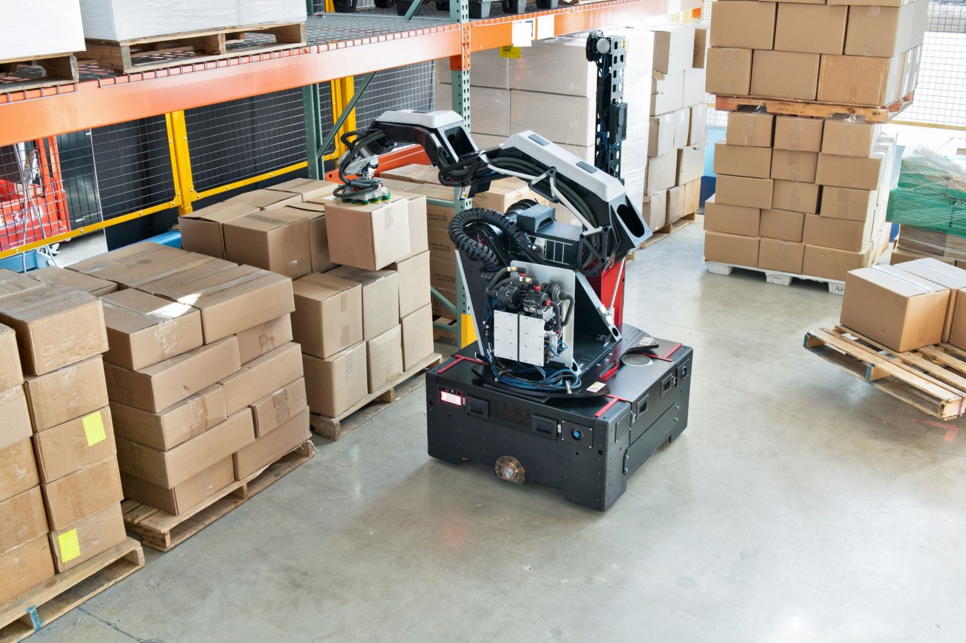
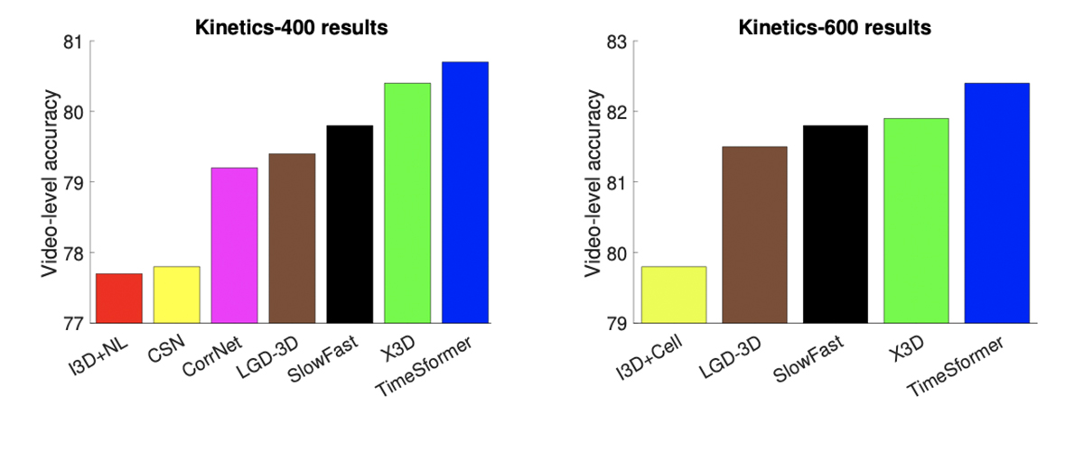
2021 AI https://data-science-ua.com/blog/top-ai-achievements-of-2021-so-far
DALLE-E from GPT3, OpenAI, images from text; Google better than GPT3?
CLIP, OpenAI, generate description from pictures, better than Imagenet, Resnet;
with StyleGAN:
SEER, Facebook AI
image Multi-purpose robot, Boston Dynamics
restoration Facebook AI; video

Slide 35
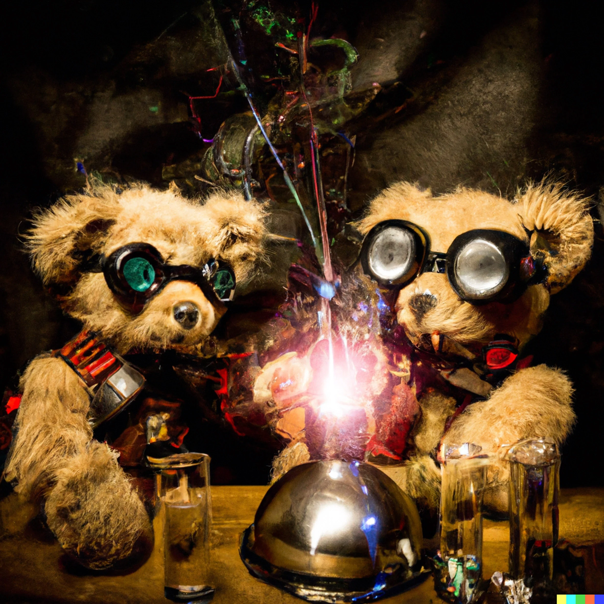


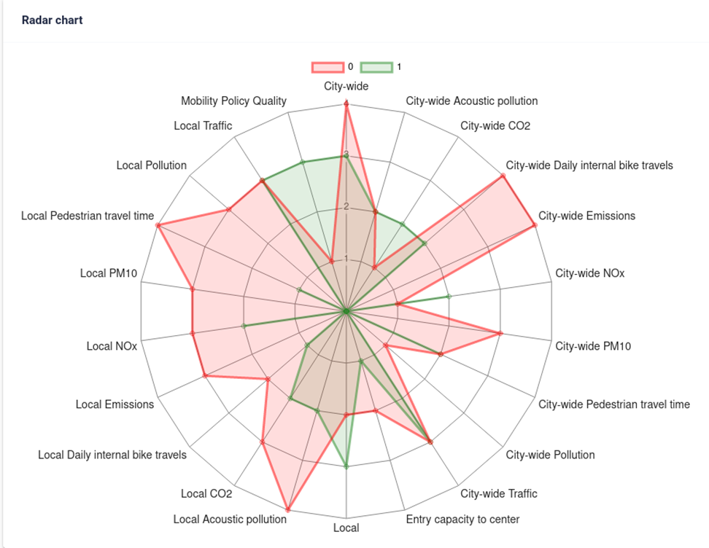
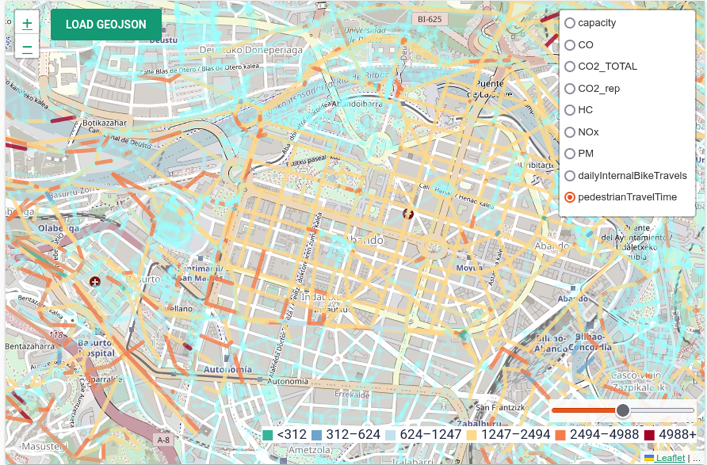
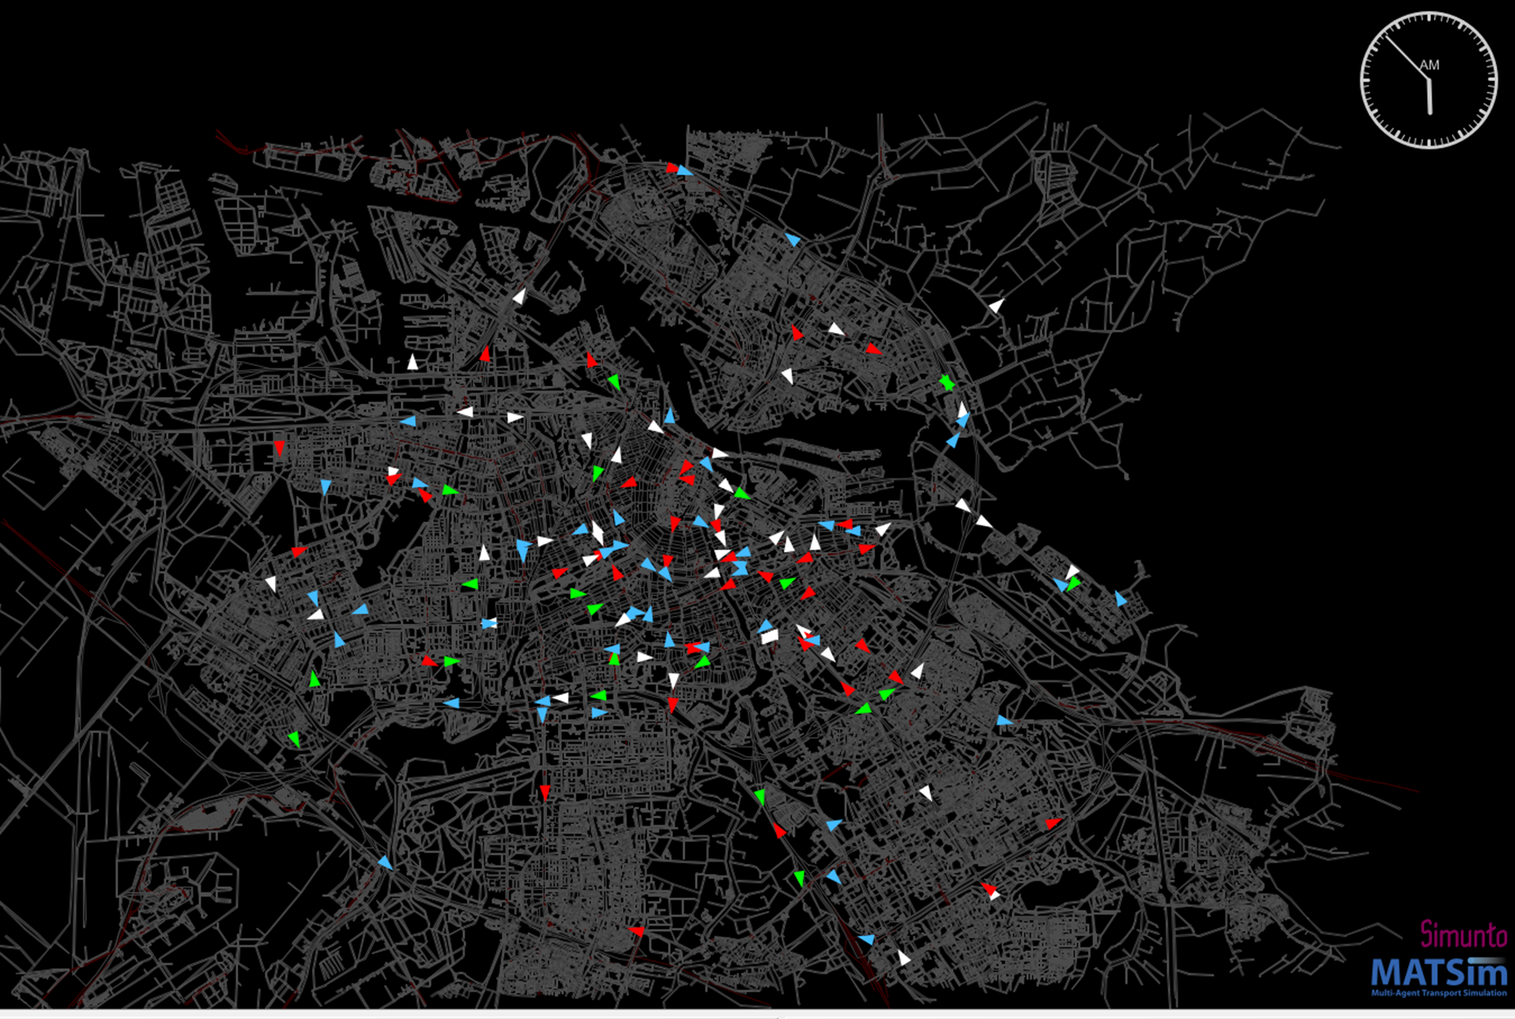
Creative AI IJCAI-ECAI report: emerginghttps://www.informatica.si/index.php/informatica/article/view/4366/1899
Human master smart city algorithm
Human partner cmart city autonomous companion
Example: Dalle: "teddy bears mixing sparkling chemicals
as mad scientists in a steampunk style"
Smart city: "find best closure of 1 or many city district for cars"
(Pareto front with several best solutions)

Slide 36
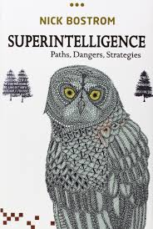
Razvoj človeštva

Slide 37
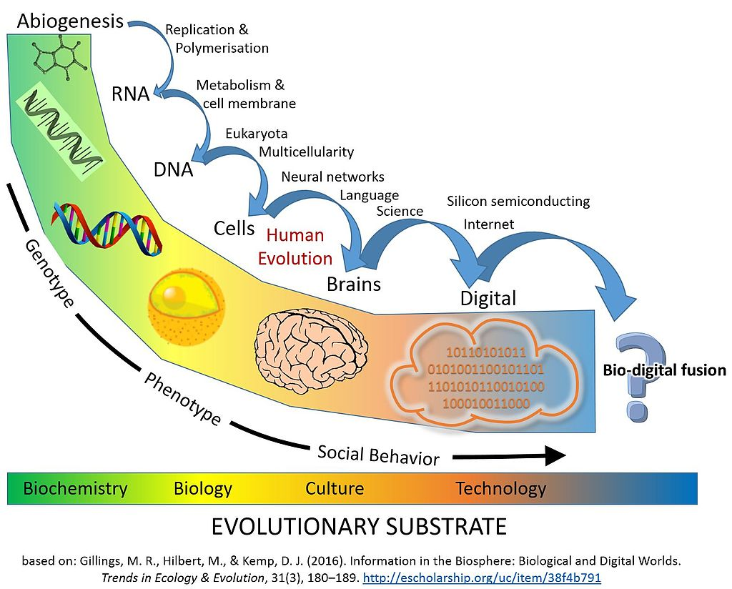
Information society
2 merges:
individual
society

Slide 38
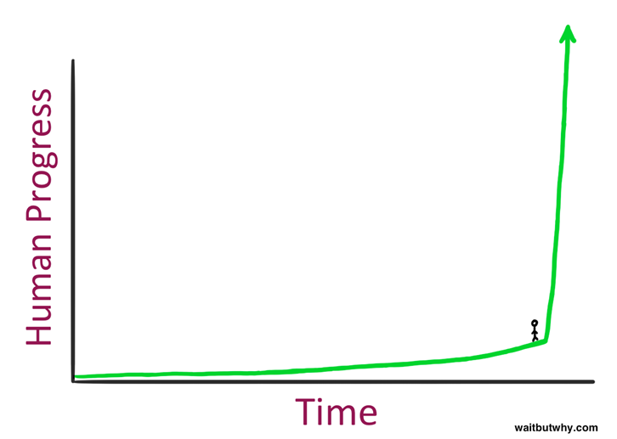
Singularity / superintelligence
John von Neumann 1959 first use
2005 book, The Singularity is Near, Ray Kurzweil, Google director for engineering, patents,
The singularity: AI will make humans sexier and funnier, says Google expert
How AI is going to cure our sick health care system. The doctor will see you now.
AI will have 10 times the
impact of any technology in history
in one-fifth the time.
Jump-up will be very fast / singular
(like flying)

Slide 39
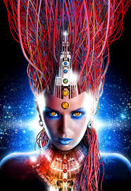
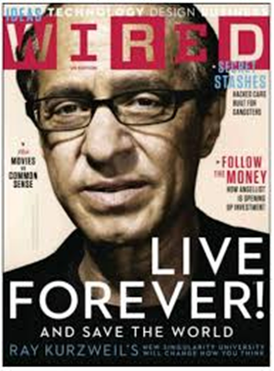
Superintelligence - Humans
AI will have 10 times the impact of any technology in history
in one-fifth the time / autonomous cars 9x safer
Human + computer (robot) merging
Programming ourselves at molecular level
Elon Musk Neuralink Startup To Connect
Your Brain to the Internet
human+internet, human-diseases, live forever ?
3D printing of tissue, organs, stem cells
When? Kurzweil: 2029
Predictions: 10-100 years

Slide 40
Future ?

Slide 41

Unbelivable progress!

Slide 42

Unbelivable progress!
Dangers ahead – mysterious
(hyperglobalisation)

Slide 43
Unbelivable progress!
Dangers ahead – mysterious
(hyperglobalisation)
Superintelligence is our savior!

Slide 44

Thank you
Matjaž Gams

