Slide 1
Cognitive Sciences Materials for further study
Vedrana Vidulin
vedrana.vidulin@ijs.si
Jožef Stefan Institute, Ljubljana, Slovenia
13.1.2014

Slide 2
Content
Courses in cognitive sciences
Lectures
Cognitive architectures

Slide 3
Courses (1)
MIT – Department of Brain and Cognitive Sciences http://ocw.mit.edu/courses/brain-and-cognitive-sciences/index.htm
Aim of the proposed courses: to study the human brain by combining the theoretical power of computational neuroscience and cognitive sciences with the experimental technologies of neurobiology, neuroscience, and psychology.
Undergraduate and postgraduate courses with online materials:
Computational Cognitive Science (1, 2)
Introduction to Computational Neuroscience
Probability and Causality in Human Cognition

Slide 4
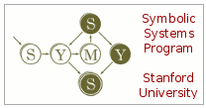
Courses (2)
Stanford University – Symbolic System Program http://symsys.stanford.edu
Focuses on computers and minds: artificial and natural systems that use symbols to communicate, and to represent information.
Undergraduate and master‘s degree courses in:
cognitive science
artificial intelligence
human-computer interaction
Example courses:
Introduction to Cognitive and Information Sciences
Research Methods in the Cognitive and Information Sciences
Cognition in Interaction Design, etc.

Slide 5
Courses (3)
CMU and UP – Center for the Neural Basis of Cognition http://www.cnbc.cmu.edu
Aim is to investigate cognitive and neural mechanisms that underlie biological intelligence and to transfer the knowledge to the areas of artificial intelligence, robotics, education and medicine.
Undergraduate and postgraduate courses:
Statistical Methods for Neuroscience and Psychology
Cognitive Robotics
Applications of Cognitive Science, etc.

Slide 6
Courses (4)
Cognitive Science Society – Academic programs in Cognitive Science http://cognitivesciencesociety.org/study_programs.html
Free online courses related to the topics in cognitive science at Coursera:
Computational Neuroscience – University of Washington
Synapses, Neurons and Brains – The Hebrew University of Jerusalem
Artificial Intelligence Planning – University of Edinburgh
Natural Language Processing – Stanford University
Machine Learning – Stanford University

Slide 7
Lectures
Cognitive Science and Machine Learning Summer School (MLSS), Sardinia 2010
Joshua B. Tenenbaum, Department of Brain and Cognitive Sciences, MIT - What is cognitive science? http://videolectures.net/mlss2010_tenenbaum_csfml/
Nick Chater, Department of Psychology, University College London Tom Griffiths, Computational Cognitive Science Lab, Department of Psychology, UC Berkeley - Cognitive science for machine learning http://videolectures.net/mlss2010_chater_csfml/

Slide 8
Cognitive architectures
Cognitive architectures are tools for modeling intelligent systems, enabling design and implementation of capabilities characteristic for human intelligence.
Perception
Recognition
Decision making
Prediction & monitoring
Environment
Problem solving & planning
Reasoning
Remembering, reflection & learning
Action execution
Interaction & communication

Slide 9
Cognitive architectures (2)
A short introduction into cognitive architectures (8:43 – 19:10)
Langley, P., Laird, J.E., and Rogers, S. Cognitive architectures: Research issues and challenges, Cognitive Systems Research 10 (2009) 141-160.

Slide 10
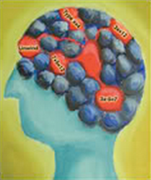
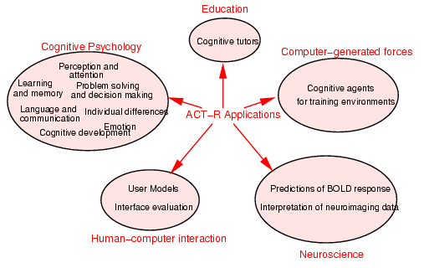
ACT-R
ACT-R (http://act-r.psy.cmu.edu) was constructed with the primary aim to simulate and understand human cognition.
(Source: http://act-r.psy.cmu.edu)

Slide 11
SOAR
SOAR (http://sitemaker.umich.edu/soar) was constructed with the primary aim to develop computational systems that exhibit intelligent behavior.
Characteristics:
work on the full range of tasks expected of an intelligent agent, from highly routine to extremely difficult, open-ended problems
represent and use appropriate forms of knowledge, such as procedural, semantic, and episodic
interact with the outside world, and
learn about all aspects of the tasks and its performance on them.
A short introduction into SOAR cognitive architecture (25:47 – 28:15)

