Slide 1
ARTIFICIAL INTELLIGENCE
Russell and Norvig ARTIFICIAL INTELLIGENCE: A Modern Approach

Slide 2
Fourth edition, 2020 older also OK
The leading textbook in Artificial Intelligence, used in 1500 schools in 135 countries and regions
Basic theory, understanding

Slide 3
Youtube: AI a modern approach
Dan Klein, Peter Abbeel Berkeley
Video:
http://aima.cs.berkeley.edu/
https://www.youtube.com/watch?v=tONNlv6osG4&list=PL5cz44VCrscVrzSJ9ptlybpWyKdIypvPj

Slide 4
Berkeley Course
http://aima.cs.berkeley.edu/
https://aimacode.github.io/aima-exercises/
Exercises
Exercise 1.1 // exam Q
Define in your own words:
(a) intelligence, (b) artificial intelligence, (c) agent, (d) rationality, (e) logical reasoning.

Slide 5
Contents
Part I Artificial Intelligence 1 Introduction 2 Intelligent Agents
Part II Problem Solving 3 Solving Problems by Searching 4 Informed Search and Exploration 5 Constraint Satisfaction Problems 6 Adversarial Search Part III Knowledge and Reasoning 7 Logical Agents 8 First-Order Logic 9 Inference in First-Order Logic 10 Knowledge Representation

Slide 6
Contents
Part IV Planning 11 Planning 12 Planning and Acting in the Real World
Part V Uncertain Knowledge and Reasoning 13 Uncertainty 14 Probabilistic Reasoning 15 Probabilistic Reasoning Over Time 16 Making Simple Decisions 17 Making Complex Decisions Part VI Learning 18 Learning from Observations 19 Knowledge in Learning 20 Statistical Learning Methods 21 Reinforcement Learning

Slide 7
Contents
Part VII Communicating, Perceiving, and Acting 22 Communication 23 Probabilistic Language Processing 24 Perception 25 Robotics Part VIII Conclusions 26 Philosophical Foundations 27 AI: Present and Future
Data mining …

Slide 8
Contents
Part I Artificial Intelligence 1 Introduction Check exercises for all sections 2 Intelligent Agents
Types of agents – see Wikipedia, Roomba
https://en.wikipedia.org/wiki/Intelligent_agent Part II Problem Solving 3 Solving Problems by Searching
search problem, (Pac-man)
solution, state space, graph/tree depth-first, breadth-first
uniform-cost search

Slide 9
Contents
4 Informed Search and Exploration heuristics (estimate to goal)
greedy search (most promising)
A*, f(n) = g(n) + h(n)
h less than true, optimal bidirectional (if), common 5 Constraint Satisfaction Problems 6 Adversarial Search Part III Knowledge and Reasoning ….

Slide 10
Wikipedia
The intelligence of machines and the branch of computer science which aims to create it.
Major AI textbooks define the field as "the study and design of intelligent agents."
John McCarthy, who coined the term in 1956, defines it as "the science and engineering of making intelligent machines.“ (Turing first?)
The field was founded on the claim that intelligence can be simulated by a machine.
Artificial intelligence has been the subject of breathtaking optimism, has suffered stunning setbacks and is today an essential part of the technology industry, computer science and IS.

Slide 11
Ethics, movies
Ethics of artificial intelligence: if a machine can be created that has intelligence, could it also feel? If it can feel, does it have the same rights as a human being?
Movies: A.I. (ethics, savior), a servant (R2D2 in Star Wars), a comrade (Lt. Commander Data in Star Trek), an extension to human abilities (Ghost in the Shell), a conqueror (The Matrix), a dictator (With Folded Hands), an exterminator (Terminator, Battlestar Galactica) and a race (Asurans in "Stargate Atlantis")

Slide 12
Future?
Ray Kurzweil has used Moore's law to calculate that computers will have the same processing power as human brains by the year 2029, and that by 2045 artificial intelligence will reach a point where it is able to improve itself at a rate that far exceeds anything conceivable in the past (superintelligence), a scenario that science fiction writer Vernor Vinge named the technological singularity. Edward Fredkin argues that artificial intelligence is the next stage in evolution. Cyborgs = merging humans and machines.

Slide 13
Areas of AI
Deduction, reasoning, problem solving
Knowledge representation
Planning
Learning and data mining
Natural language processing
Motion and manipulation
Perception
Social intelligence
Creativity
General intelligence

Slide 14
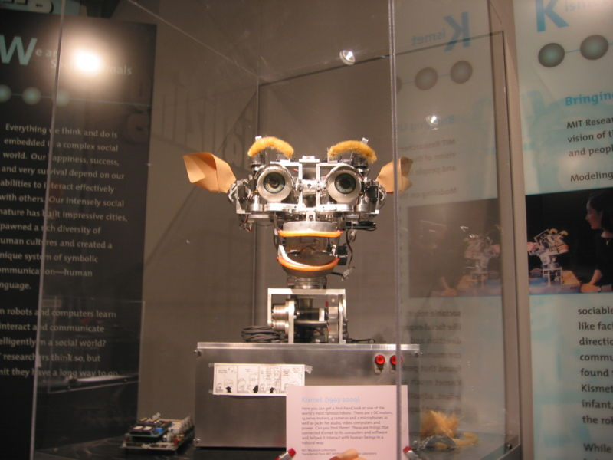
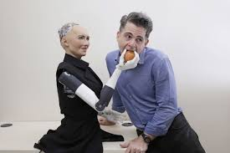
Approaches to AI
Cybernetics and brain simulation
Traditional symbolic AI
Sub-symbolic AI
Kismet
Sophia socia robot

Slide 15
Tools of AI research Search and optimization
Logic
Probabilistic methods for uncertain reasoning
Classifiers and statistical learning methods
Neural networks
Control theory
Specialized languages

Slide 16
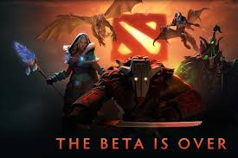
AI performance
optimal: it is not possible to perform better
strong super-human: performs better than all humans (chess)
super-human: performs better than most humans (Dota2
sub-human: performs worse than most humans
(open door)

