Slide 1
INTELLIGENT SYSTEMS AND AGENTS
+ INTELLIGENCE
+ INFORMATION SOCIETY
+ BUSINESS, COGNITIVE SCIENCES
Prof. dr. Matjaž Gams
MPŠ

Slide 2
INTELLIGENT SYSTEMS AND ROBOTICS
INTELIGENTNI SISTEMI IN ROBOTIKA
Intelligent Systems and Robotics (ISR) are dealing with advanced information sciences and technologies including intelligent systems, ambient intelligence, business intelligence, evolutionary computation, cognitive sciences, humanoid robotics, computer vision, controlling robots and systems. These are key information society technologies enabling knowledge-based society.
Evolutionary algorithms
Humanoid and service robotics
Intelligent systems and agents
Intelligent robot control
Cognitive sciences
Business intelligence
Ambient intelligence
Robot vision basic book: AI – A modern approach
Modern control systems seminar work + oral exam

Slide 3
ARTIFICIAL INTELLIGENCE
Russell and Norvig
ARTIFICIAL INTELLIGENCE:
A Modern Approach

Slide 4
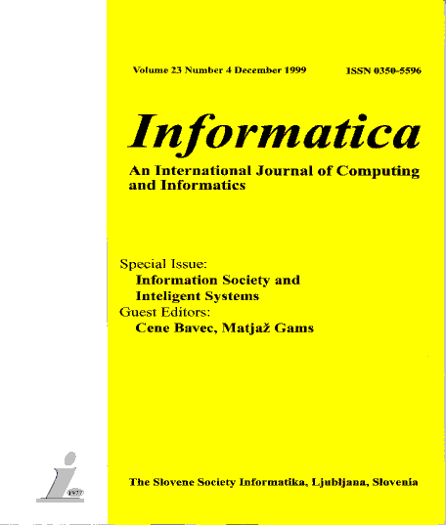
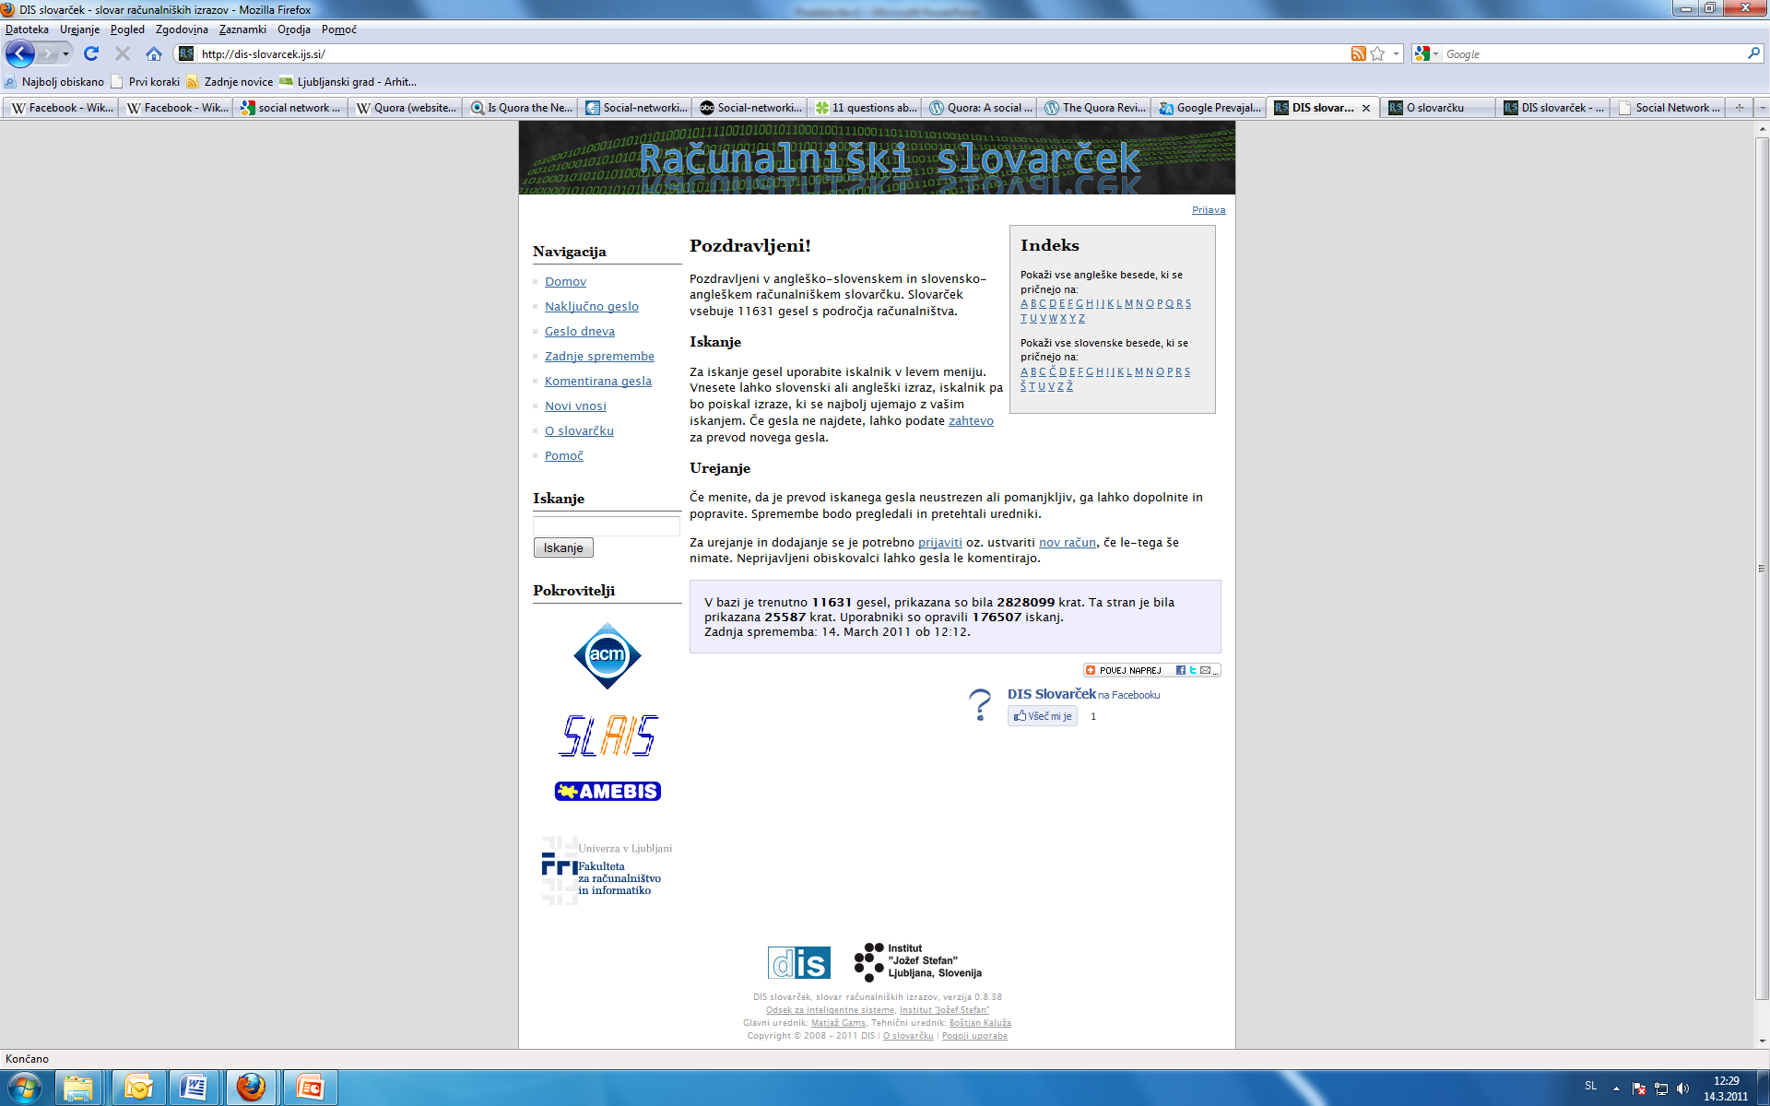
SOCIETIES
ACM Slovenia, SLAIS, DKZ, IAS, Informatika
Dictionary: Wikipedia style – enter new terms
http://dis-slovarcek.ijs.si/ (računalniški slovarček) 12.000 gesel
Informatica
PhD reports 2 pages
Among best quoted Slovenian journals in Google, Scopus etc.
JSI department growth – E9, E8, E3 …Our now 35 members
Co-founder of ACM Slo, SLAIS, DKZ, IAS
European and world level (2 competitions, 700+, 2 1st, 1 2nd

Slide 5
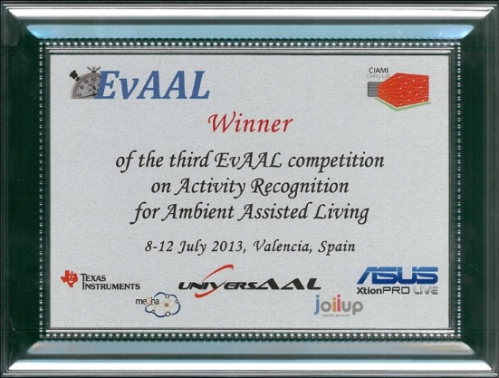


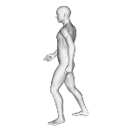
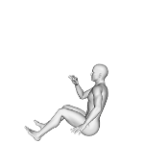

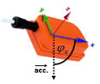

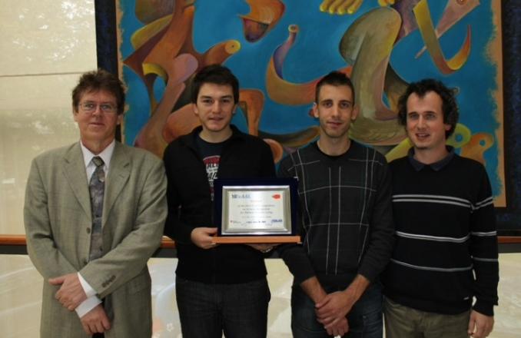
Competitions: EvAAL-AR 2013, first 10 in Tricorder
Victory at the annual competition in activity recognition – EvAAL-AR 2013 (Evaluating AAL Systems through Competitive Benchmarking)
Three layer
Activity Recognition
Activity
Bluetooth
Data
preprocessing
Fall Detection
Fall

Slide 6

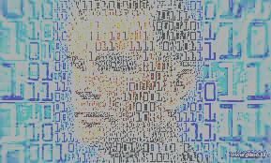
The Intelligent Future is Near
Matjaž Gams
Institut “Jožef Stefan”

Slide 7
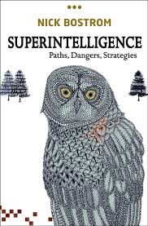
SUPERINTELLIGENCE
Bostrom, N. 2014. Superintelligence – Paths, Dangers, Strategies. Oxford University Press, Oxford, UK.
(100 Global Thinkers)
Future of Life Institute:
„Because of the great potential of AI, it is
important to research how to reap its benefits
while avoiding potential pitfalls“
Relations when computers surpass humans
3 forms of superintelligence: speed, collective, quality
Intelligence can not be controlled
Depending on the form, AI will be more or less dangerous
Most dangerous: 1 global, conflict with humans

Slide 8
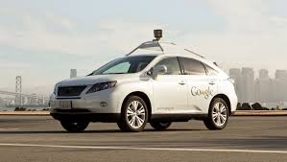
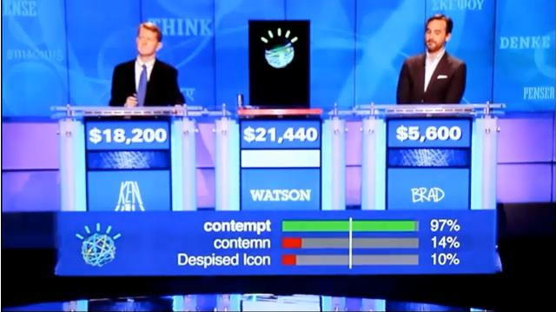
AI PROGRESS
Examples of AI progress
Self-driving cars: Google car: over 1 million miles without accident fault,
several cars with lane assist
Computers surpass humans in
symbolic tasks like chess,
Jeopardy, IQ tests, verbal IQ tests (Microsoft Beijing, 2015; an average person)
Autonomous robots
(walking, flying)

Slide 9
DEFINITIONS OF INTELLIGENCE
Intelligence has been defined in different ways, including the abilities for abstract thought, understanding, communication, reasoning, learning, planning, emotional intelligence and problem solving.
Intelligence is most widely studied in humans, but has also been observed in animals and plants.
Artificial intelligence is the intelligence of machines or the simulation of intelligence in machines.
Numerous definitions of and hypotheses about intelligence have been proposed since before the twentieth century, with no consensus reached by scholars.

Slide 10
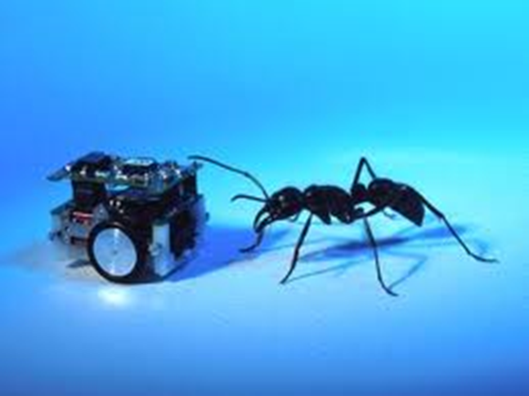
DEFINITIONS OF
ARTIFICIAL INTELLIGENCE
Wikipedia: Artificial intelligence (AI) is the intelligence of machines and the branch of computer science that aims to create it.
AI textbooks define the field as "the study and design of intelligent agents"[2] where an intelligent agent is a system that perceives its environment and takes actions that maximize its chances of success.
[3] John McCarthy, who coined the term in 1956,[4] defines it as "the science and engineering of making intelligent machines."[5]
Types: Natural intelligence (humans, animals, plants), Artificial intelligence, Engineering intelligence.
Artificial intelligence has been the subject of breathtaking optimism, has suffered stunning setbacks and is today an essential part of the technology industry, computer science and IS.

Slide 11
DEFINITION OF
INTELLIGENT SYSTEMS
Intelligent system is a system that learns during its existence. AI systems are intelligent systems.
It senses its environment and learns, for each situation, which action permits it to reach its objectives.
It continually acts, mentally and externally, and by acting reaches its objectives.
To reach its objective it has to select its response. A simple way to select a response is to select one that was favorable in a similar previous situation.

Slide 12

PROPERTIES OF INTELLIGENT SYSTEMS
Learning
Flexibility
Adaptation
Explanation
Discovery

Slide 13
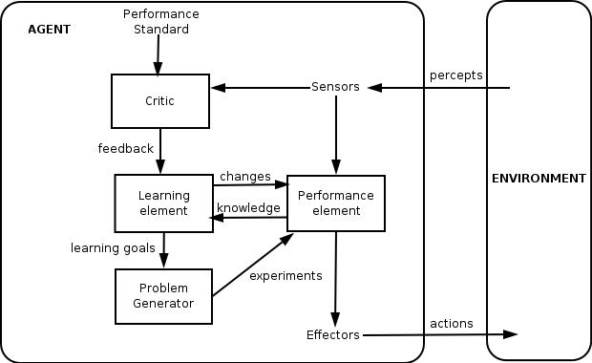
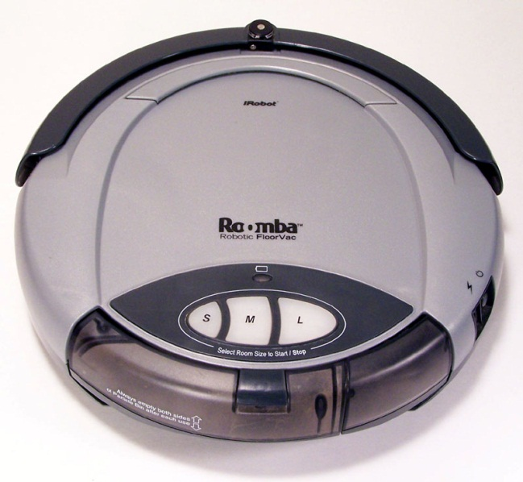
DEFINITION OF INTELLIGENCE
Definition: An intelligent entity is capable of learning.
What learns is intelligent.
An intelligent entity is an intelligent system.
Engineering definition: More
advanced than current classical
solutions (may not learn).
According to Wikipedia:
A thermostat is an intelligent agent.
Our definition: an intelligent agent
learns.
An intelligent agent without learning is just an agent.

Slide 14
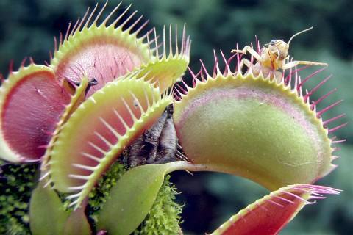

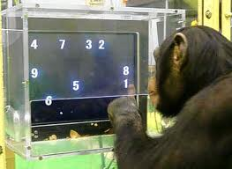
NATURAL INTELLIGENCE
Humans, animals, plants?
Are viruses intelligent?
All beings are!
Different levels of intelligence.
Sort dogs by intelligence.
Do animals really think?
Tools (birds, apes)
Joy, empathy, greed (apes, orkas, elephants, pigs)
Are animals getting smarter?
(humans + aliens?)
(interactions with humans, wash food, crash walnuts)
Notes:
muholovka

Slide 15
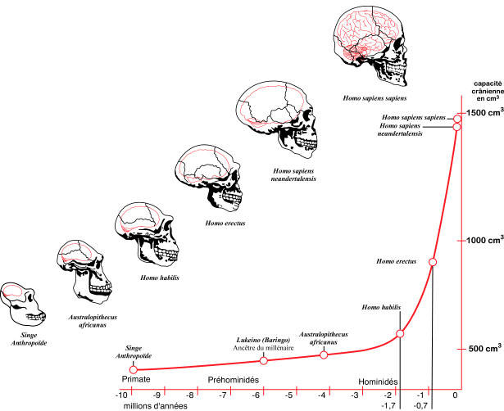
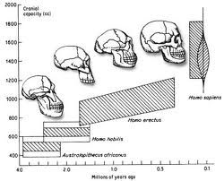
HUMAN INTELLIGENCE
Intelligence = better predictions, better reaction. More energy consumption – 25%.
Sexual attraction? Anthropological principle.
Tool evolution?

Slide 16
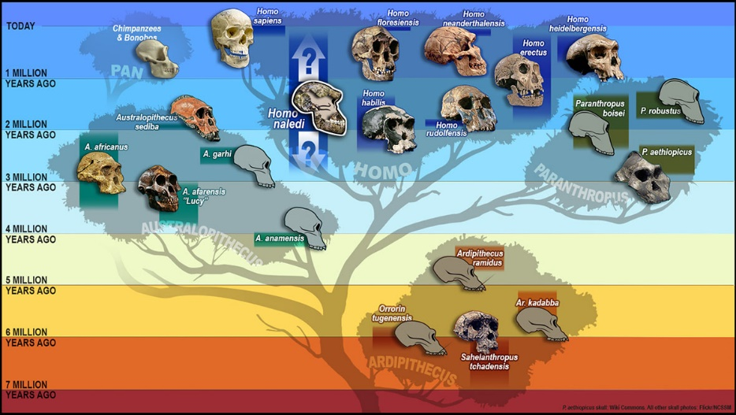
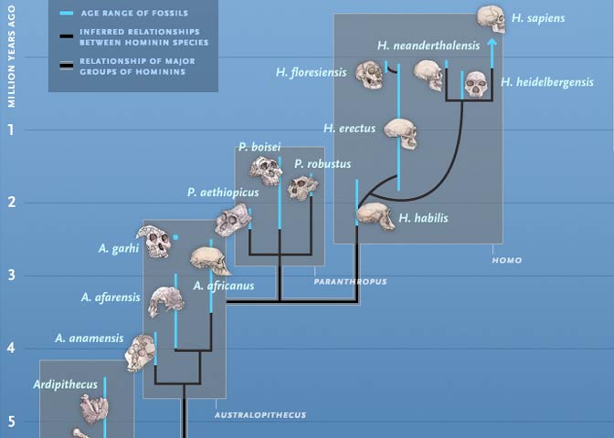
HUMAN INTELLIGENCE

Slide 17
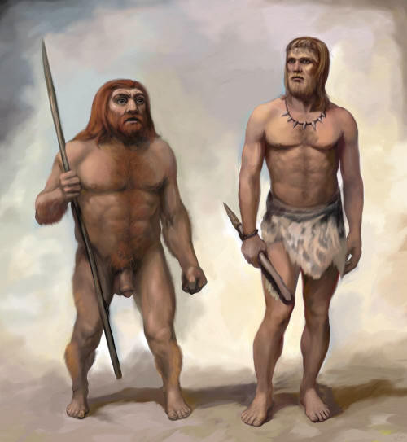
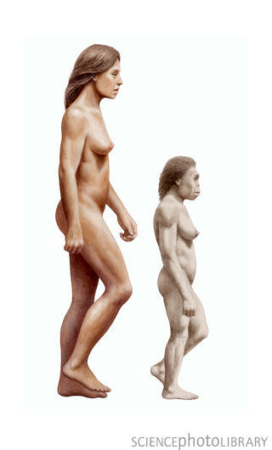
HUMAN SPECIES
European Neanderthals
Very similar to us, big brained
Europe 230.000-25.000 years
Reason: climate, our species
Genetic cross-breading with Europeans-us
Homo Floresiensis
Indonesian island 95,000 – 17,000 / 10.000 / 5.000 (folk saying)
1m, brain size of an orange
Folk saying: we burned them out
Sounds similar to animal extinctions?

Slide 18

Dwarf humans
Scientists have discovered a tiny species of ancient human that lived 18,000 years ago on an isolated island east of the Java Sea -- a prehistoric hunter in a "lost world" of giant lizards and miniature elephants.
These "little people" stood about three feet tall (1 m) and had heads the size of grapefruit. They coexisted with modern humans for thousands of years yet appear to be more closely akin to a long-extinct human ancestor.
Prebivalci okoliških vasi pripovedujejo zgodbe o teh „malih ljudeh“, ki so živeli v pečinah. Ženske so metale prsi čez rame. Ker so jim kradli otroke, so se njihovi predniki enkrat razjezili in jih požgali.

Slide 19
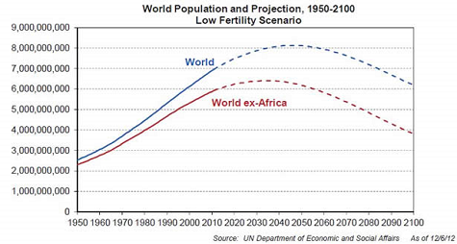
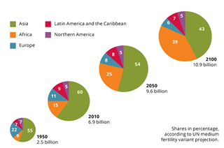
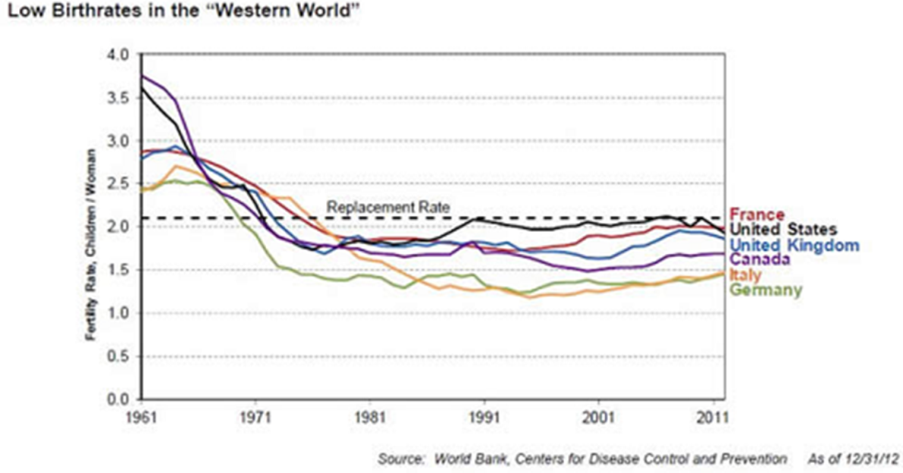
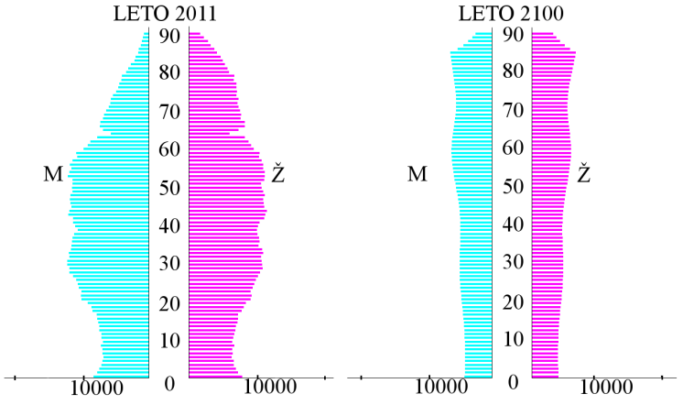

DEMOGRAPHY

Slide 20
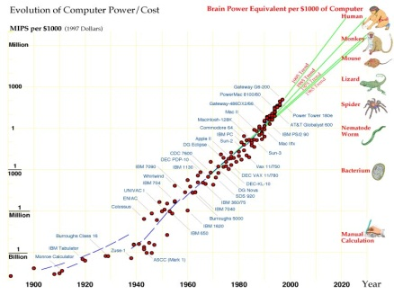
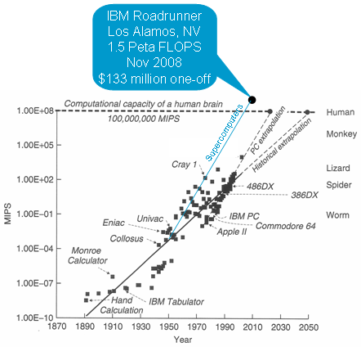
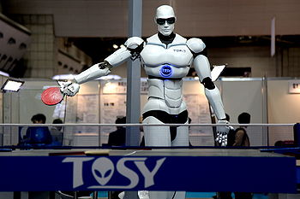
COMPUTERS
Chess, JEOPARDY …

Slide 21
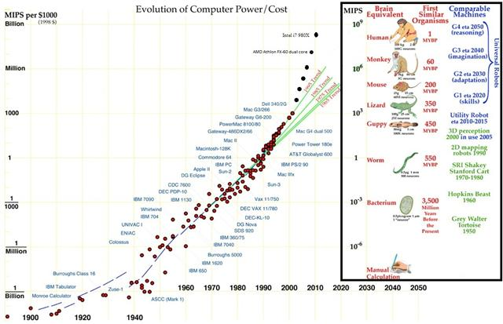
HUMAN INTELLIGENCE VS. COMPUTERS

Slide 22
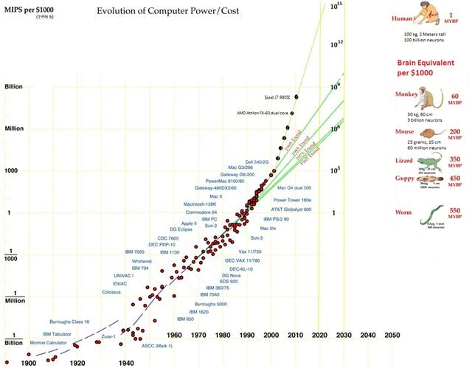
HUMAN INTELLIGENCE VS. COMPUTERS
Predictions failed

Slide 23

HUMAN/COMPUTER INTELLIGENCE
Kurtzweil
Kurtzweil
People + Computers = Information society
Flynn +30
Processing power
Drake’s equation
Computers
Human
Time
Computers are tools for enhancing our mental capabilities
Computers and robots are far less dangerous than real life
All doomsday talks failed to this day

Slide 24

Human-level intelligence ≠ AI
Unknown barrier

Slide 25
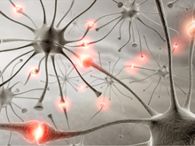
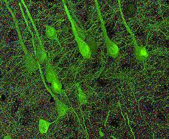
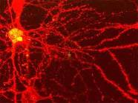
NEURON
Connected to 10.000 each, a switch?
Stanford 2010: … the brain’s overall complexity is almost beyond belief, said Smith. “One synapse, by itself, is more like a microprocessor —with both memory-storage and information-processing elements — than a mere on/off switch. In fact, one synapse may contain on the order of 1,000 molecular-scale switches. A single human brain has more switches than all the computers and routers and Internet connections on Earth,” he said.
…neuroscientists uncovered strong evidence that neurons also communicate with each other through weak electric fields. The study, published in the journal Nature Neuroscience, by Dr Costas Anastassiou (Caltech), explains how every time an electrical impulse races down the branch of a neuron, a tiny electric field surrounds that cell ..

Slide 26
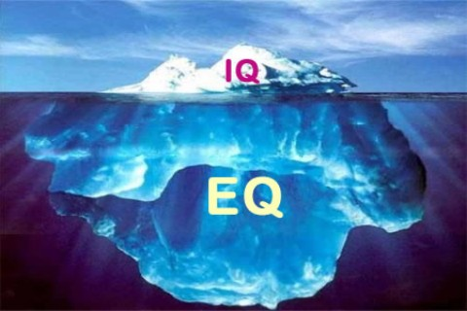
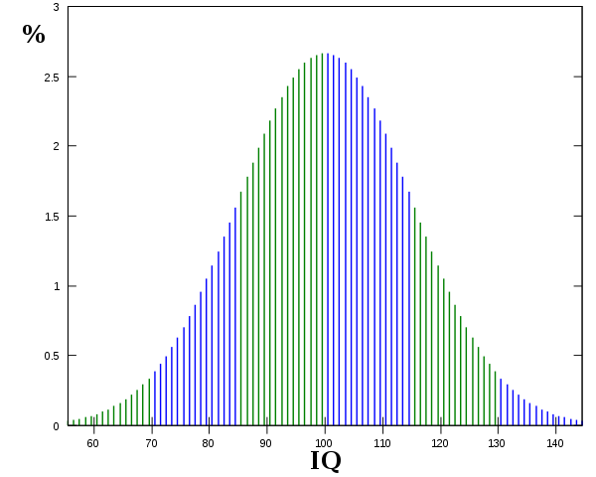
HUMAN INTELLIGENCE
10-30 types of intelligence: general, symbolic, emotional, abstract, motion, visual, speech, read-write, music …
Emotional intelligence (EI) is a skill or ability in the case of the trait EI model, a self-perceived ability to identify, assess, and control the emotions of oneself, of others, and of groups. Various models and definitions have been proposed of which the ability and trait EI models are the most widely accepted in the scientific literature. Criticisms have centered on whether the construct is a real intelligence and whether it has incremental validity over IQ and the Big Five personality dimensions.
Flynnov effect / smarter people have less children
IQ tests of different kinds: specific, integral …
Advanced

Slide 27
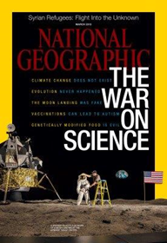
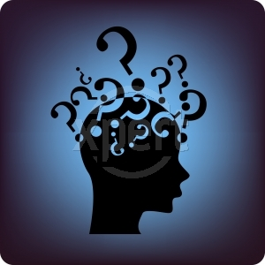
HUMAN INTELLIGENCE
IQ is the best single predictor of success at job. People with higher IQ
have higher title, status, income, live longer and healthier. And vice versa.
(W: individuals with low IQs are more likely to be divorced, have a child out of marriage, be incarcerated, and need long-term welfare support).
What is this – a political lecture?? This is too sensible?
The world is not as it seems!
(commercial, political, popular, semi-popular,
scientific)
Science, facts, empirical verification,
platonism
Engineers: Science should deal with relevant issues. What is your opinion?

Slide 28

SCIENCE, FACT ≠ IDEOLOGY, POLITICS

Slide 29
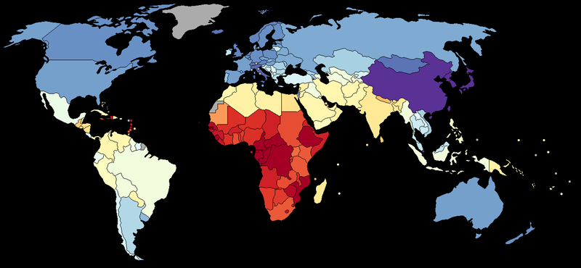
HUMAN INTELLIGENCE
DISTRIBUTIONS: big/small, M/W, religious, use of browser …
no major difference!

Slide 30
DISCUSSION
What is intelligence?
What is science/ scientific and what not?
A superior level of understanding
and predictions
Knowledge and intelligence enable better predictions and performance

