Slide 1

Ambient Intelligence
Mitja Luštrek
Jožef Stefan Institute
Department of Intelligent Systems

Slide 2
What is ambient intelligence (AmI)
Defined not by technology but by objectives → interdisciplinary
Environment should be sensitive and responsive to the users and their needs
No special skills and minimal interaction from the users needed
Technology disappears except for the user interface, its benefits remain

Slide 3
AmI in relation to other areas
Artificial intelligence
Sensing
Ubiquitous computing
AmI
Pervasive computing
Internet of things
Human-computer interaction
Mobile and distributed computing

Slide 4
Common settings

Slide 5
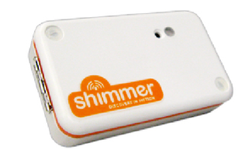
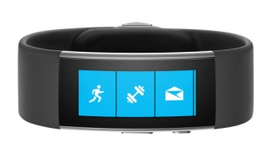
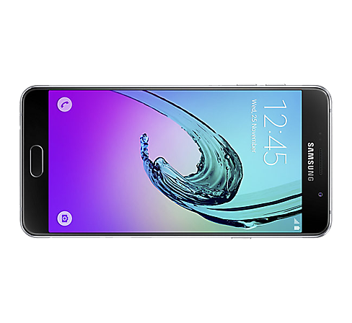
Wearables systems
Specialized devices
(sensing, some processing)
Consumer wearables
(sensing, some processing, HCI)
Smartphones
(sensing, processing, HCI)
Images copyright Shimmer, Microsoft, Samsung

Slide 6
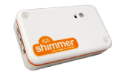
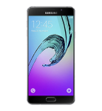

Wearable sensors
Accelerometer: acceleration, including gravity → orientation
Gyroscope: angular velocity → orientation
Magnetometer: magnetic field → orientation
Inertial sensors / inertial
measurement unit (IMU)

Slide 7
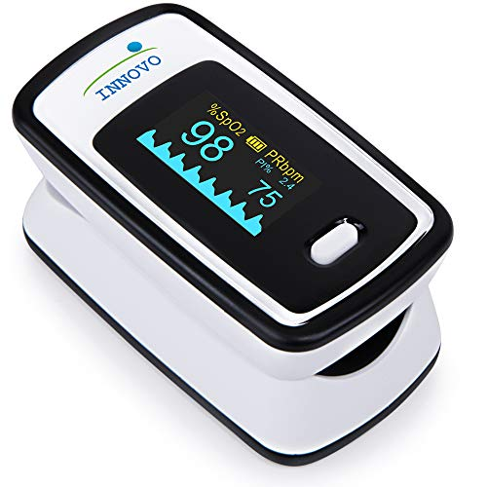
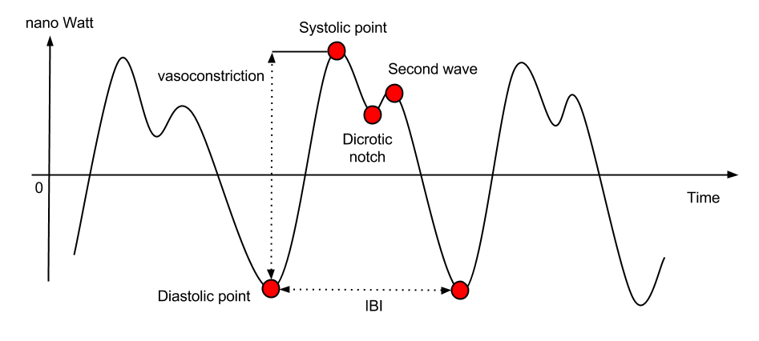
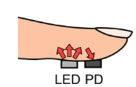
Wearable sensors
Photoplethysmogram (PPG) sensor: blood volume pulse → heart activity, blood oxygen (multiple wavelenghts)
Image copyright Innovo, University of Toronto

Slide 8
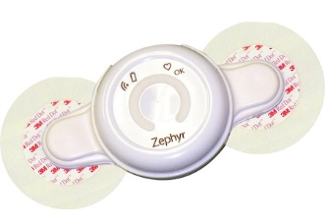
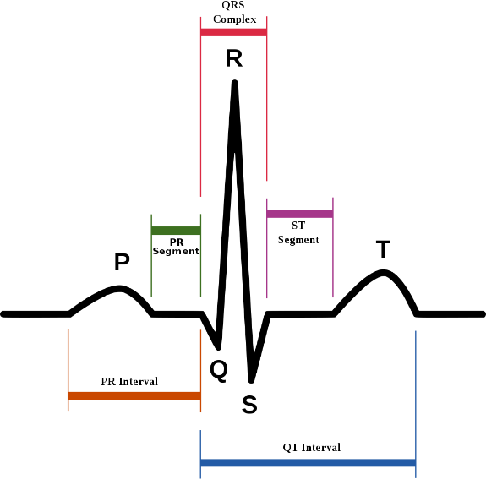
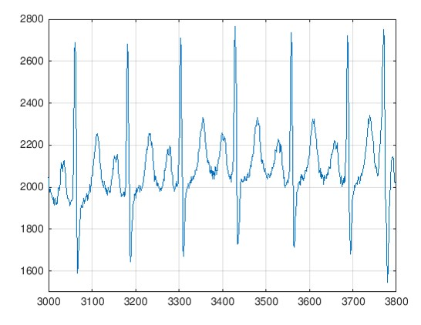
Wearable sensors
Electrocardiogram (ECG) sensor: heart activity (richer information than PPG)
Electromyogram (EMG) sensor: activity of other muscles
Images copyright Zephyr, MathWorks, Agateller

Slide 9
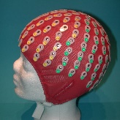
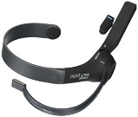
Wearable sensors
Galvanic skin response (GSR) / electrodermal activity (EDA): skin conductivity → sweating
Electroencephalogram (EEG) sensor: brain activity
Temperature sensor: skin/ambient temperature
Air pressure sensor: air pressure → (change in) altitude
GPS: location
Images copyright BioSemi, MindWave

Slide 10
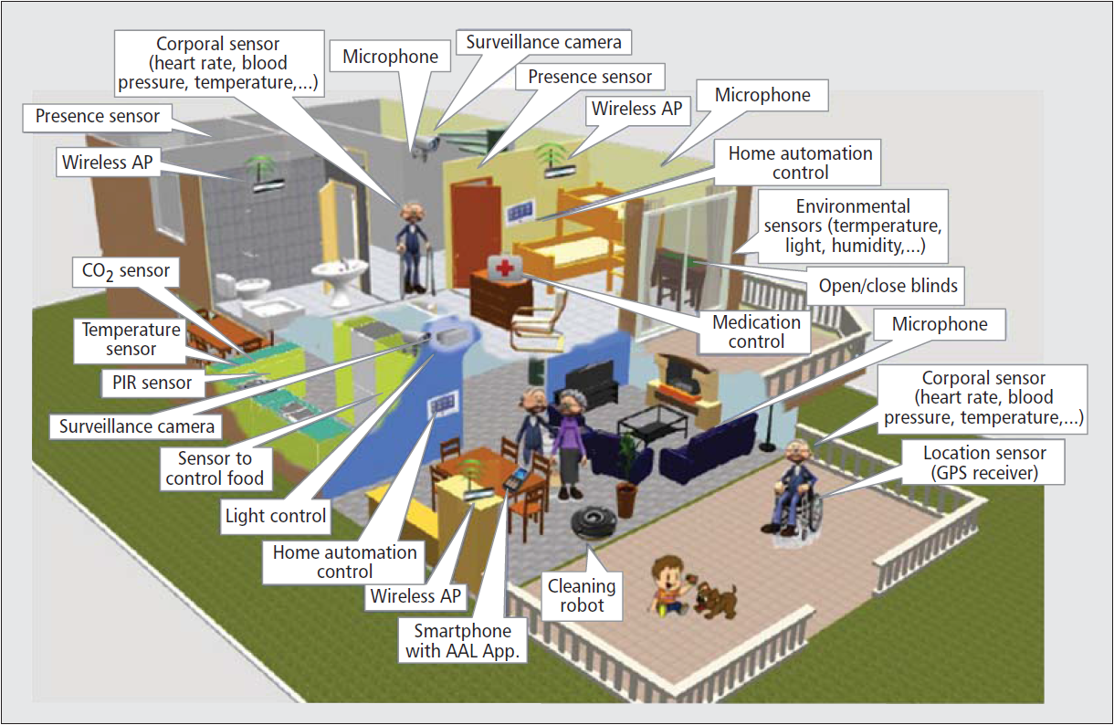
Smart indoor environments
Smart homes/offices
Ambient assisted living (AAL) environments
Living laboratories
Special: smart factories, hospitals, shops...
Sensing, actuation
Processing not an
issue
Various
methods for HCI
Image copyright IEEE / Lloret et al.

Slide 11
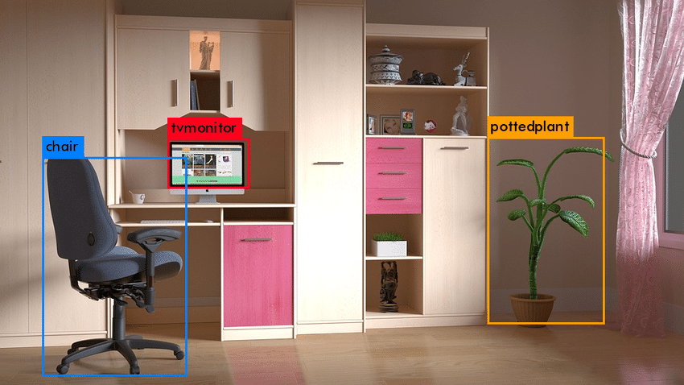
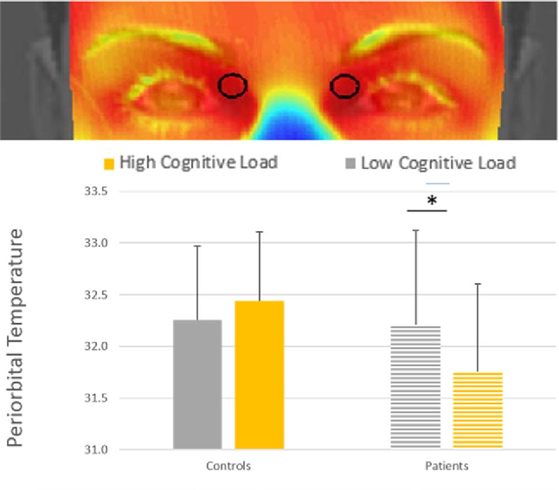
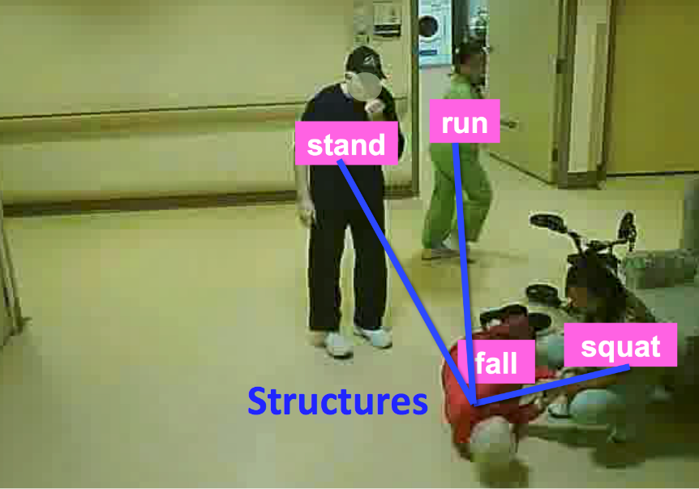
Ambient sensors
Camera (infrared)
Image copyright Potdar et al., Simon Fraser University, Springer / Panasiti et el.

Slide 12
Ambient sensors
Microphone: human activity, machine noise
Passive infrared (PIR) sensor, pressure sensor:
human movement
Door, window, water flow sensor
Temperature, humidity, CO₂, air pressure sensor
Gas, carbon monoxide, flood sensor
Electricity meter: appliance use

Slide 13
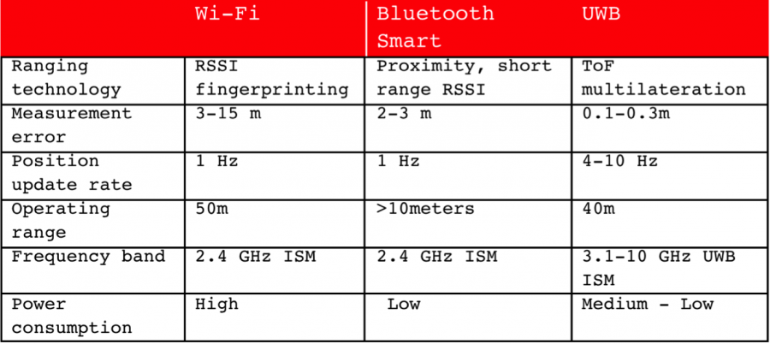
Ambient sensors
Electronic nose: specific gases
Indoor localization – Bluetooth beacons, RFID, ultrasound, ultra-wideband ...
Image copyright Eliko

Slide 14
Smart outdoor environments
Smart cities
Public displays
Farms
Natural environments
...

Slide 15
Common applications

Slide 16
Health, wellbeing and AAL
Monitoring and assisting elderly people at home and on the go
Monitoring and guiding chronic patients at home and on the go
Monitoring hospital patients / nursing home residents
Monitoring and encouraging physical activity and general wellbeing of healthy users

Slide 17
Comfort, energy and security
Controlling heating, ventilation, lighting etc. for higher comfort and lower energy consumption
Appliance use scheduling for lower energy consumption
Security monitoring – detection of unusual or prohibited behaviours/events

Slide 18
Miscellaneous
Affective computing
Sensing and actuation for managing smart city infrastructure and providing public services
Sensing and actuation for precision agriculture
Monitoring natural environment for preservation and exploitation
...

Slide 19
Common technolgies and methods

Slide 20
... by area
Artificial intelligence
Sensing
AmI
Human-computer interaction
Mobile and distributed computing

Slide 21
Artificial intelligence
Artificial intelligence
Sensing
AmI
Machine learning and symbolic reasoning
to models events, users, activities ...
Ontologies to represent knowledge
Rules to represent actions
Human-computer interaction
Mobile and distributed computing

Slide 22
Sensing
Artificial intelligence
Sensing
AmI
Computer vision
Indoor localization
Radio-based sensing
Human-computer interaction
Mobile and distributed computing

Slide 23
Mobile and distributed computing
Artificial intelligence
Sensing
AmI
Protocols
Middlewares (e.g., UniversAAL)
Human-computer interaction
Mobile and distributed computing

Slide 24
Human-computer interaction
Artificial intelligence
Sensing
AmI
Gesture-based, tangible
interaction
Augmented reality
User-centred design
Human-computer interaction
Mobile and distributed computing

Slide 25
Wearable example with classical machine learning

Slide 26
Overview of the example
Wellbeing
recommendations:
Adequate daily/
weekly physical
activity
Relaxation exercises
if stressed
Sensing:
Acceleration
Heart rate
GSR
Processing:
Activity recogniton
Human energy
expenditure estimation
Stress detection

Slide 27
Activity recognition
a_{t} | a_{t+1} | a_{t+2} | ...
Acceleration data
Sliding window (2 s)

Slide 28
Activity recognition
a_{t} | a_{t+1} | a_{t+2} | ...
Acceleration data
Sliding window (2 s)
Training
f₁ | f₂ | f₃ | ... |  | Activity
AR model
Average acceleration
Standard deviation
of acceleration
Orientation
...
Machine learning
Manually
labelled

Slide 29
Activity recognition
a_{t} | a_{t+1} | a_{t+2} | ...
Acceleration data
Sliding window (2 s)
Use/testing
f₁ | f₂ | f₃ | ...
AR model
Activity

Slide 30
Energy expenditure estimation
a_{t} | a_{t+1} | a_{t+2} | ...
Acceleration,
heart rate data
Sliding window (10 s)
AR model
Activity

Slide 31
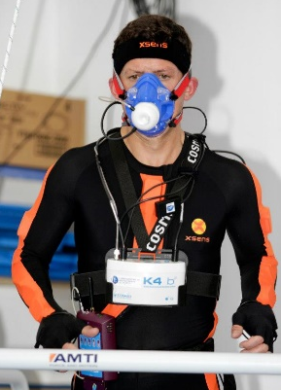
Energy expenditure estimation
a_{t} | a_{t+1} | a_{t+2} | ...
Acceleration,
heart rate data
Sliding window (10 s)
Like for AR
Heart rate
Area under
acceleration
Kinetic energy
...
AR model
Activity
f’₁ | f’₂ | f’₃ | ... |  | Activity | EE
EEE model
Training
Machine learning (regression)
Image copyright University of Porto

Slide 32
Energy expenditure estimation
a_{t} | a_{t+1} | a_{t+2} | ...
Acceleration,
heart rate data
Sliding window (10 s)
AR model
Activity
f’₁ | f’₂ | f’₃ | ... |  | Activity
EEE model
EE
Use/testing

Slide 33
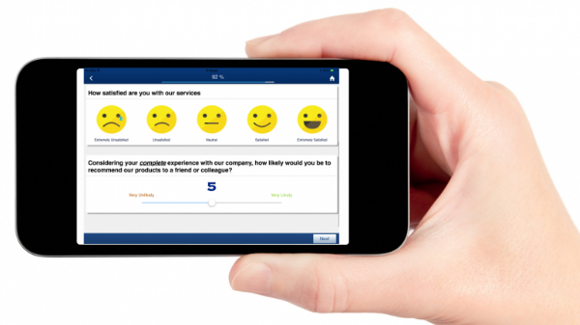
Stress detection
a_{t} | a_{t+1} | a_{t+2} | ...
Acceleration,
heart rate,
GSR data
Sliding window (1 min)
Training
Machine learning (classification)
f“₁ | f“₂ | f“₃ | ... | History | Time | EE | Stress
Stress model
Heart rate variability
features
GSR frequency features
EEE model
EE
Image copyright QuestionPro

Slide 34
Stress detection
a_{t} | a_{t+1} | a_{t+2} | ...
Acceleration,
heart rate,
GSR data
Sliding window (1 min)
Use/testing
Machine learning (classification)
f“₁ | f“₂ | f“₃ | ... | History | Time | EE
Stress model
Stress
EEE model
EE

Slide 35
Wellbeing monitoring
AR model
Activity
EEE model
EE
Stress model
Stress
Improvements:
Adaptation to the phone‘s location, orientation
Multiple models (for energy expenditure estimation, stress detection)
Deep learning
...

Slide 36
Wearable example with deep learning

Slide 37
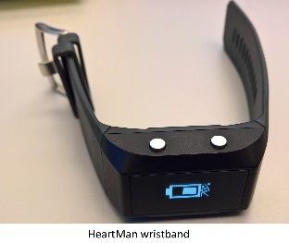
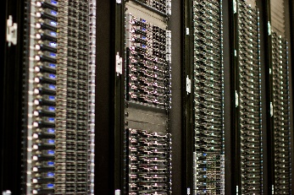

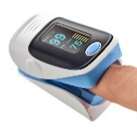
Overview of the example
Sensing:
PPG
(Acceleration,
temperature,
GSR)
Processing:
Data cleaning
BP estimation
MIMIC III
Sensing:
PPG
Image copyright Designmodo, Victorgrigas

Slide 38
Data cleaning (1)
Download PPG + continuous arterial BP data
→ 30,000 patients
Remove empty or obviously useless files
→ 10,000 patients
Remove files < 10 min
Standardize: mean = 0, std. dev = variance = 1
Band-pass filter: 4th order Butterworth filter with cut-off frequencies 0.5, 8 Hz

Slide 39
Data cleaning (2)
Remove outliers
(Hempel filter = version of median filter)
Remove anomalies in ground truth
→ 510 patients

Slide 40
Preparing for deep learning
Original
5-second
windows
Derived

Slide 41
DL architecture (1)
PPG
PPG‘
PPG‘‘
ResNet blocks
(CNN)
Spectro-temporal block
ResNet blocks
(CNN)
Spectro-temporal block
ResNet blocks
(CNN)
Spectro-temporal block
Gated recurrent u. (GRU)
Concat.
2 x dense
SBP
DBP

Slide 42
DL architecture (2)
ResNet block
Spectro-temporal block
Convolution
Spectrogram
Convolution
Short-
cut
GRU
Convolution
Add
4 more ResNet blocks

Slide 43
Personalisation
Results unsatisfactory:
  Error 15.4/12.4 mmHg for SPB/DBP
  Dummy error 19.7/10.6 mmHg
Add each person‘s data to training set:
  Error 9.4/6.9 mmHg

Slide 44
Mobile phone example

Slide 45
Overview of the example
Stress-relief
recommendations
Sensing:
Acceleration
GPS
Wi-fi
Audio
Light
Call log
Charging,
lock/unlock
(Application use)
Processing:
Stress detection
StudentLife

Slide 46
Feature extraction (1)
Short-term:
  Activity: percentage of active vs. stationary
  Sound: percentage of voice, noise, silence
  Time of day (day, evening, night)
Long-term:
  Activity, sound, combinations (e.g., stationary + silent)
  Distance travelled
  Live conversations
  Phone calls
... for each time of day,
relative to subject‘s average

Slide 47
Feature extraction (2)
Sleep duration (from light and charging)
Current and previous location (from wi-fi)
Days before/after midterm

Slide 48
Training and evaluation
Leave one subject out (LOSO):
  Take one subject for testing
  Train on other subjects
  Repeat for all subjects and average
Plain LOSO
Train on a cluster similar to the test subject
Use personalisation

Slide 49
Smart environment example

Slide 50
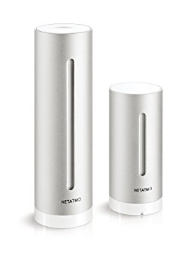
Overview of the example
Ontology +
Reasoning
Simulation
Environment
recommendations:
Appropriate temperature
Good air quality
Sensing:
Hardware
Virtual
Reason about:
Which sensor values are bad
Which actions improve them
Simulate suggested actions
Recommend the best one
Image copyright Netatmo

Slide 51
Sensing
Indoor:
Temperature
Humidity
CO₂
Outdoor:
Temperature
Humidity
Sensing:
Hardware
Virtual
Number of occupants
Windows opened/closed
Machine-learning model / heuristics
Hardware sensor readings (CO₂ and others)
Image copyright Netatmo

Slide 52
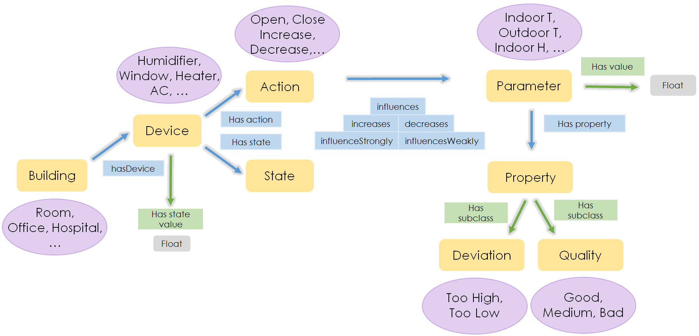
Ontology + reasoning

Slide 53
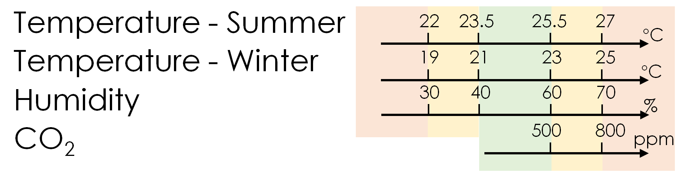
Simulation
Suggested
actions
from the
ontology +
reasoning
Prediction of
outcomes:
Temperature
Humidity
CO₂
Evaluation of
the predicted
outcomes
Recommended
action
Machine-learning / physics models
1
0
0
–1
–1
History of sensor readings

Slide 54
Miscellaneous examples

Slide 55
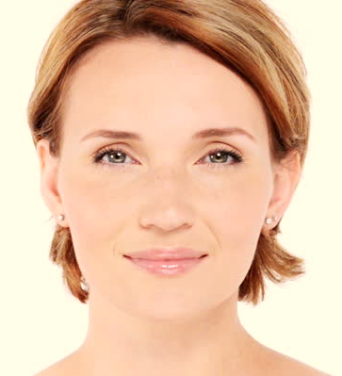
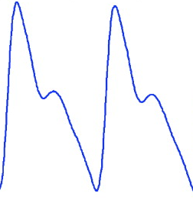
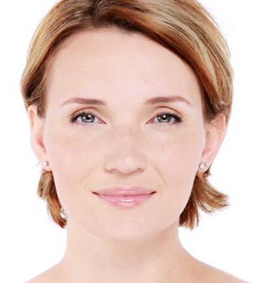
Remote PPG reconstruction
Heart pushes blood to the periphery
Color intensifies
Exploited by color-based
remote PPG monitoring
Color lightens
Blood flow through the carotid pushes head up
Exploited by motion-based
remote PPG monitoring
Blood returns
to the heart
Head moves down
Color-based: https://youtu.be/-cgESNK-84w?t=133
Motion-based: https://youtu.be/EhZXDgG9oSk?t=24

Slide 56
Radio-based activity recognition
Radio transmitter
Radio receiver
Wang et al.: Modeling RFID signal reflection for contact-free activity recognition
https://www.youtube.com/watch?v=FnK4QHj00nk

Slide 57
Localization based on ceiling lights
Fingerprint lights
(intensity, flicker ...)
Match current light
to fingerprints
Take into account
orientation, movement
Light intensity
Light intensity
Hu et al.: Lightitude: Indoor positioning using uneven light intensity distribution
https://youtu.be/mgEf7J_M0Qk?t=29

Slide 58
Human-computer interaction
Virtual mirror as a natural user interface
Contact-free haptic feedback
https://youtu.be/ZiXOsJeILmQ
Smart restaurant table
https://youtu.be/5f5Kk5RReUE
https://youtu.be/gvWxqAcsDBM?t=19

Slide 59
Conclusion
Ambient intelligence = environment intelligently and unobtrusively responsive
Devices: wearable and ambient sensors ...
Methods: machine learning, symbolic reasoning, knowledge representation ...
Domains: health and wellbeing, comfort and energy consumption ...

Slide 60
Literature (1)
Physical monitoring with wearable sensors + machine learning:
Cvetković et al., Real-time activity monitoring with a wristband and a smartphone, Information Fusion 2018
Psychological monitoring with wearable sensors + machine learning:
Gjoreski et al., Monitoring stress with a wrist device using context, Journal of Biomedical Informatics 2017
Ambient sensors + symbolic reasoning:
Alirezaie et al., An ontology-based context-aware system for smart homes: E-care@home, Sensors 2017

Slide 61
Literature (2)
Audio + deep learning:
Georgiev et al., Low-resource multi-task audio sensing for mobile and embedded devices via shared deep neural network representations, Ubicomp 2017
Indoor localization:
Zafari et al., A Survey of indoor localization systems and technologies, 2018
Internet of Things:
Al-Fuqaha et al., Internet of Things: A survey on enabling technologies, protocols, and applications, IEEE Communication Surveys & Tutorials 2015

Slide 62
Literature (3)
Human-computer interaction:
Hui & Sherratt, Towards disappearing user interfaces for ubiquitous computing: Human enhancement from sixth sense to super senses, Journal of Ambient Intelligence and Humanized Computing 2017

