Slide 1
Ambient Intelligence
Mitja Luštrek
Jožef Stefan Institute Department of Intelligent Systems

Slide 2
What is ambient intelligence (AmI)
Defined not by technology but by objectives → interdisciplinary
Environment should be sensitive and responsive to the users and their needs
No special skills and minimal interaction from the users needed
Technology disappears except for the user interface, its benefits remain

Slide 3
AmI in relation to other areas
Artificial intelligence
Sensing
Ubiquitous computing
AmI
Pervasive computing
Human-computer interaction
Mobile and distributed computing

Slide 4
Common settings

Slide 5
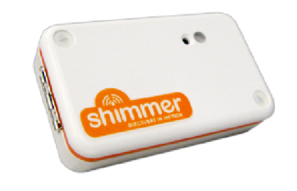
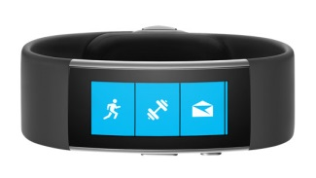
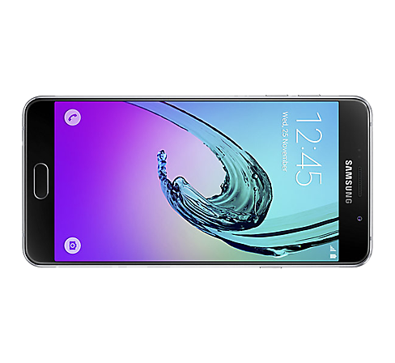
Wearables systems
Specialized devices (sensing, some processing)
Consumer wearables (sensing, some processing, HCI)
Smartphones (sensing, processing, HCI)
Images copyright Shimmer, Microsoft, Samsung

Slide 6
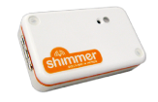
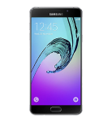
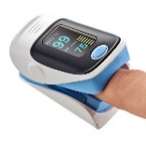
Wearable sensors
Accelerometer: acceleration, including gravity → orientation
Gyroscope: angular velocity
Photoplethysmogram (PPG) sensor: blood volume pulse → heart activity, blood oxygen (multiple wavelenghts)
Electrocardiogram (ECG) sensor: heart activity (richer information than PPG)
Electromyogram (EMG) sensor: activity of other muscles
Images copyright Shimmer, Microsoft, Samsung, Bittium

Slide 7
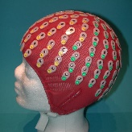
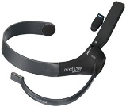
Wearable sensors
Galvanic skin response (GSR) / electrodermal activity (EDA): skin conductivity → sweating
Electroencephalogram (EEG) sensor: brain activity
Temperature sensor: skin/ambient temperature
Air pressure sensor: air pressure → (change in) altitude
GPS: location
Images copyright Shimmer, Microsoft, Samsung, BioSemi, MindWave

Slide 8
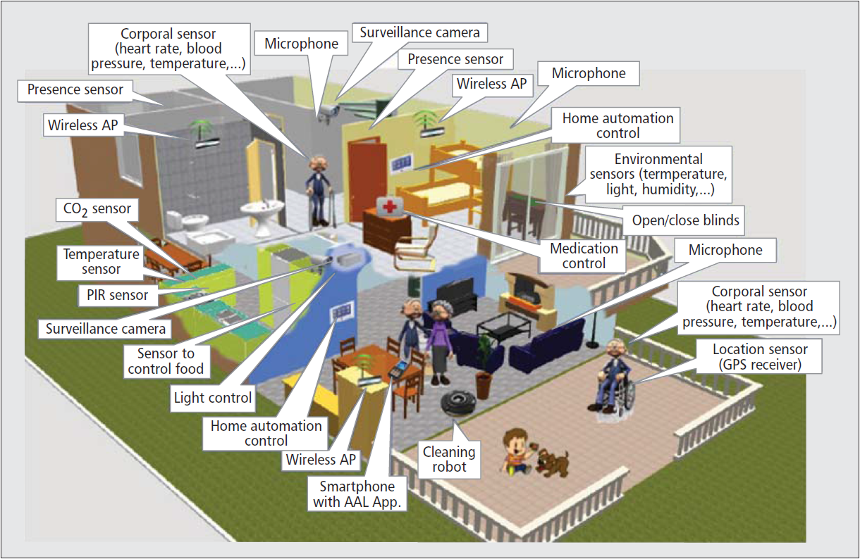
Smart indoor environments
Smart homes/offices
Ambient assisted living (AAL) environments
Living laboratories
Special: smart factories, hospitals, shops...
Sensing, actuation
Processing not an issue
Various methods for HCI
Image copyright IEEE / Jaime Lloret et al.

Slide 9
Indoor sensors
Camera (infrared)
Microphone
Passive infrared (PIR) sensor, pressure sensor: occupant movement
Door, window, water flow sensor
Temperature, humidity, CO₂, air pressure sensor
Gas, carbon monoxide, flood sensor
Electricity meter: appliance use
Indoor localization – Bluetooth beacons, RFID, ultrasound, ultra-wideband ...

Slide 10
Smart outdoor environments
Smart cities
Public displays
Farms
Natural environments
...

Slide 11
Common applications

Slide 12
Health, wellbeing and AAL
Monitoring and assisting elderly people at home and on the go
Monitoring and guiding chronic patients at home and on the go
Monitoring hospital patients / nursing home residents
Monitoring and encouraging physical activity and general wellbeing of healthy users

Slide 13
Comfort, energy and security
Controlling heating, ventilation, lighting etc. for higher comfort and lower energy consumption
Appliance use scheduling for lower energy consumption
Security monitoring – detection of unusual or prohibited behaviours/events

Slide 14
Miscellaneous
Affective computing
Management of smart city infrastructure
Sensing and content adaptation for public displays
Sensing and actuation for precision agriculture
Monitoring natural environment for preservation and exploitation
...

Slide 15
Common technolgies and methods

Slide 16
... by area
Artificial intelligence
Sensing
AmI
Human-computer interaction
Mobile and distributed computing

Slide 17
Artificial intelligence
Artificial intelligence
Sensing
AmI
Machine learning and symbolic reasoning to models events, users, activities ...
Ontologies to represent knowledge
Rules to represent actions
Human-computer interaction
Mobile and distributed computing

Slide 18
Sensing
Artificial intelligence
Sensing
AmI
Computer vision
Indoor localization
Device-free sensing (from radio interference)
Human-computer interaction
Mobile and distributed computing

Slide 19
Mobile and distributed computing
Artificial intelligence
Sensing
AmI
Internet of things
Middlewares (e.g., UniversAAL)
Human-computer interaction
Mobile and distributed computing

Slide 20
Human-computer interaction
Artificial intelligence
Sensing
AmI
Gesture-based, tangible interaction
Augmented reality
User-centred design
Human-computer interaction
Mobile and distributed computing

Slide 21
Wearable example

Slide 22
Overview of the example
Wellbeing recommendations:
Adequate daily/ weekly physical activity
Relaxation exercises if stressed
Sensing:
Acceleration
Heart rate
GSR
Processing:
Activity recogniton
Human energy expenditure estimation
Stress detection

Slide 23
Activity recognition
a_{t} | a_{t+1} | a_{t+2} | ...
Acceleration data
Sliding window (2 s)

Slide 24
Activity recognition
a_{t} | a_{t+1} | a_{t+2} | ...
Acceleration data
Sliding window (2 s)
Training
f₁ | f₂ | f₃ | ... |  | Activity
AR model
Average acceleration
Standard deviation of acceleration
Orientation
...
Machine learning
Manually
labelled

Slide 25
Activity recognition
a_{t} | a_{t+1} | a_{t+2} | ...
Acceleration data
Sliding window (2 s)
Use/testing
f₁ | f₂ | f₃ | ...
AR model
Activity

Slide 26
Energy expenditure estimation
a_{t} | a_{t+1} | a_{t+2} | ...
Acceleration, heart rate data
Sliding window (10 s)
AR model
Activity

Slide 27
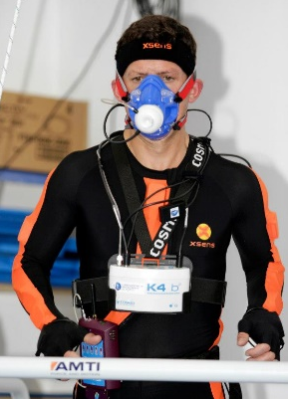
Energy expenditure estimation
a_{t} | a_{t+1} | a_{t+2} | ...
Acceleration, heart rate data
Sliding window (10 s)
Like for AR
Heart rate
Area under acceleration
Kinetic energy
...
AR model
Activity
f’₁ | f’₂ | f’₃ | ... |  | Activity | EE
EEE model
Training
Machine learning (regression)
Image copyright University of Porto

Slide 28
Energy expenditure estimation
a_{t} | a_{t+1} | a_{t+2} | ...
Acceleration, heart rate data
Sliding window (10 s)
AR model
Activity
f’₁ | f’₂ | f’₃ | ... |  | Activity
EEE model
EE
Use/testing

Slide 29
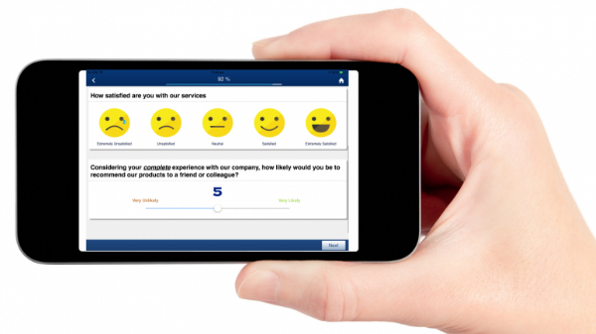
Stress detection
a_{t} | a_{t+1} | a_{t+2} | ...
Acceleration, heart rate, GSR data
Sliding window (1 min)
Training
Machine learning (classification)
f“₁ | f“₂ | f“₃ | ... | History | Time | EE | Stress
Stress model
Heart rate variability features
GSR frequency features
EEE model
EE
Image copyright QuestionPro

Slide 30
Stress detection
a_{t} | a_{t+1} | a_{t+2} | ...
Acceleration, heart rate, GSR data
Sliding window (1 min)
Use/testing
Machine learning (classification)
f“₁ | f“₂ | f“₃ | ... | History | Time | EE
Stress model
Stress
EEE model
EE

Slide 31
Wellbeing monitoring
AR model
Activity
EEE model
EE
Stress model
Stress
Improvements:
Adaptation to the phone‘s location, orientation
Multiple models (for energy expenditure estimation, stress detection)
Deep learning
...

Slide 32
Smart environment example

Slide 33
Overview of the example
Ontology +
Reasoning
Simulation
Environment recommendations:
Appropriate temperature
Good air quality
Sensing:
Hardware
Virtual
Reason about:
Which sensor values are bad
Which actions improve them
Simulate suggested actions
Recommend the best one
Image copyright Netatmo

Slide 34
Sensing
Indoor:
Temperature
Humidity
CO₂
Outdoor:
Temperature
Humidity
Sensing:
Hardware
Virtual
Number of occupants
Windows opened/closed
Machine-learning model / heuristics
Hardware sensor readings (CO₂ and others)
Image copyright Netatmo

Slide 35
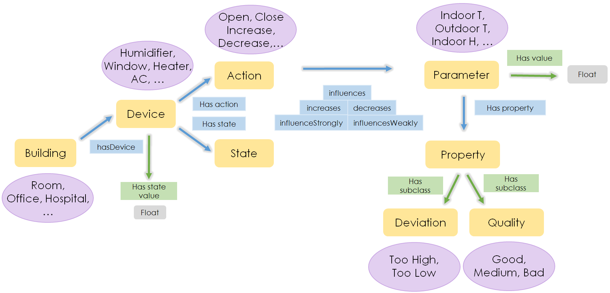
Ontology + reasoning

Slide 36
Simulation
Suggested actions
from the ontology + reasoning
Prediction of outcomes:
Temperature
Humidity
CO₂
Evaluation of the predicted outcomes
Recommended action
Machine-learning / physics models
1
0
0
–1
–1
History of sensor readings

Slide 37
Conclusion
Ambient intelligence = environment intelligently and unobtrusively responsive
Devices: wearable and ambient sensors ...
Methods: machine learning, symbolic reasoning, knowledge representation ...
Domains: health and wellbeing, comfort and energy consumption ...

Slide 38
Literature (1)
Physical monitoring with wearable sensors + machine learning: Cvetković et al., Real-time activity monitoring with a wristband and a smartphone, Information Fusion 2018
Psychological monitoring with wearable sensors + machine learning: Gjoreski et al., Monitoring stress with a wrist device using context, Journal of Biomedical Informatics 2017
Ambient sensors + symbolic reasoning: Alirezaie et al., An ontology-based context-aware system for smart homes: E-care@home, Sensors 2017

Slide 39
Literature (2)
Audio + deep learning: Georgiev et al., Low-resource multi-task audio sensing for mobile and embedded devices via shared deep neural network representations, Ubicomp 2017
Indoor localization: Zafari et al., A Survey of indoor localization systems and technologies, 2018
Internet of Things: Al-Fuqaha et al., Internet of Things: A survey on enabling technologies, protocols, and applications, IEEE Communication Surveys & Tutorials 2015

Slide 40
Literature (3)
Human-computer interaction: Hui & Sherratt, Towards disappearing user interfaces for ubiquitous computing: Human enhancement from sixth sense to super senses, Journal of Ambient Intelligence and Humanized Computing 2017

