Slide 1
Ambient Intelligence
Mitja Luštrek
Jožef Stefan Institute Department of Intelligent Systems

Slide 2
What is ambient intelligence (AmI)
Defined not by technology but by objectives → interdisciplinary
Environment should be sensitive and responsive to the users and their needs
No special skills and minimal interaction from the users needed
Technology disappears except for the user interface, its benefits remain

Slide 3
What is ambient intelligence (AmI)
Defined not by technology but by objectives → interdisciplinary
Environment should be sensitive and responsive to the users and their needs
No special skills and minimal interaction from the users needed
Technology disappears except for the user interface, its benefits remain

Slide 4
AmI in relation to other areas
Artificial intelligence
Sensing
AmI
Human-computer interaction
Mobile and distributed computing

Slide 5
AmI in relation to other areas
Artificial intelligence
Sensing
Ubiquitous computing
AmI
Human-computer interaction
Mobile and distributed computing

Slide 6
AmI in relation to other areas
Artificial intelligence
Sensing
Ubiquitous computing
AmI
Pervasive computing
Human-computer interaction
Mobile and distributed computing

Slide 7
Common settings

Slide 8
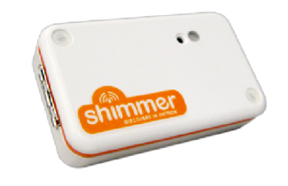
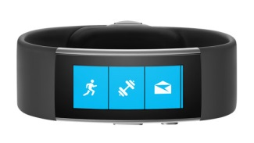
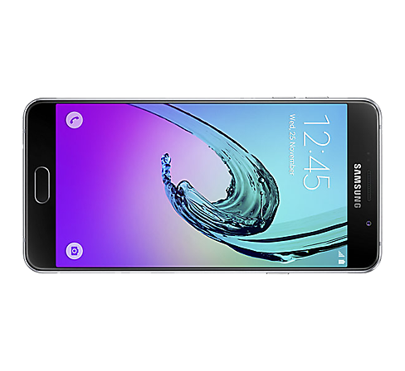
Wearables systems
Specialized devices (sensing, some processing)
Consumer wearables (sensing, some processing, HCI)
Smartphones (sensing, processing, HCI)
Images copyright Shimmer, Microsoft, Samsung

Slide 9
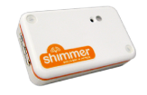
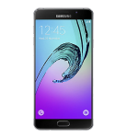
Wearable sensors
Accelerometer: acceleration, including gravity → orientation
Gyroscope: angular velocity
Photoplethysmogram (PPG) sensor: blood volume pulse → heart activity, blood oxygen (multiple wavelenghts)
Electrocardiogram (ECG) sensor: heart activity (richer information than PPG)
Electromyogram (EMG) sensor: activity of other muscles
Images copyright Shimmer, Microsoft, Samsung

Slide 10
Wearable sensors
Accelerometer: acceleration, including gravity → orientation
Gyroscope: angular velocity
Photoplethysmogram (PPG) sensor: blood volume pulse → heart activity, blood oxygen (multiple wavelenghts)
Electrocardiogram (ECG) sensor: heart activity (richer information than PPG)
Electromyogram (EMG) sensor: activity of other muscles
Images copyright Shimmer, Microsoft, Samsung

Slide 11
Wearable sensors
Electroencephalogram (EEG) sensor: brain activity
Galvanic skin response (GSR) / electrodermal activity (EDA): skin conductivity → sweating
Temperature sensor: skin/ambient temperature
Air pressure sensor: air pressure → (change in) altitude
GPS: location
Images copyright Shimmer, Microsoft, Samsung

Slide 12
Wearable sensors
Electroencephalogram (EEG) sensor: brain activity
Galvanic skin response (GSR) / electrodermal activity (EDA): skin conductivity → sweating
Temperature sensor: skin/ambient temperature
Air pressure sensor: air pressure → (change in) altitude
GPS: location
Images copyright Shimmer, Microsoft, Samsung

Slide 13
Wearable sensors
Electroencephalogram (EEG) sensor: brain activity
Galvanic skin response (GSR) / electrodermal activity (EDA): skin conductivity → sweating
Temperature sensor: skin/ambient temperature
Air pressure sensor: air pressure → (change in) altitude
GPS: location
Images copyright Shimmer, Microsoft, Samsung

Slide 14
Smart indoor environments
Smart homes/offices
Ambient assisted living (AAL) environments
Living laboratories
Special: smart factories, hospitals, shops...
Sensing, actuation; processing not an issue, various methods for HCI
Image copyright IEEE / Jaime Lloret et al.

Slide 15
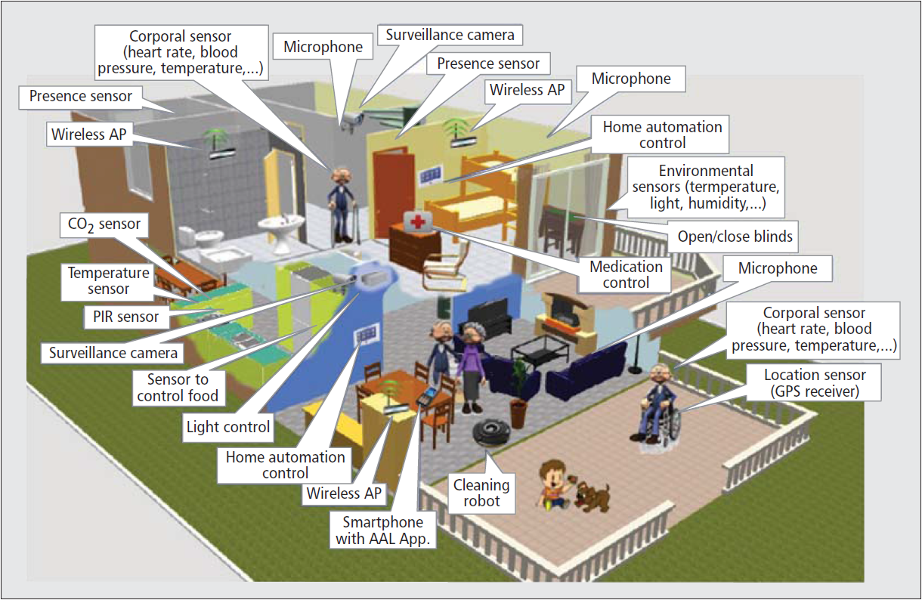
Smart indoor environments
Smart homes/offices
Ambient assisted living (AAL) environments
Living laboratories
Special: smart factories, hospitals, shops...
Sensing, actuation; processing not an issue, various methods for HCI
Image copyright IEEE / Jaime Lloret et al.

Slide 16
Indoor sensors
Camera (sometimes infrared)
Passive infrared (PIR) sensor, pressure sensor: occupant movement
Door, window, water flow sensor
Temperature, humidity, CO₂ sensor
Gas, carbon monoxide, flood sensor
Electricity meter: appliance use
Indoor localization – Bluetooth beacons, RFID, ultrasound, ultra-wideband ...

Slide 17
Indoor sensors
Camera (sometimes infrared)
Passive infrared (PIR) sensor, pressure sensor: occupant movement
Door, window, water flow sensor
Temperature, humidity, CO₂ sensor
Gas, carbon monoxide, flood sensor
Electricity meter: appliance use
Indoor localization – Bluetooth beacons, RFID, ultrasound, ultra-wideband ...

Slide 18
Indoor sensors
Camera (sometimes infrared)
Passive infrared (PIR) sensor, pressure sensor: occupant movement
Door, window, water flow sensor
Temperature, humidity, CO₂ sensor
Gas, carbon monoxide, flood sensor
Electricity meter: appliance use
Indoor localization – Bluetooth beacons, RFID, ultrasound, ultra-wideband ...

Slide 19
Indoor sensors
Camera (sometimes infrared)
Passive infrared (PIR) sensor, pressure sensor: occupant movement
Door, window, water flow sensor
Temperature, humidity, CO₂ sensor
Gas, carbon monoxide, flood sensor
Electricity meter: appliance use
Indoor localization – Bluetooth beacons, RFID, ultrasound, ultra-wideband ...

Slide 20
Indoor sensors
Camera (sometimes infrared)
Passive infrared (PIR) sensor, pressure sensor: occupant movement
Door, window, water flow sensor
Temperature, humidity, CO₂ sensor
Gas, carbon monoxide, flood sensor
Electricity meter: appliance use
Indoor localization – Bluetooth beacons, RFID, ultrasound, ultra-wideband ...

Slide 21
Smart outdoor environments
Smart cities
Public displays
Farms
Natural environments
...

Slide 22
Common applications

Slide 23
Health and AAL
Monitoring and assisting elderly people at home and on the go
Monitoring and guiding chronic patients at home and on the go

Slide 24
Health and AAL
Monitoring and assisting elderly people at home and on the go
Monitoring and guiding chronic patients at home and on the go
Monitoring hospital patients / nursing home residents

Slide 25
Health and AAL
Monitoring and assisting elderly people at home and on the go
Monitoring and guiding chronic patients at home and on the go
Monitoring hospital patients / nursing home residents
Monitoring and encouraging physical activity and general wellbeing of healthy users

Slide 26
Comfort, power and security
Controlling heating, ventilation, lighting etc. for higher comfort and lower power consumption
Appliance use scheduling for lower power consumption
Security monitoring – detection of unusual or prohibited behaviours/events

Slide 27
Comfort, power and security
Controlling heating, ventilation, lighting etc. for higher comfort and lower power consumption
Appliance use scheduling for lower power consumption
Security monitoring – detection of unusual or prohibited behaviours/events

Slide 28
Miscellaneous
Augmented reality in professional settings
Effective management of smart city infrastructure
Sensing and content adaptation for public displays
Sensing and actuation for precision agriculture
Monitoring natural environment for preservation and exploitation
...

Slide 29
Miscellaneous
Augmented reality in professional settings
Effective management of smart city infrastructure
Sensing and content adaptation for public displays
Sensing and actuation for precision agriculture
Monitoring natural environment for preservation and exploitation
...

Slide 30
Miscellaneous
Augmented reality in professional settings
Effective management of smart city infrastructure
Sensing and content adaptation for public displays
Sensing and actuation for precision agriculture
Monitoring natural environment for preservation and exploitation
...

Slide 31
Common technolgies and methods

Slide 32
... by area
Artificial intelligence
Sensing
AmI
Human-computer interaction
Mobile and distributed computing

Slide 33
Artificial intelligence
Artificial intelligence
Sensing
AmI
Machine learning and symbolic reasoning to models events, users, activities ...
Ontologies to represent knowledge
Rules to represent actions
Human-computer interaction
Mobile and distributed computing

Slide 34
Sensing
Artificial intelligence
Sensing
AmI
Computer vision
Indoor localization
Device-free sensing (from radio interference)
Human-computer interaction
Mobile and distributed computing

Slide 35
Mobile and distributed computing
Artificial intelligence
Sensing
AmI
Internet of things
Middlewares (e.g., UniversAAL)
Human-computer interaction
Mobile and distributed computing

Slide 36
Human-computer interaction
Artificial intelligence
Sensing
AmI
Gesture-based, tangible interaction
Augmented reality
User-centred design
Human-computer interaction
Mobile and distributed computing

Slide 37
Wearable example

Slide 38
Overview of the example
Sensing:
Acceleration
Heart rate
GSR

Slide 39
Overview of the example
Sensing:
Acceleration
Heart rate
GSR
Processing:
Activity recogniton
Human energy expenditure estimation
Stress detection

Slide 40
Overview of the example
Wellbeing recommendations:
Adequate daily/ weekly physical activity
Relaxation exercises if stressed
Sensing:
Acceleration
Heart rate
GSR
Processing:
Activity recogniton
Human energy expenditure estimation
Stress detection

Slide 41
Overview of the example
Wellbeing recommendations:
Adequate daily/ weekly physical activity
Move each hour
Relaxation exercises if stressed
Sensing:
Acceleration
Heart rate
GSR
Processing:
Activity recogniton
Human energy expenditure estimation
Stress detection

Slide 42
Activity recognition
a_{t} | a_{t+1} | a_{t+2} | ...
Acceleration data
Sliding window (2 s)

Slide 43
Activity recognition
a_{t} | a_{t+1} | a_{t+2} | ...
Acceleration data
Sliding window (2 s)
Training
f₁ | f₂ | f₃ | ... |  | Activity
AR model
Average acceleration
Standard deviation of acceleration
Orientation
...
Machine learning

Slide 44
Activity recognition
a_{t} | a_{t+1} | a_{t+2} | ...
Acceleration data
Sliding window (2 s)
Use/testing
f₁ | f₂ | f₃ | ...
AR model
Activity

Slide 45
Activity recognition
a_{t} | a_{t+1} | a_{t+2} | ...
Acceleration data
AR model
Activity

Slide 46
Energy expenditure estimation
a_{t} | a_{t+1} | a_{t+2} | ...
Acceleration, heart rate data
Sliding window (10 s)
AR model
Activity

Slide 47
Energy expenditure estimation
a_{t} | a_{t+1} | a_{t+2} | ...
Acceleration, heart rate data
Sliding window (10 s)
Like for AR
Heart rate
Area under acceleration
Kinetic energy
...
AR model
Activity
f’₁ | f’₂ | f’₃ | ... |  | Activity | EE
EEE model
Training
Machine learning (regression)

Slide 48
Energy expenditure estimation
a_{t} | a_{t+1} | a_{t+2} | ...
Acceleration, heart rate data
Sliding window (10 s)
AR model
Activity
f’₁ | f’₂ | f’₃ | ... |  | Activity
EEE model
EE
Use/testing

Slide 49
Energy expenditure estimation
a_{t} | a_{t+1} | a_{t+2} | ...
Acceleration, heart rate data
EEE model
EE

Slide 50
Energy expenditure estimation
a_{t} | a_{t+1} | a_{t+2} | ...
Acceleration, heart rate, GSR data
Sliding window (1 min)
Training
Machine learning (classification)
f“₁ | f“₂ | f“₃ | ... | History | Time | EE | Stress
Stress model
Heart rate variability features
GSR frequency features
EEE model
EE

Slide 51
Energy expenditure estimation
a_{t} | a_{t+1} | a_{t+2} | ...
Acceleration, heart rate, GSR data
Sliding window (1 min)
Use/testing
Machine learning (classification)
f“₁ | f“₂ | f“₃ | ... | History | Time | EE
Stress model
Stress
EEE model
EE

Slide 52
Energy expenditure estimation
a_{t} | a_{t+1} | a_{t+2} | ...
Acceleration, heart rate, GSR data
Sliding window (1 min)
Stress model
Stress

Slide 53
Wellbeing monitoring
AR model
Activity
EEE model
EE
Stress model
Stress
Improvements:
Adaptation to the phone‘s location, orientation
Multiple models (for energy expenditure estimation, stress detection)
Deep learning
...

Slide 54
Smart environment example

Slide 55
Overview of the example
Sensing:
Hardware
Virtual
Image copyright Netatmo

Slide 56
Overview of the example
Ontology +
Reasoning
Sensing:
Hardware
Virtual
Reason about:
Which sensor values are bad
Which actions improve them
Image copyright Netatmo

Slide 57
Overview of the example
Ontology +
Reasoning
Simulation
Sensing:
Hardware
Virtual
Reason about:
Which sensor values are bad
Which actions improve them
Simulate suggested actions
Recommend the best one
Image copyright Netatmo

Slide 58
Overview of the example
Ontology +
Reasoning
Simulation
Environment recommendations:
Appropriate temperature
Good air quality
Sensing:
Hardware
Virtual
Reason about:
Which sensor values are bad
Which actions improve them
Simulate suggested actions
Recommend the best one
Image copyright Netatmo

Slide 59
Sensing
Indoor:
Temperature
Humidity
CO₂
Outdoor:
Temperature
Humidity
Sensing:
Hardware
Virtual

Slide 60
Sensing
Indoor:
Temperature
Humidity
CO₂
Outdoor:
Temperature
Humidity
Sensing:
Hardware
Virtual
Number of occupants
Windows opened/closed

Slide 61
Sensing
Indoor:
Temperature
Humidity
CO₂
Outdoor:
Temperature
Humidity
Sensing:
Hardware
Virtual
Number of occupants
Windows opened/closed
Machine-learning model / heuristics
Hardware sensor readings (CO₂ and others)

Slide 62
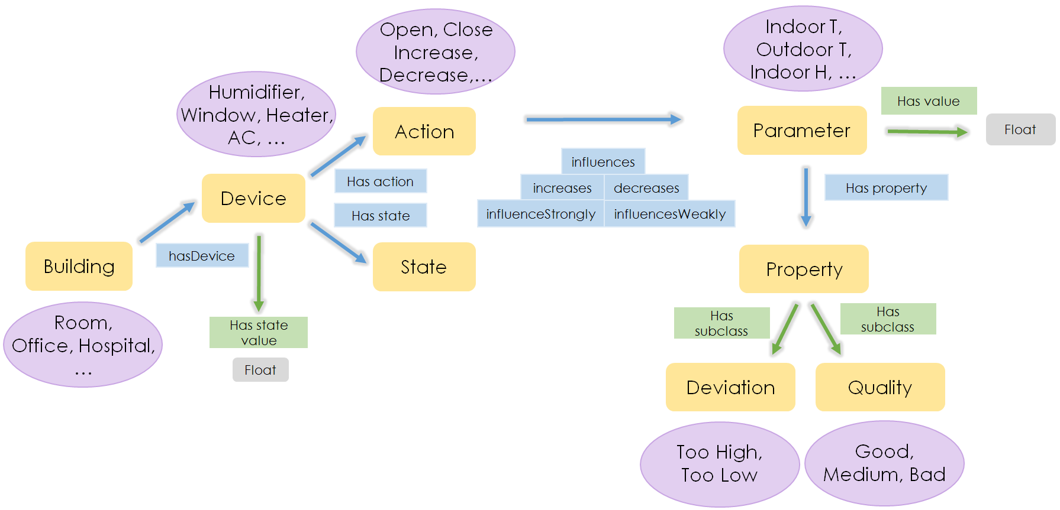
Ontology + reasoning

Slide 63
Simulation
Suggested actions
from the ontology + reasoning

Slide 64
Simulation
Suggested actions
from the ontology + reasoning
Prediction of outcomes:
Temperature
Humidity
CO₂

Slide 65
Simulation
Suggested actions
from the ontology + reasoning
Prediction of outcomes:
Temperature
Humidity
CO₂
Machine-learning / physics models
History of sensor readings

Slide 66
Simulation
Suggested actions
from the ontology + reasoning
Prediction of outcomes:
Temperature
Humidity
CO₂
Evaluation of the predicted outcomes

Slide 67
Simulation
Suggested actions
from the ontology + reasoning
Prediction of outcomes:
Temperature
Humidity
CO₂
Evaluation of the predicted outcomes
1
0
0
–1
–1

Slide 68
Simulation
Suggested actions
from the ontology + reasoning
Prediction of outcomes:
Temperature
Humidity
CO₂
Evaluation of the predicted outcomes
Recommended action

