Slide 1
Detection of unusual behavior
Mitja Luštrek
Jožef Stefan Institute
Department of Intelligent Systems
Slovenia
Tutorial at the University of Bremen, November 2012

Slide 2
Outline
Local Outlier Factor algorithm
Examples of straightforward features
Spatial-activity matrix

Slide 3
Outline
Local Outlier Factor algorithm
Examples of straightforward features
Spatial-activity matrix

Slide 4
Outliers
An outlier is an instance that is numerically distant from the rest of the data
Behavior represented as a series of numerical instances
Unusual behavior = outlier

Slide 5
The idea of Local Outlier Factor (LOF)
Outlier
Not outlier

Slide 6
LOF algorithm
Local density = distance of an instance from its k nearest neigbors
Compute local density of an instance
Compute local densities of its neigbors
If the former is substantially lower than the latter, the instance is an outlier

Slide 7
LOF algorithm
A ... instance of interest
d (A, B) ... distance between instances A and B
N_{k} (A) ... k nearest neigbors of A (may be more than k in case of ties)
k-distance (A) ... max_{B∈Nk(A)} {d (A, B)}

Slide 8
Reachability distance
Rechability distance of the instance A from B is
d (A, B); A ∉ N_{k} (B) //Normal distance
k-distance (B); A ∈ N_{k} (B) //But at least k-distance
reachability-distance_{k} (A, B) = max {d (A, B), k-distance (B)}

Slide 9
Local reachability density
Local reachability density of the instance A is the inverse of the average reachability distance of A from its neighbors
Low reachability of A ⇒ high lrd (A) ⇒ A is in a dense neigborhood

Slide 10
LOF value
LOF value of the instance A is the average lrd of its neighbors, divided by lrd (A)
High LOF (A) ⇒ neigbors of A are in denser areas than A ⇒ A is an outlier
LOF = 1 roughly separates normal from unusual

Slide 11
Detection of unusual behavior
Store (normal) training data
For a new instance A:
Find k nearest neighbors N_{k} (A)
Compute lrds of the neigbors and lrd_{k} (A)
Compute LOF_{k} (A)
If LOF_{k} (A) > threshold then A is unusual
Cache all lrds

Slide 12
Parameters
We need to tune:
The number of nearest neighbors k
The threshold between normal and unusual
If we have unusual instances: maximize area under ROC
If we only have normal instances:
Low k for small datasets, large k for large datasets
Use some common sense and experimentation
Threshold such that most instances have LOF values below it

Slide 13
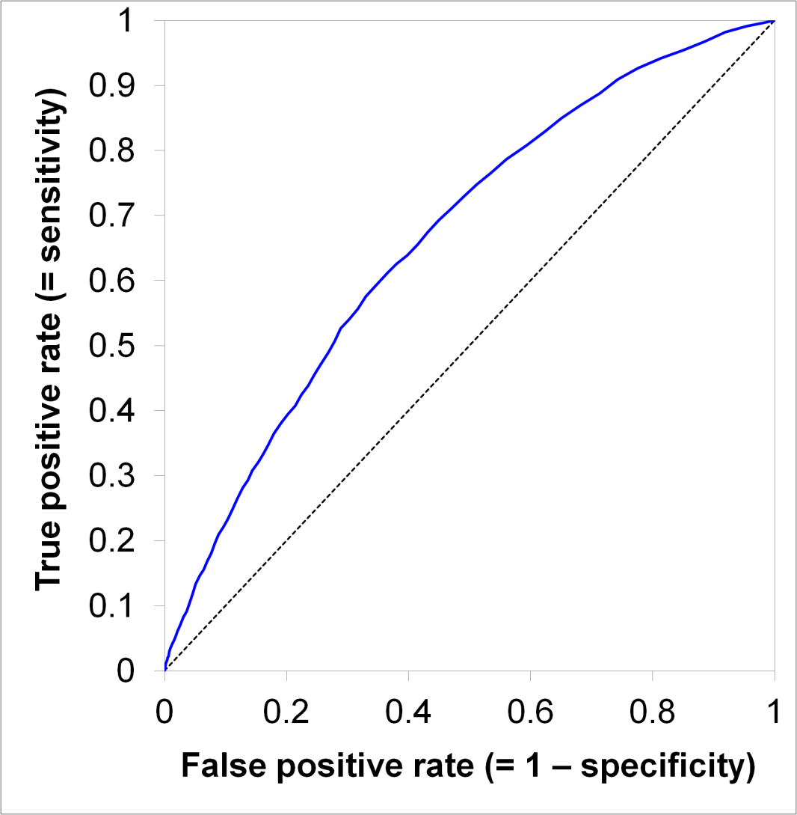
ROC curve
True positive rate = (correctly) recognized unusual instances out of all unusual instances
False positive rate = instances incorrectly recognized as unusual out of all normal instances
Area under ROC

Slide 14
Outline
Local Outlier Factor algorithm
Examples of straightforward features
Spatial-activity matrix

Slide 15
Instance for LOF
A vector af numerical features
The feature describe the observed phenomenon (behavior)
The features can also be nominal, but distance can be tricky:
Simple: same/different = 0/1
Complex: distance based on sub-features

Slide 16
Gait features
Double support time

Slide 17
Gait features
Swing time

Slide 18
Gait features
Support time

Slide 19
Gait features
Distance ankle–hip
Distance floor–ankle

Slide 20
Gait features
And others ...
Distance ankle–hip
Distance floor–ankle

Slide 21
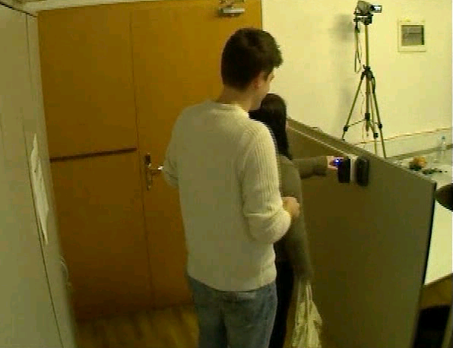
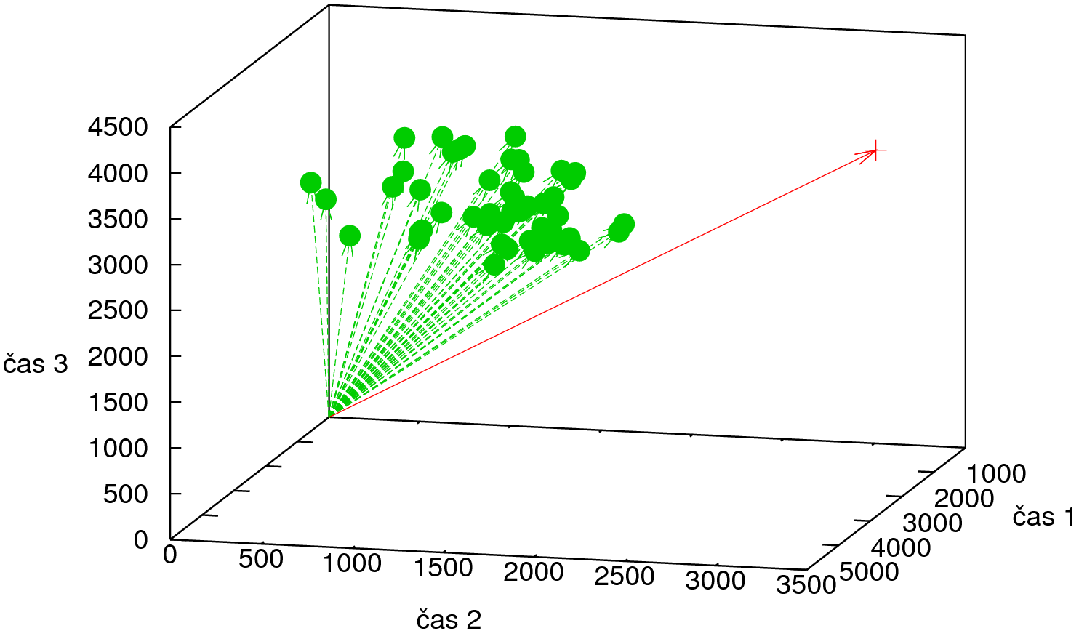
Entry control
Fingerprint reader
Card reader
Door sensor
Time 3
Time 1
Time 2

Slide 22
Outline
Local Outlier Factor algorithm
Examples of straightforward features
Spatial-activity matrix

Slide 23
Behavior trace
Spaces (rooms) 1 ... n {Lounge, Bedroom, Kitchen, WC}
Activities 1 ... m {Lying, Sitting, Standing}
Behavior trace B = [(a₁, s₁), (a₂, s₂), ..., (a_{T}, s_{T}))

Slide 24
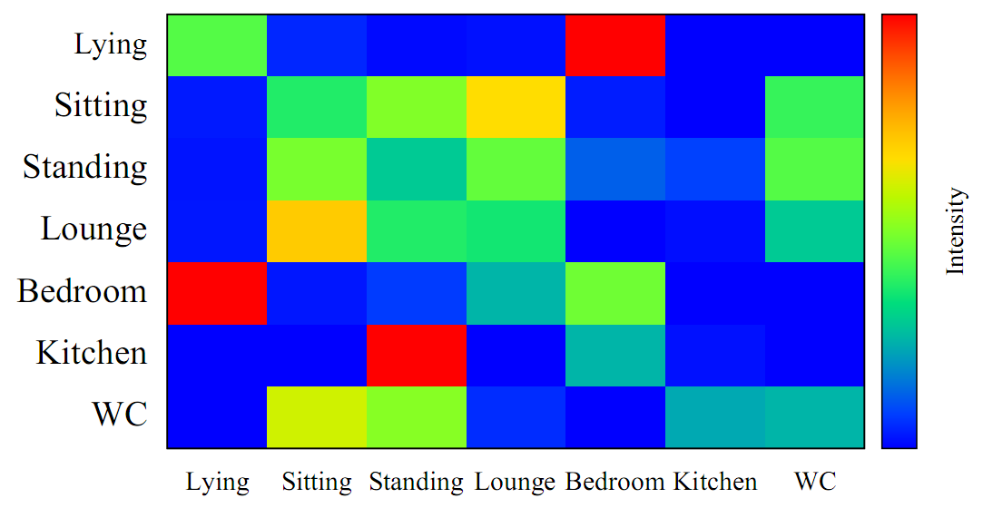
Spatial-activity matrix

Slide 25
Spatial-activity matrix
Fraction of time
spent doing activities

Slide 26
Spatial-activity matrix
Transtions between activities

Slide 27
Spatial-activity matrix
The same for rooms

Slide 28
Spatial-activity matrix
Distribution of rooms over activities

Slide 29
Spatial-activity matrix
Distribution of activities
over rooms

Slide 30
Unroll into a vector
Unroll into a vector: [(A₁, A₁), (A₁, A₂), ..., (S₄, S₄)
Apply Principal Component Analysis (PCA)

Slide 31
PCA
Dimensionality reduction method
Transforms the data to a new coordinate system, in which:
The first coordinate has the greatest variance
The second coordinate has the second greatest variance
...
The first few coordinates account for most of the variability in the data, the others may be ignored

Slide 32
Data matrix
X^{T} = Spatial-activity vector (1) Spatial-activity vector (2) ... Spatial-activity vector (N)
N ... number of days (rows)
M ... dimensionality of each spatial-activity vector (number of columns)
Normalized
to zero mean

Slide 33
Eigenvalues
C = X X^{T} ... covariance matrix
Eigendecomposition: V ^{–1} C V = D
V ... columns of V are eigenvectors of C
D ... diagonal matrix with eigenvalues of C on the diagonal
Use some computer program to do this for you
Sort V and D by decreasing eigenvalue

Slide 34
Dimensionality reduction
W = V with only the first L columns (principal components)
Y = W^{T} X ... dimensionality-reduced data
In practice:
A different, more comptationally effective PCA method is used
You do not program it yourself anyway

Slide 35
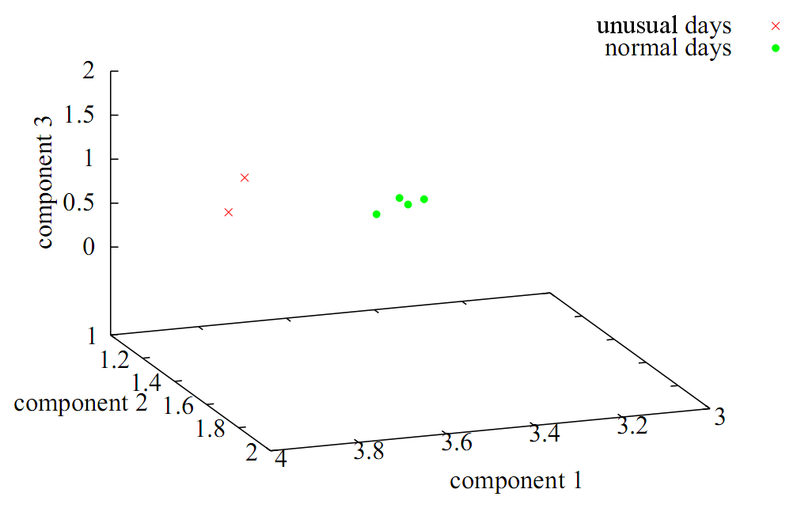
Experimental results
First 3 principal components

