Slide 1
Variants, improvements etc. of activity recognition with wearable accelerometers
Mitja Luštrek
Jožef Stefan Institute
Department of Intelligent Systems
Slovenia
Tutorial at the University of Bremen, November 2012

Slide 2
Outline
Different sensor types
Dynamic signal segmentation
Low- and high-pass filter
Feature selection
Smoothing with Hidden Markov Models

Slide 3
Outline
Different sensor types
Dynamic signal segmentation
Low- and high-pass filter
Feature selection
Smoothing with Hidden Markov Models

Slide 4
Magnetometer
It measures the strength of (Earth’s) magnetic field
MEMS magnetometers are often of the magnetoresistive type: they use strips of alloy (nickel-iron) whose electrical resistance varies with change in magnetic field
Tri-axial
Can measure azimuth (like compass) and inclination

Slide 5
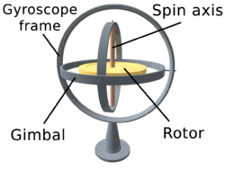
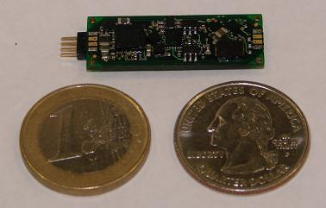
Gyroscope
It measures angular velocity
MEMS gyroscopes use vibrating objects, which also tend to preserve the direction of vibration
Gyroscope
Magnetometer
Accelerometer

Slide 6
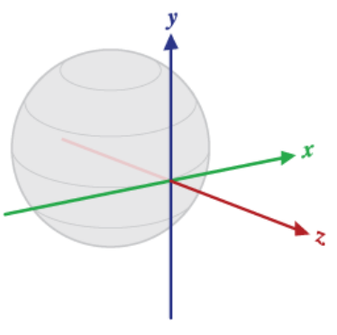
The whole inertial package
Accelerometer: x, y
Magnetometer: x, z
Orientation accurate long-term, subject to disturbances short-term
Gyroscope: orientation accurate short-term, drifts long-term
Accelerometer: location by double integration, drifts

Slide 7
Kalman filter
Statistically optimally estimates the state of a system
Combines the measurement of the current state with the extrapolation from the previous state
Combines various sensors / quantities
Takes into account noise

Slide 8
Basic Kalman equations
x_{k} = A x_{k–1} + B u_{k–1} + w_{k–1}
z_{k} = H x_{k} + v_{k}
x_{k}, x_{k–1} ... current, previous state
u_{k–1} ... input in the previous state
w_{k–1} ... process noise (in the previous state )
A ... relation previous state – current state
B ... relation previous input – current state

Slide 9
Basic Kalman equations
x_{k} = A x_{k–1} + B u_{k–1} + w_{k–1}
z_{k} = H x_{k} + v_{k}
z_{k} ... current measurement
v_{k} ... measurement noise
H ... relation state – measurement

Slide 10
Combining accelerometer and gyroscope
x_{k} = A x_{k–1} + B u_{k–1} + w_{k–1}
ϕ ... orientation (one direction only!)
ω_{drift} ... gyroscope drift
dt ... time between states k and k–1
ω ... angular velocity

Slide 11
Combining accelerometer and gyroscope
z_{k} = H x_{k} + v_{k}
ϕ_{acc} ... orientation according to accelerometer

Slide 12
Noise
Process noise w ~ N (0, Q)
Measurement noise v ~ N (0, R)

Slide 13
Kalman computations
Predict:
x_{k} = A x_{k–1} + B u_{k–1}
P_{k} = A P_{k–1} + A^{T} + Q (P ... error covariance, initialized to 0)
Correct:
K_{k} = P_{k} H^{T} (H P_{k} H^{T} + R)^{–1} (K ... Kalman gain)
x_{k} = x_{k} + K_{k} (z_{k} – H x_{k})
P_{k} = (I – K_{k} H) P_{k}

Slide 14
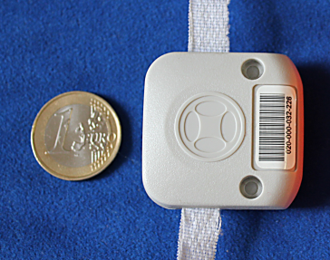
UWB location sensors
Tags that transmit ultra-wideband radio pulses
Sensors that detect the time and angle of arrival of these pulses
Ubisense real-time location system:
Declared accuracy 15 cm
~10.000 EUR

Slide 15
Applications to activity recogntion etc.
All the sensors generate a data stream that can be treated the same way as accelerometer streams
Combining multiple sensors can improve orientation sensing
Location sensors good for providing context (fall detection in the bed / on the floor)

Slide 16
Outline
Different sensor types
Dynamic signal segmentation
Low- and high-pass filter
Feature selection
Smoothing with Hidden Markov Models

Slide 17
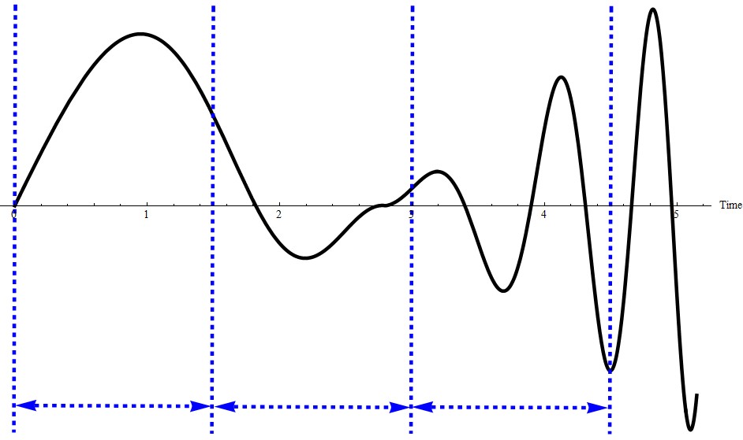
The problem
In activity recognition, the data is usually segmented into intervals and an activity is assigned to each interval
Intervals usually have equal lengths
One interval can contain multiple activities or different parts of an activity

Slide 18
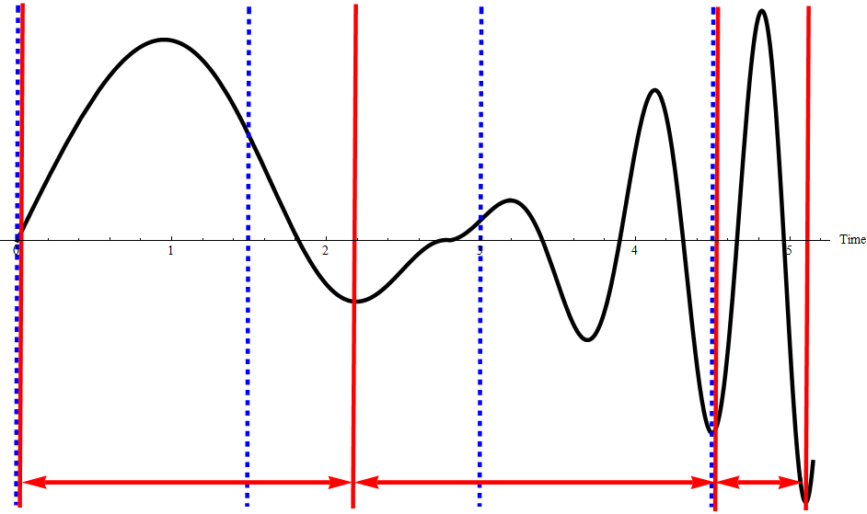
The solution
Align intervals with activities
Set interval boundaries when a significant change between data samples occurs
Improve classification accuracy

Slide 19
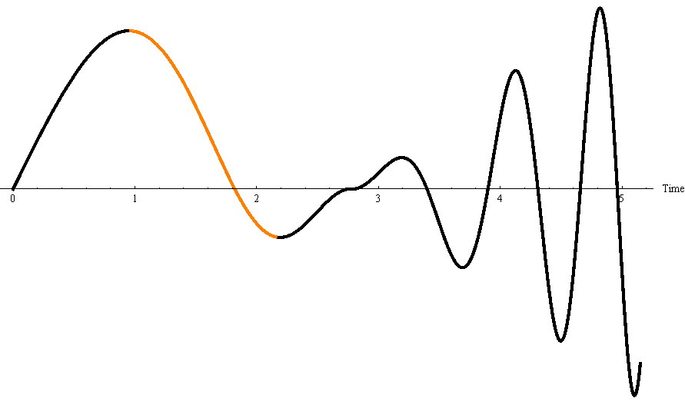
The algorithm
Find an interval S of data samples with monotonically decreasing values
If |max (S) – min (S)| > threshold then boundary between two intervals (significant change occured)
Only decreasing because acceleration is usually followed by deceleration

Slide 20
Threshold
Threshold based on previous N samples
Dynamically adapts to the data
threshold = = (avg_{max} – avg_{min}) C
N = 100
C = 0.4
$${avg}_{max}$$
$${avg}_{min}$$

Slide 21
Experimental results
Activity recognition:
(Static) activities
Transitions between activities
 | Methods
 | Non-overlapping sliding window | Overlapping sliding window | Dynamic signal segmentation
Activities | 94.8 % | 95.3% | 97.5 %
Activities and transitions | 89.0 % | 89.6 % | 92.9 %

Slide 22
Outline
Different sensor types
Dynamic signal segmentation
Low- and high-pass filter
Feature selection
Smoothing with Hidden Markov Models

Slide 23
Accelerometer signal elements
Gravity, which signifies orientation (rotation)
Changes with a low frequency when the accelerometer is worn on a person
Acceleration due to translation
Changes with a medium frequency
Noise
Changes with a high frequency

Slide 24
Features depend on different elements
Gravity / low frequency:
The orientation of the accelerometer
...
Translation / medium frequency:
The variance of the acceleration
The sum of absolute differences between the consecutive lengths of the acceleration vector
...

Slide 25
Remove unnecessary elements
Gravity / low frequency:
Low-pass filter
Attenuates higher-frequency signal elements
Translation / medium frequency:
Band-pass filter
Attenuates low- (gravity) and high-frequency (noise) signal elements

Slide 26
Low-pass filter
Completely removing higher frequencies impossible without an infinite delay
Many practical filters exist: Butterworth, Chebyshev ...
Simple implementation: x_{lp} (i) = α x (i) + (1 – α) x_{lp} (i – 1) Decreasing α increases the inertia of the filter

Slide 27
Band-pass filter
Combines low- and high-pass filter
Simple high-pass filter: Subtracts low-pass signal from the raw signal x_{lp} (i) = β x (i) + (1 – β) x_{lp} (i – 1) x_{hp} (i) = x (i) – x_{lp} (i)

Slide 28
Outline
Different sensor types
Dynamic signal segmentation
Low- and high-pass filter
Feature selection
Smoothing with Hidden Markov Models

Slide 29
Feature selection
Usually not difficult to come up with many features, however:
They may slow down learning
Some may be redundant
Some may be noisy
Some machine learning algorithms cope badly with many features (overfitting)
So, select just the features that are really useful!

Slide 30
Selection by information gain
Information gains assigns a score to each feature
Rank features by these scores
Select the top n features

Slide 31
Selection by Random Forest
Random Forest selects N instances randomly with replacement out of the total N instances
Roughly 1/3 of the instances not selected
Classify these, compute accuracy ac_{before}
Randomly permute each feature f, compute accuracy ac_{after} (f)
Assign score ac_{before} – ac_{after} (f) to feature f
Rank by these scores, select the top n features

Slide 32
ReliefF
N ... number of instances
M ... number of features
C ... number of classes
NN [1 ... C, 1 ... K] ... nearest K neighbors of an instance for each class
dist (i, j; k) ... distance between instances i and j according to the feature k
Imp [1 ... M] ... importance of features

Slide 33
For i = 1 to M //Features
Imp [i] = 0
For i = 1 to N //Instances
NN = nearest K neighbors of instance i in each class
For j = 1 to M //Features
For k = 1 to C //Classes
If instance i belongs to class k then
For l = 0 to K //Neighbors
Imp [j] –= dist (i, NN [k, l]; j)
else
For l = 0 to K //Neighbors
Imp [j] += dist (i, NN [k, l]; j)

Slide 34
For i = 1 to M //Features
Imp [i] = 0
For i = 1 to N //Instances
NN = nearest K neighbors of instance i in each class
For j = 1 to M //Features
For k = 1 to C //Classes
If instance i belongs to class k then
For l = 0 to K //Neighbors
Imp [j] –= dist (i, NN [k, l]; j)
else
For l = 0 to K //Neighbors
Imp [j] += dist (i, NN [k, l]; j)

Slide 35
For i = 1 to M //Features
Imp [i] = 0
For i = 1 to N //Instances
NN = nearest K neighbors of instance i in each class
For j = 1 to M //Features
For k = 1 to C //Classes
If instance i belongs to class k then
For l = 0 to K //Neighbors
Imp [j] –= dist (i, NN [k, l]; j)
else
For l = 0 to K //Neighbors
Imp [j] += dist (i, NN [k, l]; j)

Slide 36
For i = 1 to M //Features
Imp [i] = 0
For i = 1 to N //Instances
NN = nearest K neighbors of instance i in each class
For j = 1 to M //Features
For k = 1 to C //Classes
If instance i belongs to class k then
For l = 0 to K //Neighbors
Imp [j] –= dist (i, NN [k, l]; j)
else
For l = 0 to K //Neighbors
Imp [j] += dist (i, NN [k, l]; j)

Slide 37
What should n be
Find out experimentally
Use one of the methods to rank features
Start removing features from the bottom
Perform classification after removing each feature
Stop when the classification gets worse

Slide 38
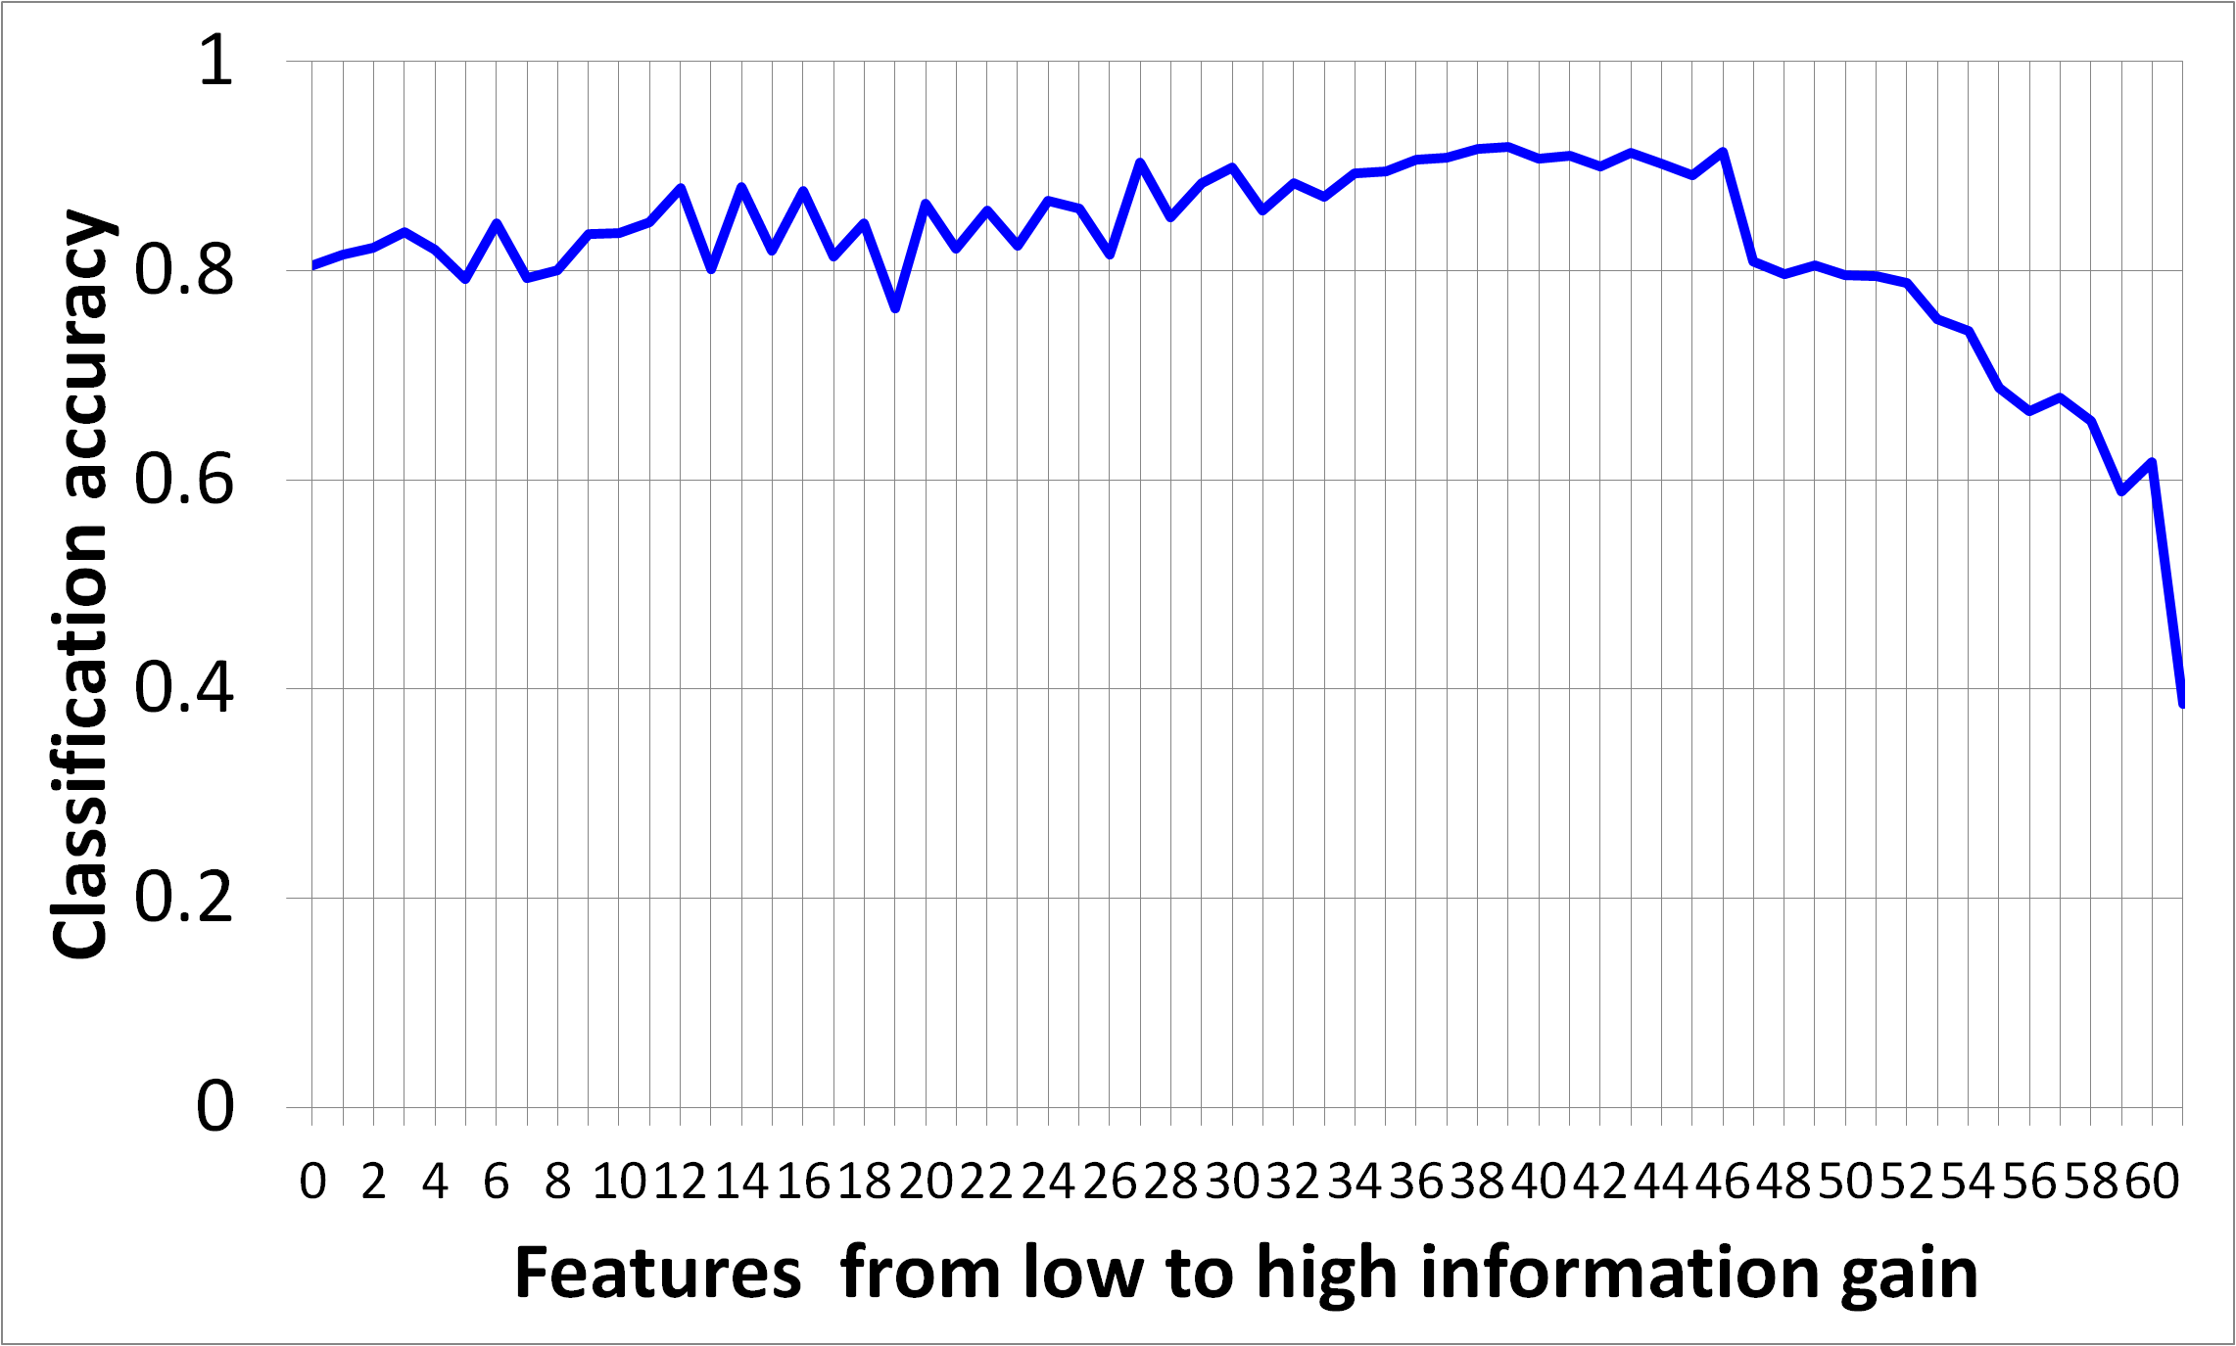
Experimental results
The best cutoff

Slide 39
Do not touch test data until testing
Golden rule of machine learning: never test on training data
Hence cross-validation:
Divide data into n “folds”
Train on (n – 1) folds, test on the last fold
Repeat n times
Also: never test on data used for feature selection (it is a bit like training)

Slide 40
Outline
Different sensor types
Dynamic signal segmentation
Low- and high-pass filter
Feature selection
Smoothing with Hidden Markov Models

Slide 41
Hidden Markov Model
a₁₁
Observation 1
b₁₁
State 1
b₁₂
Observation 2
b₁₃
b₂₂
a₂₁
Observation 3
b₂₁
b₃₁
a₁₂
b₃₂
b₂₃
a₁₃
a₃₁
b₃₃
States
Transitions
Emissions/
observations/
outputs
State 2
State 3
a₂₃
a₃₂
a₂₂
a₃₃

Slide 42
Hidden Markov Model (HMM)
States are hidden and are typically the item of interest (= true activities)
The next state depends on the previous one (Markov property)
Observations are visible (= recognized activities)

Slide 43
Learning the model
Baum-Welch algorithm
Possible states and observations known
Input: sequence of observations Y = {y₁, y₂, ..., y_{T}}
Output: transition matrix A emission matrix B

Slide 44
Learning the model
Initialize A and B to something (e.g., uniform distribution)
α_{j} (t) ... probability that the model is in state x_{j} at time t, having generated Y until t
α_{j} (0) initialized to something for all j (sometimes starting state is known)
α_{j} (t) = Σ_{i} α_{i} (t – 1) a_{ij} b_{jy(t)}
Can compute α_{j} (t) recursively for for all j, t

Slide 45
Learning the model
Initialize A and B to something (e.g., uniform distribution)
β_{i} (t) ... probability that the model is in state x_{j} at time t, and will generate Y from t on
β_{i} (T) initialized to something for all j (sometimes end state is known)
β_{i} (t) = Σ_{j} a_{ij} b_{jy(t+1)} β_{j} (t + 1)
Can compute β_{i} (t) recursively for for all i, t

Slide 46
Learning the model
Probability of transition from x_{i} (t – 1) to x_{j} (t), given that the current model generated Y:
Iteratively estimate for all i, j, k:

Slide 47
Using the model
Viterbi algorithm
Complete model known
Input: sequence of observations Y = {y₁, y₂, ..., y_{T}}
Output: sequence of states X = {x₁, x₂, ..., x_{T}}

Slide 48
Using the model
X = {}
For t = 1 to T
For all j compute α_{j} (t) //In state y_{j} at time t, having generated Y until t
j_{max} = argmax α_{j} (t)
Append x_{jmax} to X

Slide 49
HMM in activity recognition
Take into account probabilities of transitioning from one activity to another (A)
Take into account the probabilities of different errors of activity recognition (B)
Reduce the number of spurious transitions

Slide 50
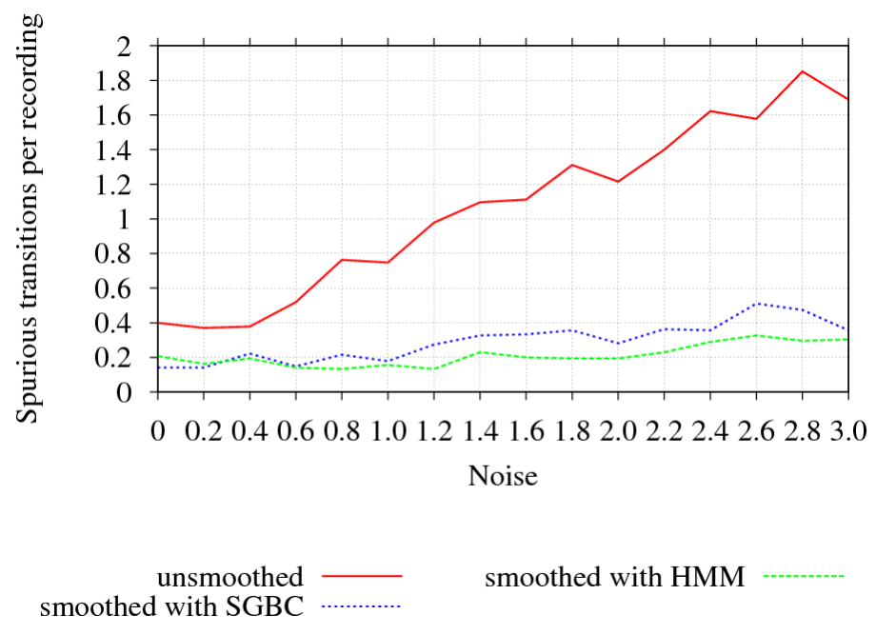
Experimental results

Slide 51
Other applications of HMM
Recognition of complex activities from simple ones
Speech recognition
Part-of-speech tagging, named entity recognition
Sequence analysis in bioinformatics
...

