Slide 1
Activity recognition with wearable accelerometers
Mitja Luštrek
Jožef Stefan Institute
Department of Intelligent Systems
Slovenia
Tutorial at the University of Bremen, November 2012

Slide 2
Outline
Accelerometers
Activity recognition with machine learning
Random Forest machine learning algorithm
Machine learning tools

Slide 3
Outline
Accelerometers
Activity recognition with machine learning
Random Forest machine learning algorithm
Machine learning tools

Slide 4
Whan an accelerometer does
It measures acceleration!
9.81 m/s² at rest (1 g, the Earth’s gravity)
0 m/s² in free fall
Gravity + whatever additional forces are present in typical conditions

Slide 5
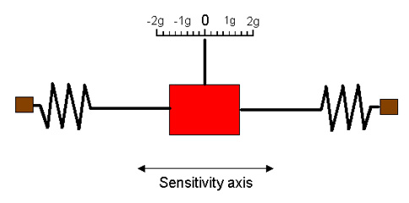
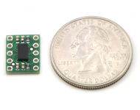
How does it work
In MEMS accelerometers the mass pushes:
Metal plates of a capacitor to change capacitance
A resistor to change resistance
A piezoelectric crystal to produce voltage

Slide 6
Three axes
Accelerometers normally sense acceleration along a single axis
To sense all acceleration, three-axial accelerometers are typically used
Since accelerometers sense the gravity, this means we know which way the ground is
Auto-rotation of smartphone display
Orientation of body parts

Slide 7
Best placement for activity recognition

Slide 8
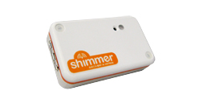
Shimmer accelerometers
Bluetooth
802.15.4 (ZigBee)
Programmable microcontroller (TinyOS)
200 EUR
Also available:
Gyroscope
Magnetometer
ECG
EMG
Galvanic skin response
Ambient (temperature, humidity, motion)
GPS

Slide 9
TinyOS programming
OS for low-power wireless devices
nesC – a C dialect, event-driven
A bit tricky to get used to, not perfectly documented
Quite capable, can do any (not overly computationally demanding) data manipulation and transmission

Slide 10
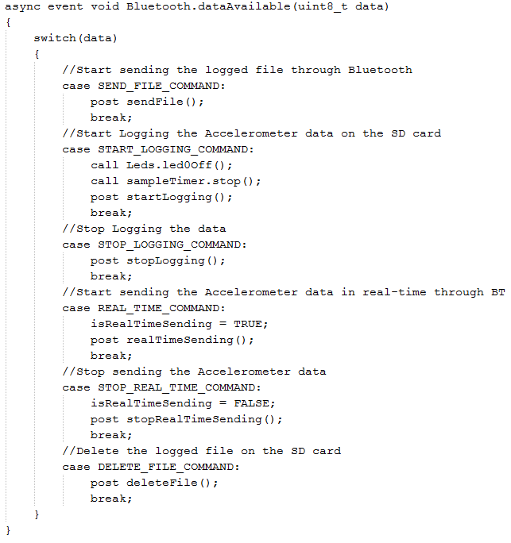
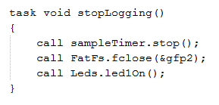
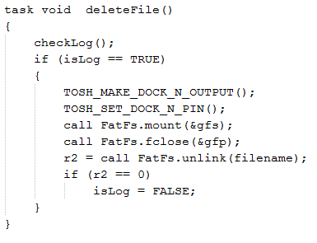

Slide 11
Bluetooth Low Energy
Important limitation of wearable sensors:
Bluetooth consumes too much power (Shimmer drains battery in <8 hours of continuous transmission)
802.15.4 (ZigBee) a bit better, but incompatible with smartphones
Bluetooth Low Energy coming to the market:
50 hours of continuous transmission from a coin battery
Works on Motorola RAZR smartphone (more phones coming)

Slide 12
Outline
Accelerometers
Activity recognition with machine learning
Random Forest machine-learning algorithm
Machine learning tools

Slide 13
Sensor signal → features
20–50 Hz (our choice is 50 Hz)
1 g
x
y
z
Sliding window
(overlapping or no)
1–5 s
(our choice is 2 s)
Compute features/attributes for each window

Slide 14
Features
The average acceleration along the x, y and z axes, and the average length of the acceleration vector within the window.

Slide 15
Features
The variance of the acceleration along x, y and z axes and the variance of the length of the acceleration vector
The maximum and the minimum acceleration along the x, y and z axes and the maximum and the minimum length of the acceleration vector

Slide 16
Features
The orientation of the accelerometer along the x, y and z axes
The sum of absolute differences between the consecutive lengths of the acceleration vector

Slide 17
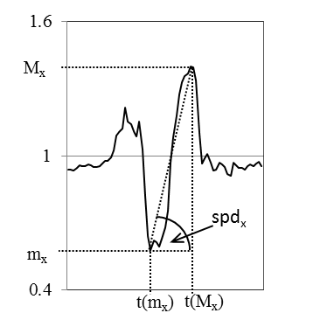
Features
The angle of change in the acceleration between the maximum and the minimum acceleration along the x, y and z axes and the length of the acceleration vector

Slide 18
Features
The correlation between all pairs of axes of the accelerometer, computed as the Pearson product-moment correlation coefficient
And others, including frequency-domain features ...

Slide 19
Machine learning
Features
Class
Feature vector
f₁ | f₂ | f₃ | ... |  | Activity
Training data needed, in which the class is manually labelled
Time-consuming to prepare
Labelling during recording can speed it up

Slide 20
Machine learning
Features
Class
Feature vector
f₁ | f₂ | f₃ | ... |  | Activity
Machine-learning algorithm
Training
Classifier

Slide 21
Machine learning
Features
Feature vector
f₁ | f₂ | f₃ | ...
Use/testing
Predicted
class
Classifier
Activity

Slide 22
Outline
Accelerometers
Activity recognition with machine learning
Random Forest machine learning algorithm
Machine learning tools

Slide 23
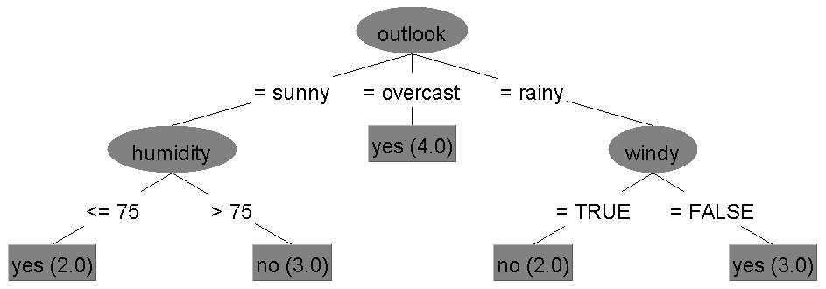
Decision tree
Play tennis?
Feature
Feature value
Class

Slide 24
ID3/C4.5 algorithm
FS = the set of all features
TS = whole training set
T = tree with a single node
BuildTree (FS, TS, T)
F = feature from FS that best classifies TS
Assign F to the node in T
For each possible value of F = f1 ... fN
TSi = subset of TS where F = fi
If all instances in TSi have the same class then
stop
else
Ti = newly crated descendant of T
BuildTree (FS without F, TSi, Ti)

Slide 25
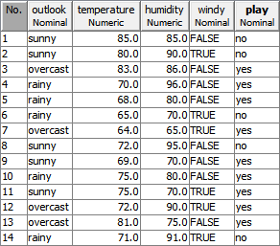
ID3/C4.5 algorithm
FS = {outlook, temperature, humidity, windy}
TS =
T =

Slide 26
BuildTree (FS, TS, T)
F = feature from FS that best classifies TS
Assign F to the node in T
For each possible value of F = f1 ... fN
TSi = subset of TS where F = fi
If all instances in TSi have the same class then
stop
else
Ti = newly crated descendant of T
BuildTree (FS without F, TSi, Ti)
F = outlook

Slide 27
BuildTree (FS, TS, T)
F = feature from FS that best classifies TS
Assign F to the node in T
For each possible value of F = f1 ... fN
TSi = subset of TS where F = fi
If all instances in TSi have the same class then
stop
else
Ti = newly crated descendant of T
BuildTree (FS without F, TSi, Ti)
F = outlook
outlook = sunny

Slide 28
BuildTree (FS, TS, T)
F = feature from FS that best classifies TS
Assign F to the node in T
For each possible value of F = f1 ... fN
TSi = subset of TS where F = fi
If all instances in TSi have the same class then
stop
else
Ti = newly crated descendant of T
BuildTree (FS without F, TSi, Ti)
F = outlook
outlook = sunny

Slide 29
BuildTree (FS, TS, T)
F = feature from FS that best classifies TS
Assign F to the node in T
For each possible value of F = f1 ... fN
TSi = subset of TS where F = fi
If all instances in TSi have the same class then
stop
else
Ti = newly crated descendant of T
BuildTree (FS without F, TSi, Ti)
F = humidity

Slide 30
BuildTree (FS, TS, T)
F = feature from FS that best classifies TS
Assign F to the node in T
For each possible value of F = f1 ... fN
TSi = subset of TS where F = fi
If all instances in TSi have the same class then
stop
else
Ti = newly crated descendant of T
BuildTree (FS without F, TSi, Ti)
F = humidity

Slide 31
BuildTree (FS, TS, T)
F = feature from FS that best classifies TS
Assign F to the node in T
For each possible value of F = f1 ... fN
TSi = subset of TS where F = fi
If all instances in TSi have the same class then
stop
else
Ti = newly crated descendant of T
BuildTree (FS without F, TSi, Ti)
F = outlook
outlook = overcast

Slide 32
BuildTree (FS, TS, T)
F = feature from FS that best classifies TS
Assign F to the node in T
For each possible value of F = f1 ... fN
TSi = subset of TS where F = fi
If all instances in TSi have the same class then
stop
else
Ti = newly crated descendant of T
BuildTree (FS without F, TSi, Ti)
F = outlook
outlook = rainy

Slide 33
BuildTree (FS, TS, T)
F = feature from FS that best classifies TS
Assign F to the node in T
For each possible value of F = f1 ... fN
TSi = subset of TS where F = fi
If all instances in TSi have the same class then
stop
else
Ti = newly crated descendant of T
BuildTree (FS without F, TSi, Ti)
F = outlook
outlook = rainy

Slide 34
BuildTree (FS, TS, T)
F = feature from FS that best classifies TS
Assign F to the node in T
For each possible value of F = f1 ... fN
TSi = subset of TS where F = fi
If all instances in TSi have the same class then
stop
else
Ti = newly crated descendant of T
BuildTree (FS without F, TSi, Ti)
F = windy

Slide 35
BuildTree (FS, TS, T)
F = feature from FS that best classifies TS
Assign F to the node in T
For each possible value of F = f1 ... fN
TSi = subset of TS where F = fi
If all instances in TSi have the same class then
stop
else
Ti = newly crated descendant of T
BuildTree (FS without F, TSi, Ti)
F = windy

Slide 36
Feature that best classifies ...
Measured by information gain
Information gain of the feature F measures how much information about the class C one gains by knowing the value of F
In other words, it is the reduction in uncertainy about C, which is measured by entropy
H (C) ... entropy of C
H (C|F) ... conditional entropy of C if the value of F is known
IG (C, F) = H (C) – H (C|F)

Slide 37
Entropy
Entropy of the class C is the expected number of bits needed to (optimally) encode the class of a randomly drawn instance
Assume C has 4 possible values c₁, c₂, c₃, c₄
Evenly distributed | Unevenly distributed
P (c₁) = 0.25, c₁ = 00 | P (c₁) = 0.90, c₁ = 0
P (c₂) = 0.25, c₂ = 01 | P (c₂) = 0.08, c₂ = 10
P (c₃) = 0.25, c₃ = 10 | P (c₃) = 0.01, c₃ = 110
P (c₄) = 0.25, c₄ = 11 | P (c₄) = 0.01, c₄ = 111
H (C) = 2 bit | H (C) = 1.12 bit

Slide 38
Entropy & information gain
The class C has possible values c₁, ..., c_{M}
The feature F has possible values f₁, ..., f_{N}
IG (C, F) = H (C) – H (C|F)

Slide 39
Random forest
Random forest is composed of multiple trees (it is an ensemble of trees)
The trees are somewhat random
No surprises so far!
Works really well on activity recognition

Slide 40
Random forest
N ... number of instances
M ... number of features
N instances are selected randomly with replacement
m features (m << M) are selected randomly
A decision tree is built from the selected instances and features
The procedure is repeated an arbitrary number of times
A new instance is classified by all the trees in the forest
The final class is selected by majority voting

Slide 41
Outline
Accelerometers
Activity recognition with machine learning
Random Forest machine learning algorithm
Machine learning tools

Slide 42
Free machine learning tools
Weka (Waikato Environment for Knowledge Analysis)
Orange
RapidMiner
KNIME (Konstanz Information Miner)
...

Slide 43
Weka
Written in Java
Open source
University of Waikato, New Zealand
Graphical user interface
Command-line interface
Java API

Slide 44
//Train classifier
Instances dsTrain = new Instances (new BufferedReader (new FileReader ("arff/chest&thigh_train.arff")));
dsTrain.setClassIndex (dsTrain.numAttributes () - 1);
RandomForest rf = new RandomForest ();
rf.buildClassifier (dsTrain);
//Classify
Instances dsTest = new Instances (new BufferedReader (new FileReader ("arff/chest&thigh_test.arff")));
dsTest.setClassIndex (dsTest.numAttributes () - 1);
int correctCount = 0;
for (int i = 0; i < dsTest.numInstances (); i++) {
double cl = rf.classifyInstance (dsTest.instance (i));
if (cl == dsTest.instance (i).classValue ()) {
correctCount++;
}
}
//Output accuracy
System.out.println ("Accuracy: " + (double)correctCount / (double)dsTest.numInstances ());

Slide 45
Orange
Written in C++ and Python
Open source
University of Ljubljana, Faculty of Computer and Information Science, Slovenia
Graphical user interface
Scripting in Python

Slide 46
